Slide 1
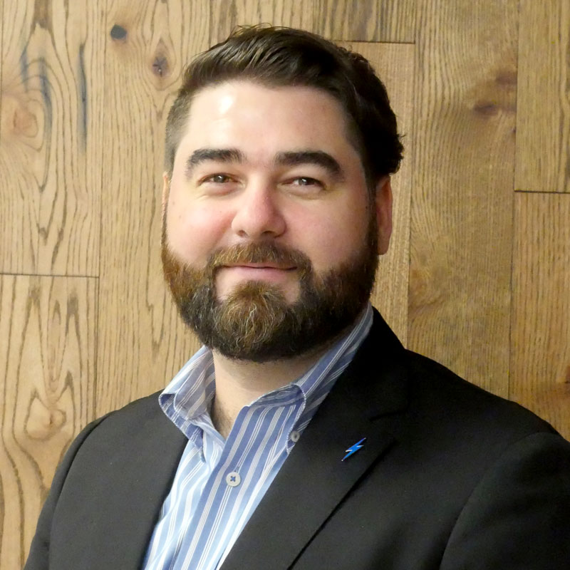
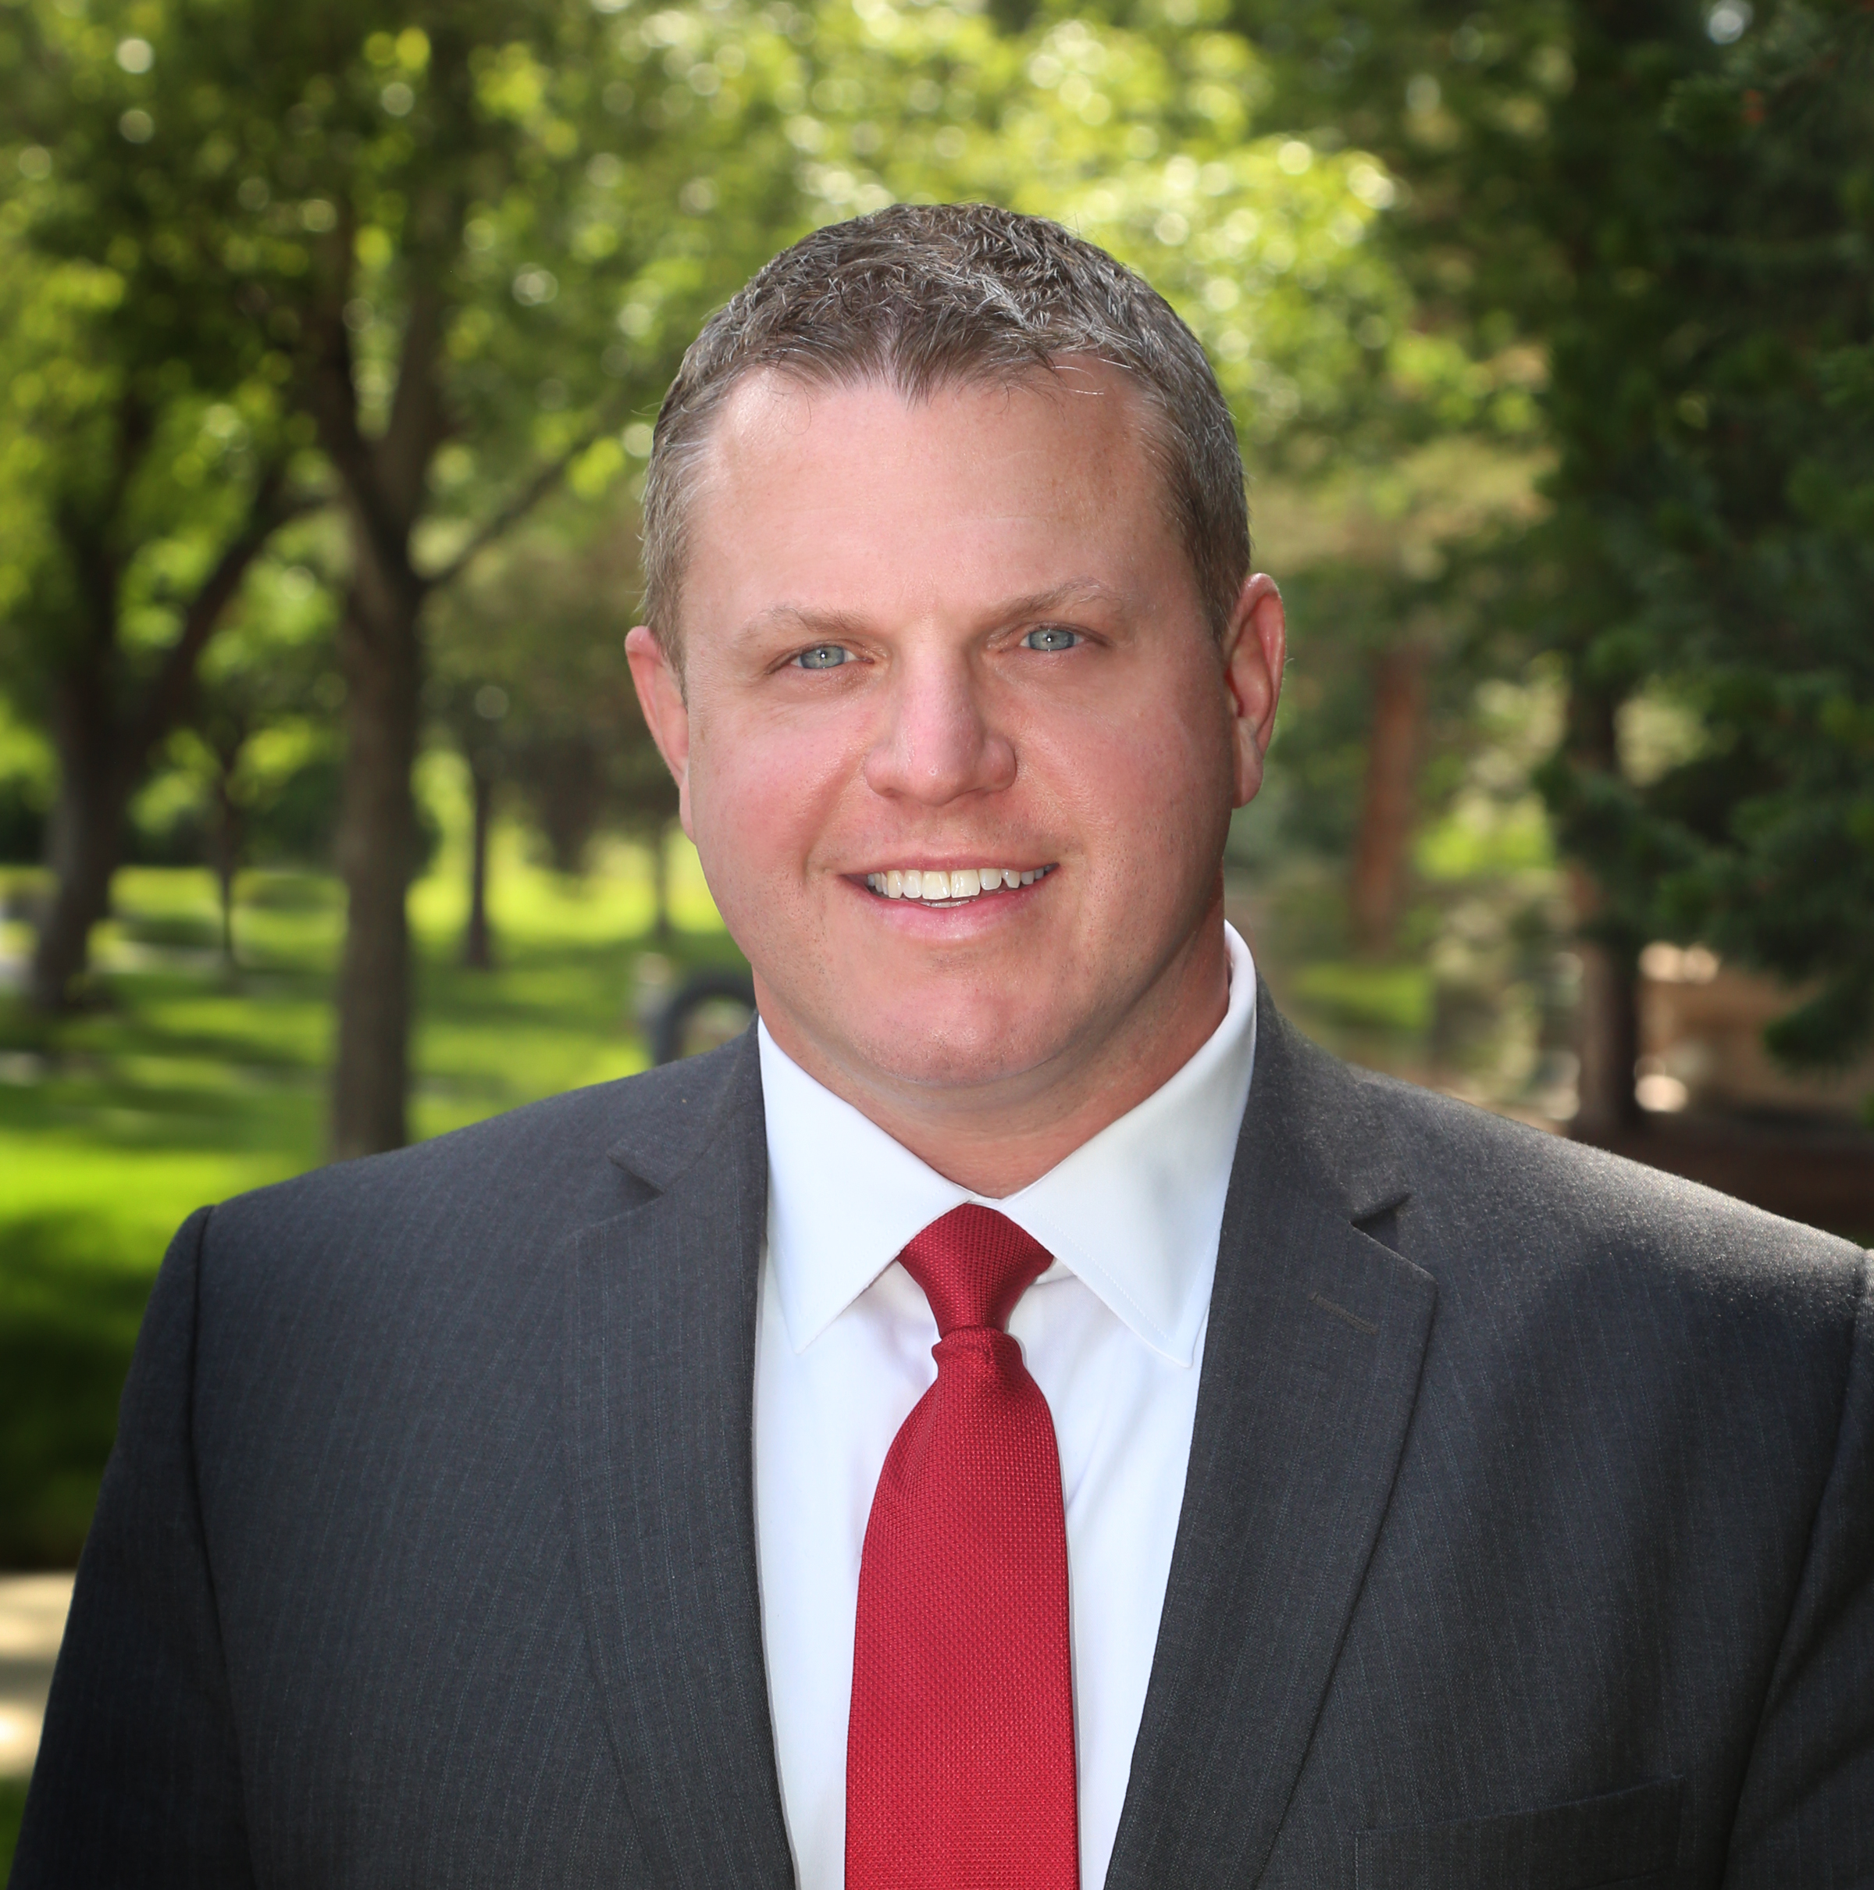
BREAKOUT SESSION:
Using Social Media to Influence Your Legislators
Diego Rivera
Business Analyst
Phone2Action
Jason Glass
Superintendent
Jeffco Public Schools

Slide 2
The History Colorado Center Wifi Network: eventswifi Wifi Password: none, open network
WIFI INFORMATION
The ART, a hotel
Wifi Network: Art_Hotel_Conference Wifi Password: Butterfield

Slide 14
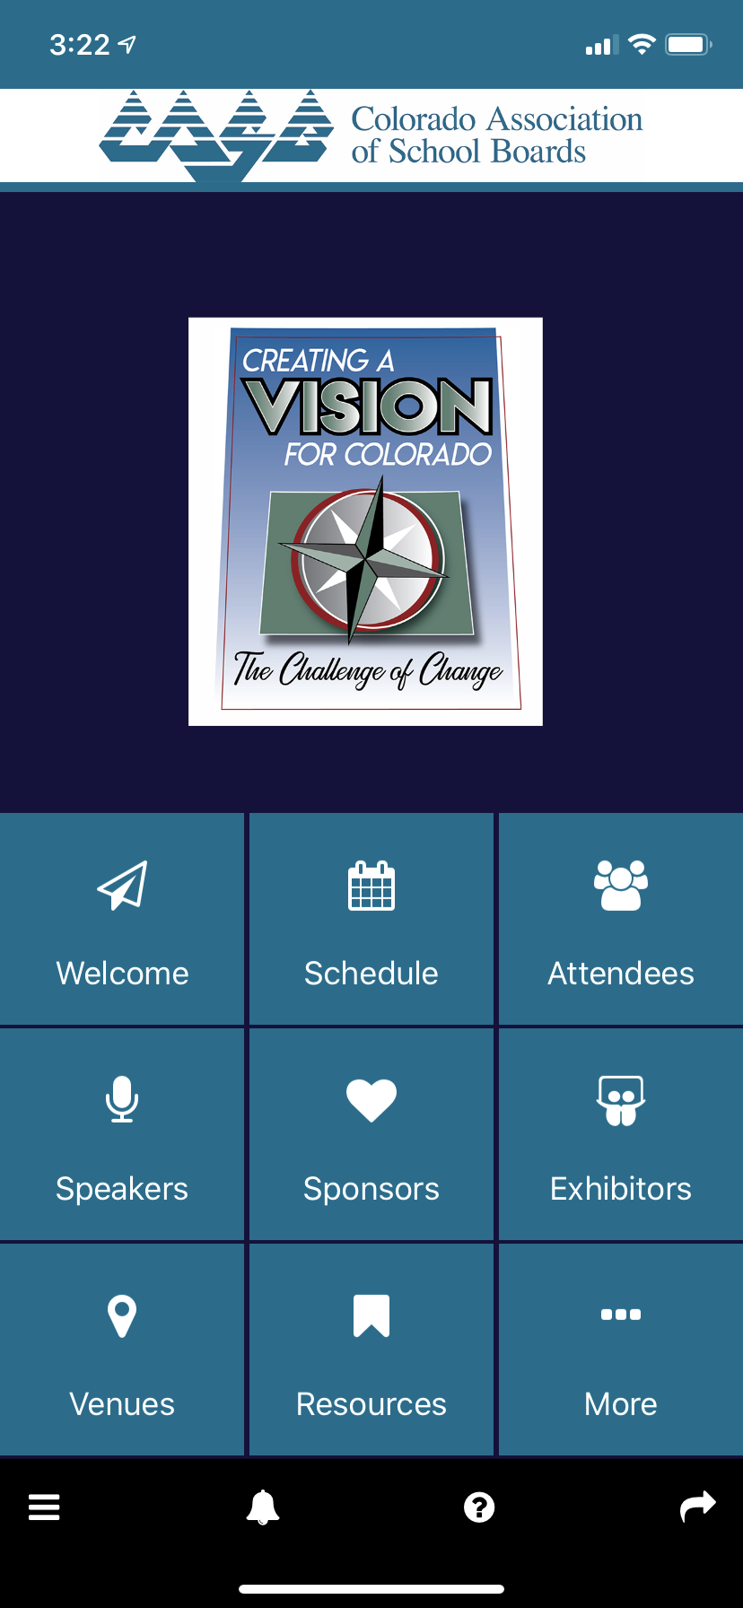
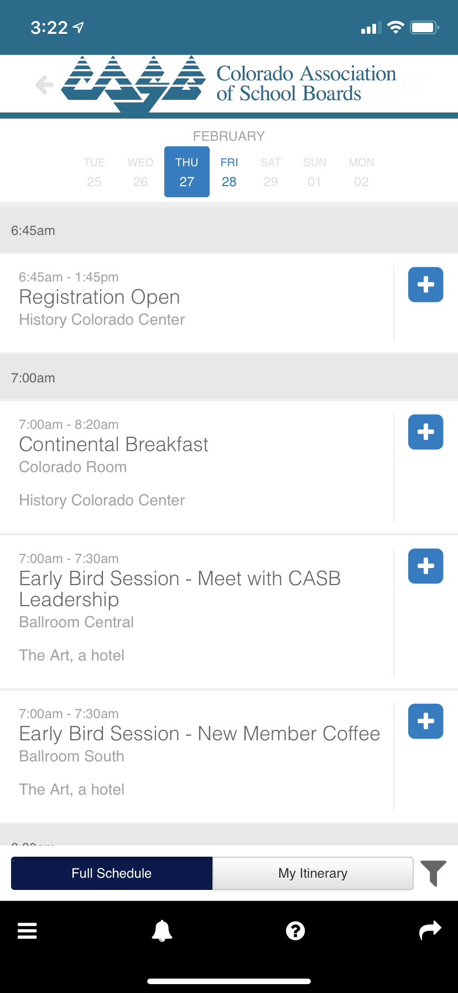
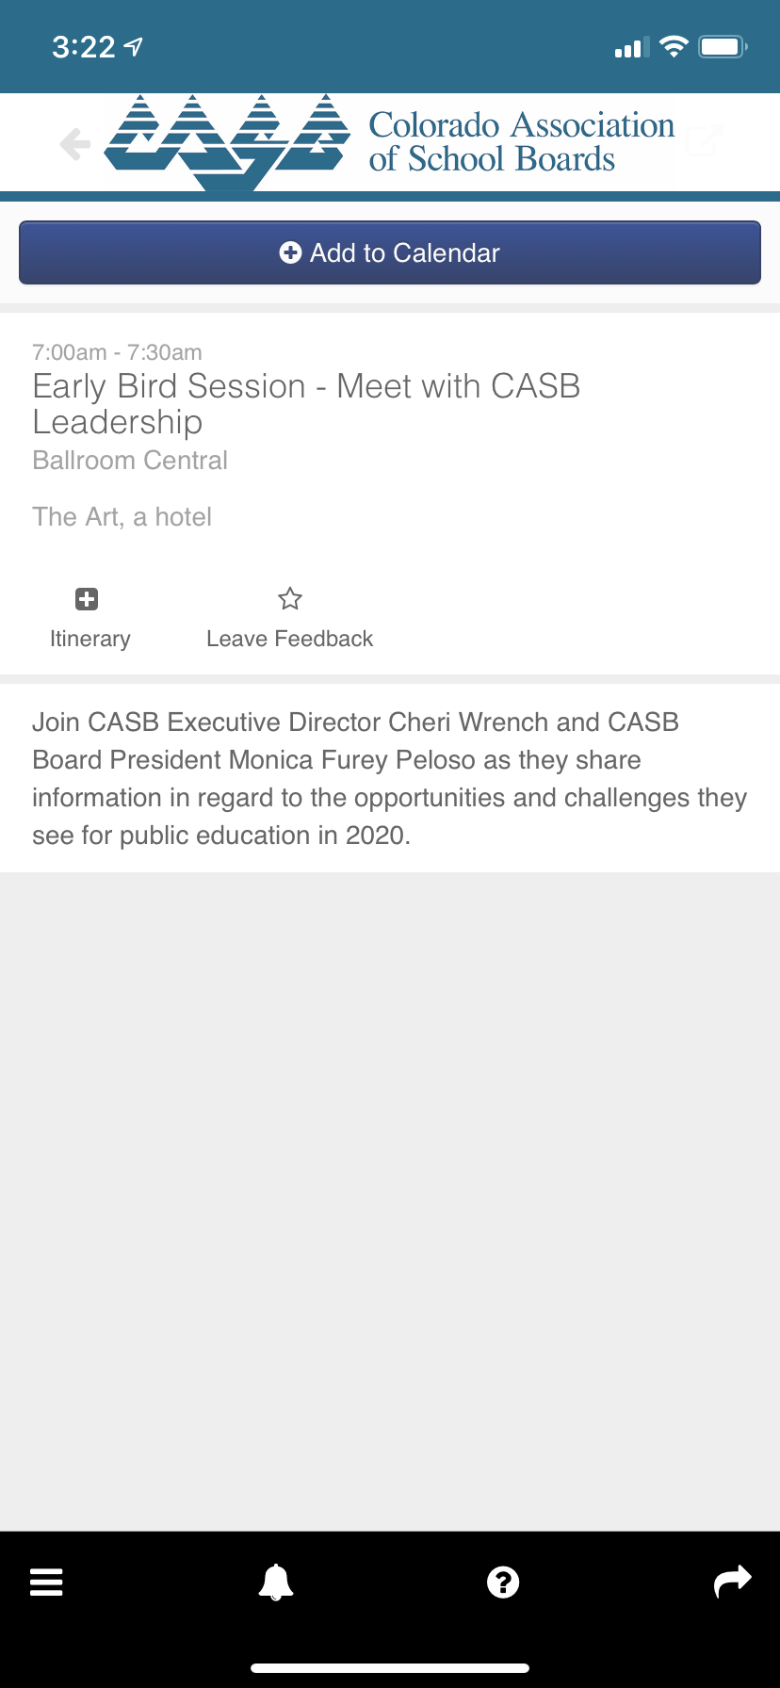
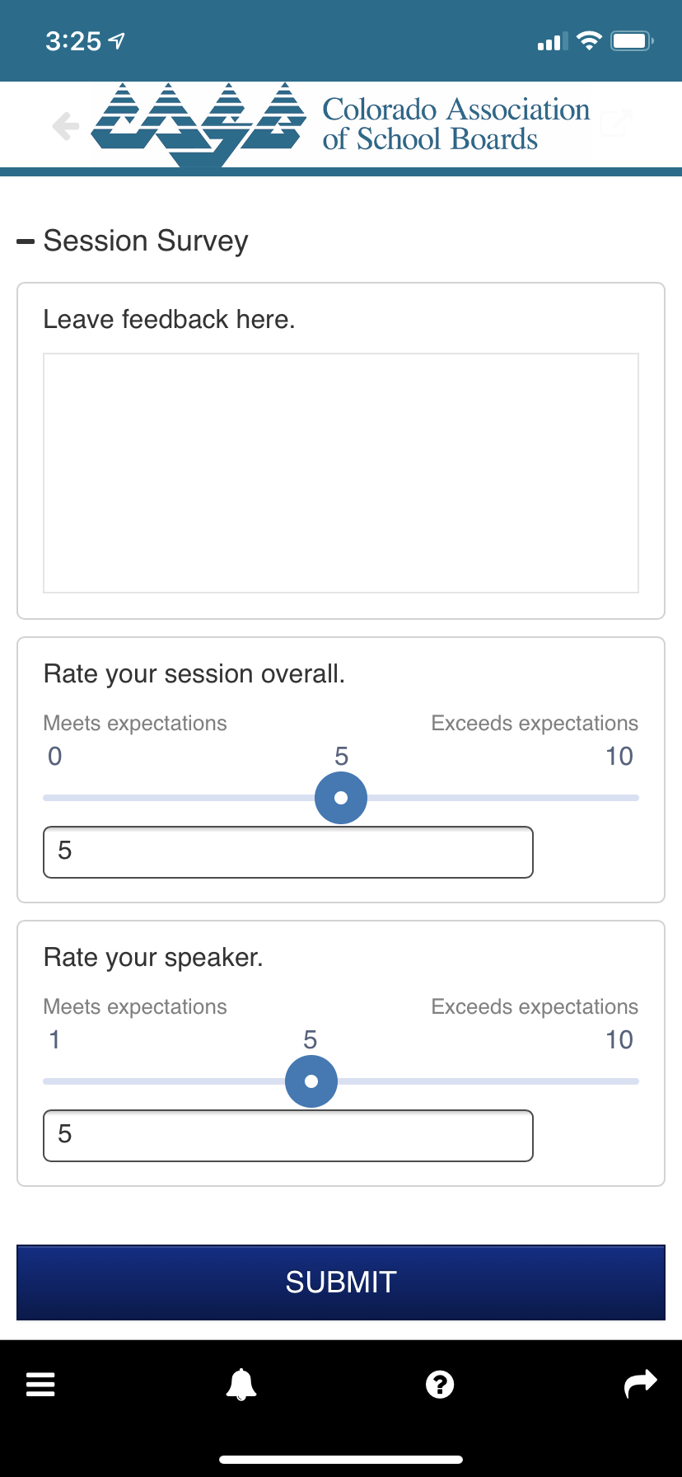
MOBILE APP SESSIONS SURVEYS
STEP 1: On the home screen click on Schedule
STEP 2: Click on the session you
are attending
STEP 3: Click on the Leave Feedback star
STEP 4: Rate your session & leave feedback, click Submit

Slide 15
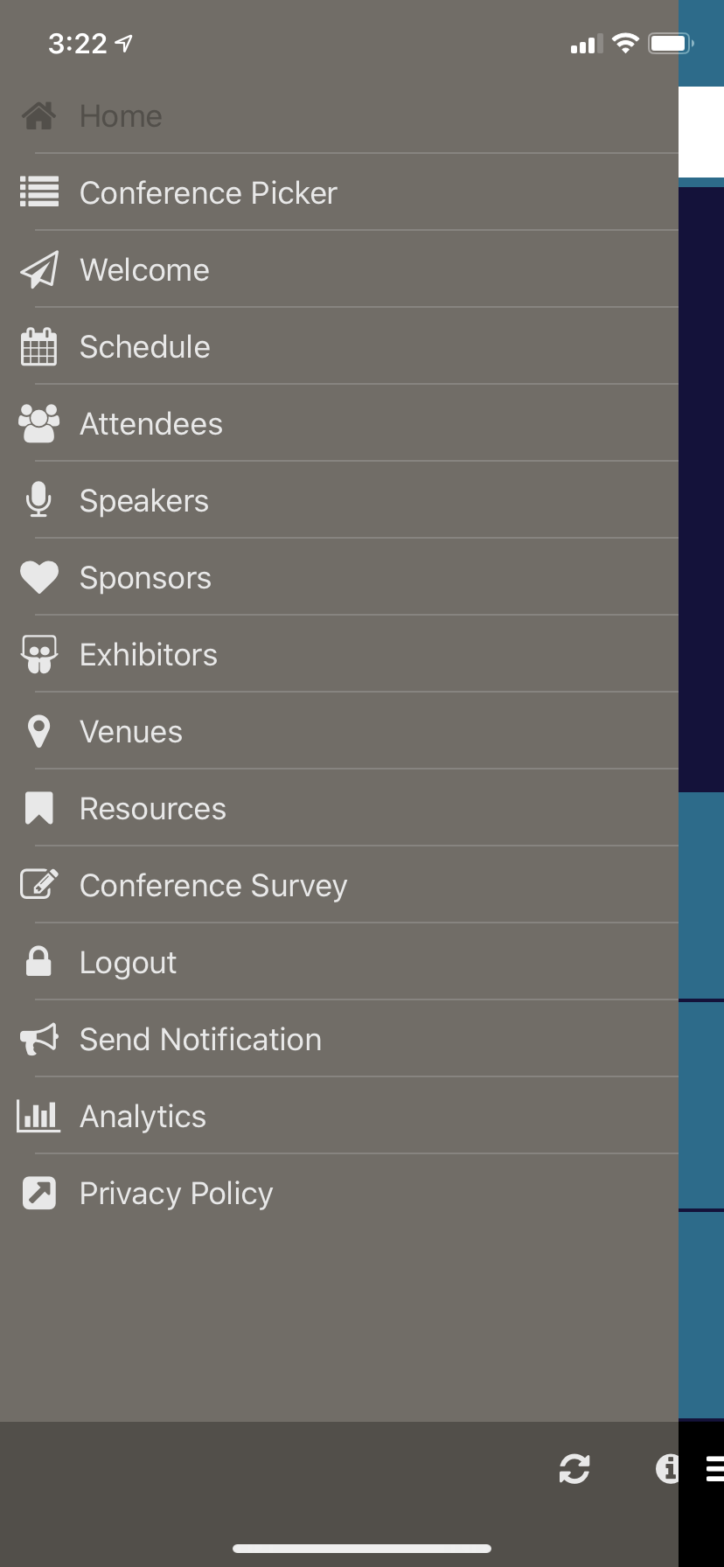
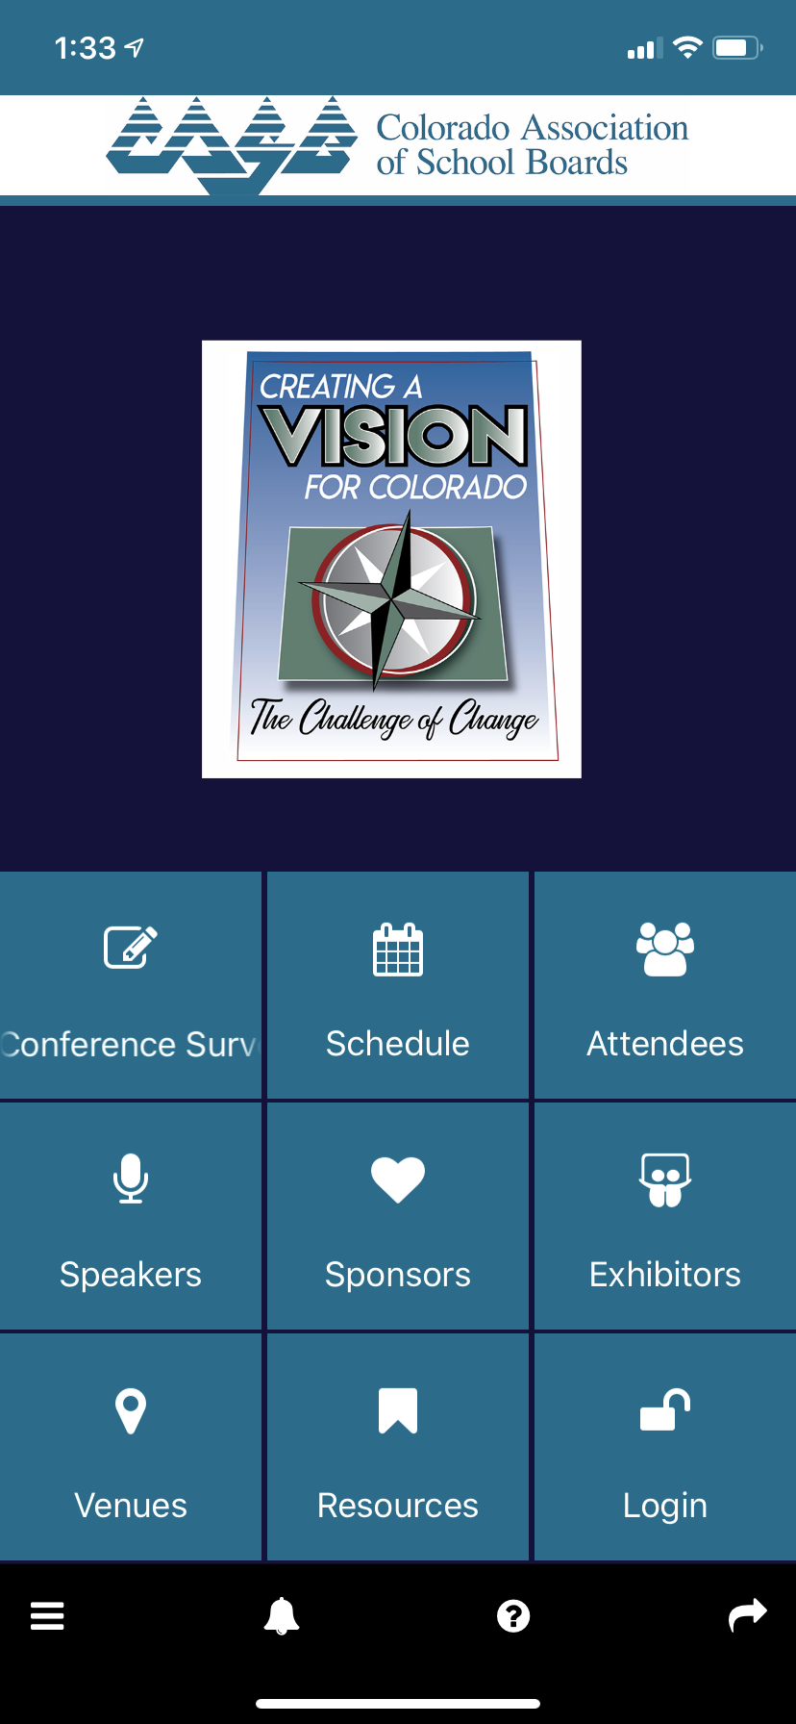
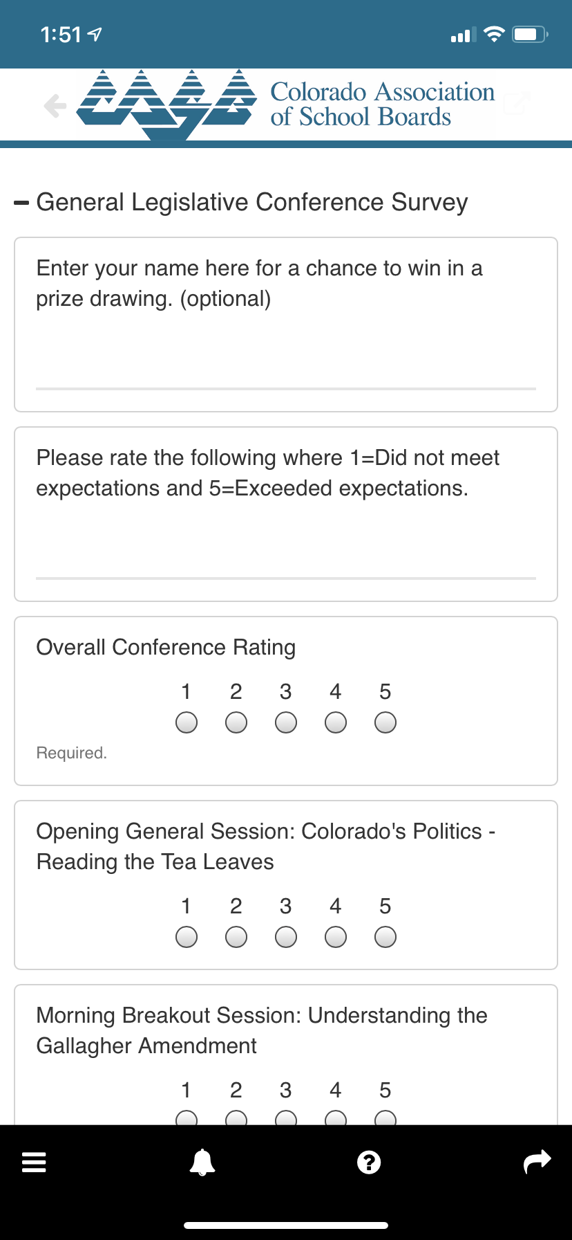
MOBILE APP GENERAL CONFERENCE SURVEY
STEP 1: From the menu, make sure you are logged into the app
STEP 2: On the home screen click the Conference Survey tile
STEP 1: Rate the conference, click Submit

