Slide 1
Sustaining Superintendent Leadership:
Lessons from the Field
Colorado Superintendent Panel
CASB Convention | December 2023
Notes:
RH opens

Slide 2
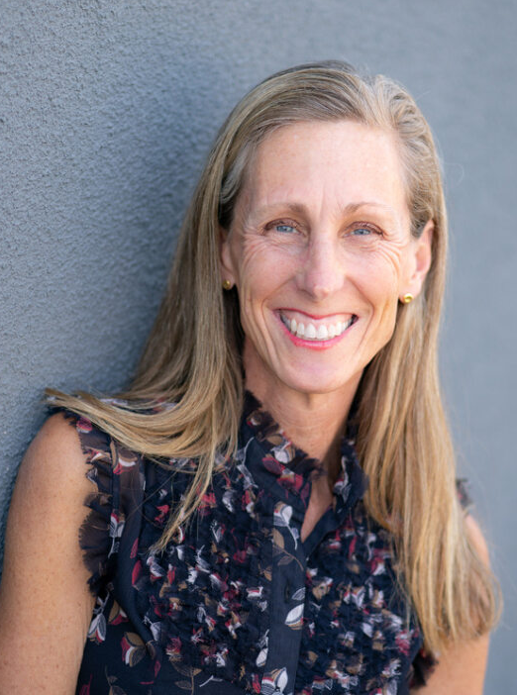
CEI Team
Rebecca Holmes
President and Chief Executive Officer
Karen Quanbeck
Vice President,
Statewide Partnerships
Notes:
RH, 7-8 minutes
Introductions, brief! Have each person introduce themselves.
Who is CEI?
Why are we in this “space”? Where did the worry about superintendent sustainability come from? What led to the summit?
This is what keeps me up at night
CEI believes that leadership is the most important factor when it comes to sustaining the best, most equitable, exceptional learning. CEI has a strong commitment to leadership.
It was a worry pre-pandemic, during the pandemic, and continues to be so post-pandemic.
We pulled together 22 superintendents whom we really respect to think together about this topic.
Although the superintendent isn’t the only leader, we know he/she is the most important/impactful leader in the system
We talked about sustaining strategies & jeopardizing factors through the frame of self, site, sector.

Slide 3
Superintendent Sustainability
Self: what superintendents can do for themselves
Site: what local school boards can do - local contexts that matter most
Sector: what state leaders can do - state level factors that matter most
.
Notes:
3 minutes
Q - I was one of those 22, now CEI, but at the time. I thought really helpful , self site actor

Slide 4
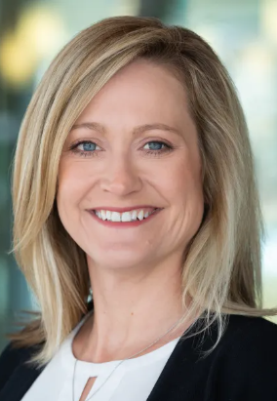
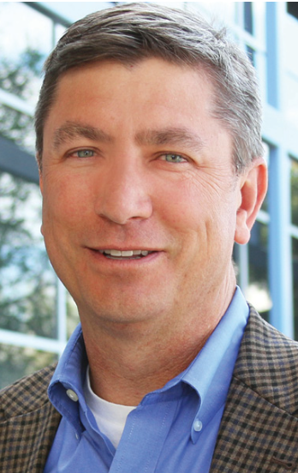
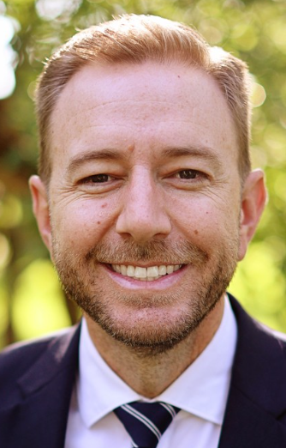
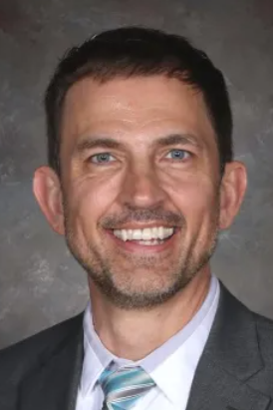
Superintendent Panel
Tracy Dorland
Superintendent
Jeffco Public Schools
Chris Gdowski
Superintendent
Adams 12 Five Star Schools
Brian Hill
Superintendent
Mesa County Schools D51
Greg Rabenhorst
Superintendent
Weld RE-3J Schools
Notes:
35 minutes: panel
today you are going to hear from our most respected leaders…each will take one of the framing concepts, self site sector…
7-8 minutes each
Self (Chris): you’ve been a superintendent in a large school district for over a decade, what are the things that you do to help yourself sustain? What do you avoid? What are jeopardizing factors and how do you plan for them or mitigate them?
Site (Brian): we recognize that you have navigated a great investment in your community, Asst Super and Super, you do things that help you stay plugged in, etc. What do you do for yourself, and what does your community do for you? What are some of the local factors that are jeopardizing factors? (board goals, prioritizing relationships between board and superintendent–speak to board transitions)
Sector (Tracy): you are running a very complex local system, everything that happens in the sector happens in Jeffco. If we had a panel right after the summit, what would you have said/advocated for/cautioned about? Same things as now? (state demographer playing any role? State coherence as important?)
Application to a smaller system (Greg): you are superintendent of the year; in your success, what makes a difference? Of what are you incredibly proud? What is different (or the same) in a smaller system in terms of what you heard from the other panelists? (if time) You’ve been a super for 11 years; jeopardizing factors and sustaining strategies?
Ask Greg today if it makes the most sense to have him speak on each, self, site, sector, after EACH superintendent, OR instead speak on all of it at once after all three..PREFERENCE is to share after EACH superintendent–add nuance to each: self, site, sector

Slide 5
SELF Sustaining Strategies and Jeopardizing Factors
Find the joy and seek the good
Identify and amplify the "good news" in public education:
Share the load
Build a network of fellow superintendents
Reject the idea of balance – but seek harmony
Lean into humor
Think from “we”
Don’t try to eat the elephant in one bite
.
Notes:
30 seconds

Slide 6
SITE Sustaining Strategies and Jeopardizing Factors
Stay hyper-local and community-focused
Set and focus on clear board goals and operating Practices
Prioritize relationship between the board president and superintendent
Create conditions for stable and sustainable governance
.
Notes:
30 seconds

Slide 7
SECTOR Sustaining Strategies and Jeopardizing Factors
Value the Voice of ALL Superintendents
Connect legislators and district leaders when considering new policy
Build coherence around a co-created statewide vision for education
Jeopardizing factor - State abdicates responsibility when it’s hard (too much local control)
.
Notes:
30 seconds

Slide 8
Questions from the audience
.

Slide 9
Thank you!
CASB feedback survey
.
Notes:
handouts

Slide 10
CEI’s Leadership and Governance Work
.
Notes:
Put details in the notes on CEI L & G offerings:
Strategic planning & implementation support
RSA
DNC
Executive Coaching
Governance Team Workshops
School Board Planning & New Superintendent Transition Support

Slide 11
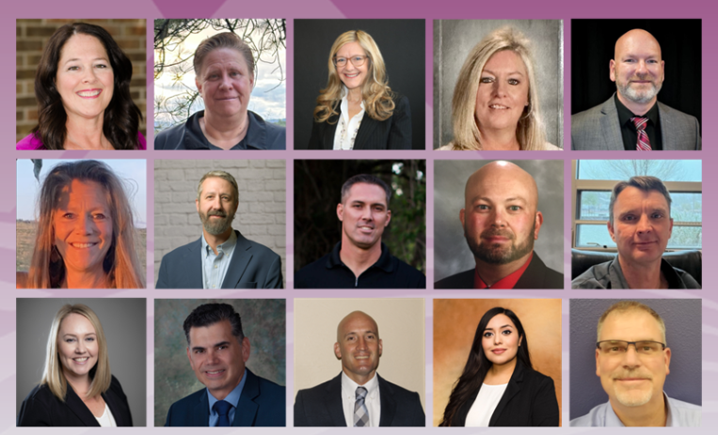
CEI’s Leadership and Governance Work: RSA
The Rural Superintendent Academy Supports new and experienced superintendents and district and school leaders to develop and advance rural system leadership capacity.
Made possible with support from Boettcher Foundation
.
Notes:
45-55: CEI’s Rural Superintendent Academy Supports new/experienced superintendents and district and school leaders to develop and advance rural system leadership capacity
how to create conditions for excellence in district governance, community leadership, and district operational capacity.
how to build adaptive and responsive relationships among students and families, communities, school boards, and staff as they collectively work toward the goal of long-term success and sustainability for their districts and communities.
Made possible with support from Boettcher Foundation

Slide 12
Leadership & Governance: Building District Governance Teams
Governance Team Workshops (superintendents and school board members)
CEI began providing select partner districts with customized support to build strong governance teams during times of transition in 2022. Workshops help elected boards develop and commit to working norms, coalesce around concrete goals and expectations for their district leader, and set board goals and operational standards for the coming school year.
School District Board Planning and New Superintendent Transition Support (school boards)
CEI supports districts and school boards to strengthen governance systems and structures that enable staff and community members to work together in an atmosphere of care and respect and ensure each student has access to an array of educational programs designed to foster his/her unique academic, vocational, and personal strengths. We create a customized scope of services that addresses local needs through support across four core focus areas:
Board retreats and monthly work sessions;
Board professional learning and networking opportunities with other highly effective boards across Colorado;
Board member strategic planning and executive coaching focused on emerging issues; and
Executive coaching as part of new superintendent onboarding, including orientation to the Colorado context.
.

