Slide 1
School Finance Changes are Coming CASB Conference
Colorado School Finance Project
December 2023

Slide 2
Who is CSFP?
Non-profit, non-partisan
Supported by school district contributions
School finance analysis for local and state policy makers since 1995
Governed by a board comprised of national and state experts on school finance
Our Mission: To compile, collect and distribute research-based, non-partisan information and data on topics related to school finance for state and local policymakers. CSFP also supports school districts by providing expertise, technical assistance and capacity building related to best practices in school finance.
December 2023

Slide 3
Current Topics
Special Session and impact on K12
School Finance Task Force and Adequacy Studies
Changes to At-Risk Measure
Universal Preschool
ESSER Funding

Slide 4
Special Legislative Session

Slide 5
Special Session
On Nov.9th Governor Polis called a special legislative session for property tax.
Members of the legislature met from Friday, November 17th to Monday, November 20th.
7 bills were passed
HB23B-1001
HB23B-1002
HB23B-1003
HB23B-1008
SB23B-101
SB23B-102
SB23B-103
December 2023

Slide 6
Special Session (cont’d)
SB23b-101
Lowers property tax rate for residential properties to 6.7%
Non-Residential at 27.9%
Expands value deductions to $55,000 on residential properties
This is a 1-year fix – a task force will be formed to make recommendations for a permanent fix.
School districts must certify mills by January 10th, 2024.
December 2023

Slide 7
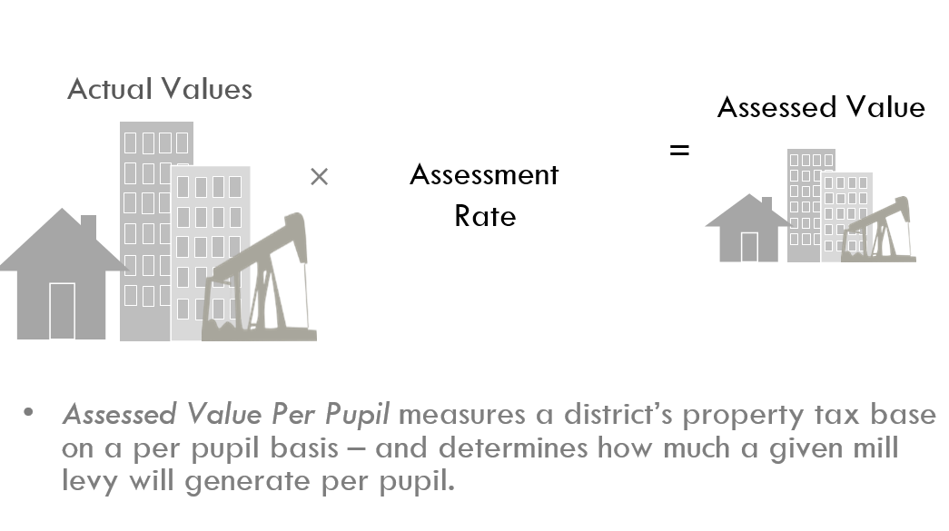
$300,000
Residential Assessment Rate (RAR)
$20,100
6.7%
27.9%
Non-Residential Assessment Rate
$83,700
$300,000
Understanding mills
$20,100
27
$542.70
$2,259.90
$83,700
27
December 2023

Slide 8
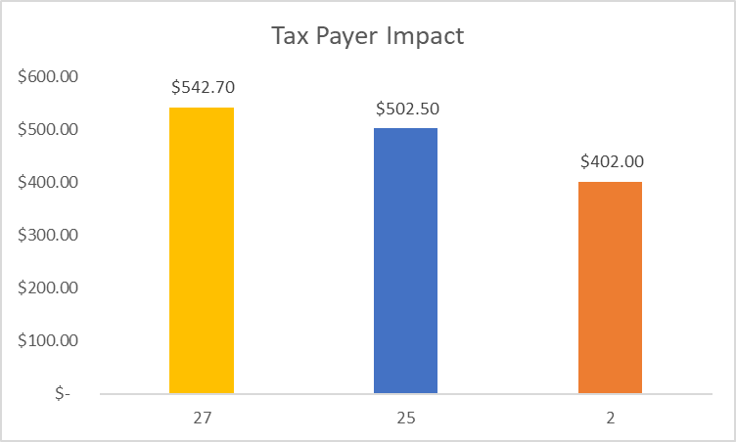
How are mills calculated?
Actual Value of Home= $300,000
Residential Assessment Rate (RAR)
= 6.7%
Home value x RAR =
Total Assessed Value= $20,100
Total Assessed value x mill levy = taxes paid (mill levies vary by district)
December 2023
Notes:
Glenn

Slide 9
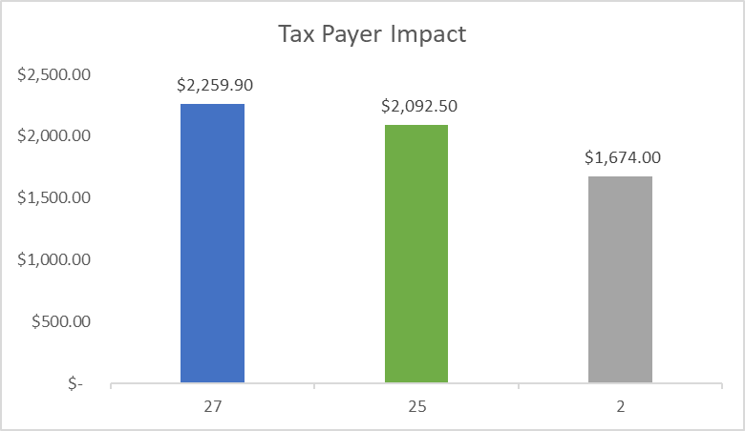
How are mills calculated?
Actual Value of Non-residential= $300,000
Non-residential Assessment Rate
(RAR)= 27.9%
Non-residential x RAR =
Total Assessed Value= $83,700
Total Assessed value x mill levy = taxes paid (mill levies vary by district)
December 2023
Notes:
Glenn

Slide 10
Letter from the Governor
What does it mean to lower your mill?
What’s the difference than lowering your assessment rate?
What are the implications from lowering your mill that districts must consider?
Contractual agreements – teachers, technology, transportation, food service, janitorial services, etc.
Bonds and COPs
December 2023

Slide 11
Letter from the Governor (cont’d)
Any reduction in a school district’s mill levies that are certified now will result in a reduction in the district’s revenue for the 2023-2024 school year (current school year budget).
School districts may not receive their certification until January 3 and must certify their mills by January 10th
Please consult your legal counsel before making any decisions.
December 2023

Slide 12
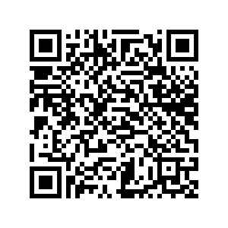
How do I learn more about potential impacts of lowering mills
Presentation on Mill Levies and Current Issues
Scan here for CSFP’s FAQ on Governor’s Request
December 2023

Slide 13
Question – State and Local Share
Do you know your state/local share?
Are you from a district that is totally locally funded?
December 2023

Slide 14
School Finance Task Force

Slide 15
School Finance Task Force
Created by SB23-287
17 members comprised of stakeholder groups, including Superintendents, CFOs, and school finance experts
Only 1 more meeting left - work completed by Jan. 2024
Costing out work – completed by Jan. 2025
December 2023

Slide 16
School Finance Task Force (cont’d)
The Task Force is charged with two tasks:
Recommending changes to factors in the school finance formula to be enacted for the 2024-25 budget year.
They developed the parameters for a study, commonly called an adequacy or costing out study. RFI to be out for bidders. Work to be completed January 2025.
December 2023
Notes:
TRACIE

Slide 17
Task Force – School Finance Formula
The Task Force is charged with recommending adjustments to the following factors for the School Finance Formula:
Eliminating the use of multiplicative indexes for cost of living, personnel and non-personnel cost and district size.
Recalibrating, capping, or alternative methods to account the cost-of-living factor.
Factors designed to serve students with additional needs such as at-risk, English learner and special education.
December 2023

Slide 18
Task Force – School Finance Formula (cont’d)
Including other considerations other than or in addition to student enrollment and remoteness of school district for the size factor
Securing equalization in mill levy overrides for institute charter schools based on school location, location of students, multi-district online programs and total program funding
December 2023

Slide 19
Current Conversations of the Task Force
At-Risk – new student count – new weight
Cost of Living – cost of doing business or wage index
Special Ed – new weight
ELL – new weight – how many years of funding
Size – sparsity – remoteness – increase amount
CSI Mill Levy Match
Etc. - order of operations of the formula
December 2023

Slide 20
Recap of Meeting #7
Recommendation for adequacy studies to be funded through an additional supplemental bill so that work can be done based upon actual costs of this analysis.
Recommendation for CSI Mill Levy Match to be implemented.
Recommendation for the legislature to readdress mill levy match for all school districts.

Slide 21
Recap of Meeting #7 (cont’d)
Base amount of funding needs to be increased.
Ongoing discussion of cost-of-living, cost of doing business, a wage index, and CWIFT.
Ongoing discussion of size, remoteness, sparsity, and size adjustments within student characteristics.
Trying to find a balance of what might be phased in regarding changes to the school finance formula.

Slide 22
Ongoing Discussions
No districts should be getting less money than they currently are.
Accommodations around economies of scale, size – are challenging.
Still waiting on at-risk data
Next meeting – modeling to be moved forward for final report in January
(Next meeting December 12th)

Slide 23
Adequacy Studies
What are Adequacy/Costing Our Studies?
What did the task force determine to be the 3 of 4 methods?
Professional Judgment
Evidence Based
Statistical/Educational Cost Function
December 2023

Slide 24
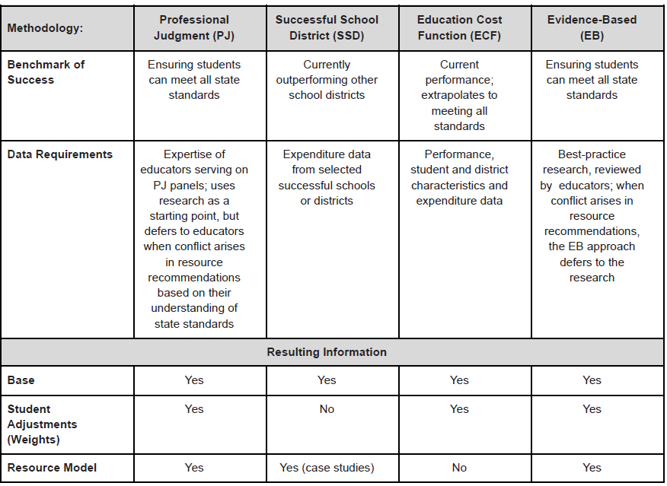

Slide 25
Question – Are you aware of this task force?
If you want to have updates on this process, please give me your name and email before you leave today.
December 2023

Slide 26
Changes to At-Risk Measure

Slide 27
New At-Risk Measure Basic Principles
Replaces FRL count with ISP...
...and adds address-based weight
Identified Student Percentage (ISP)
Directly certified students (SNAP, TANF, migrant)
Students categorically eligible for free meals (homeless, foster, Head Start, etc.)
Now includes Medicaid and CHP+
Neighborhood Socio Economic (SES) Index
Census-based neighborhood indicators
Every student assigned a census block based on their physical address
Many indicators to choose from
+
December 2023

Slide 28
At-Risk Factor
CDE is planning to model actual data this fall
Pilot: November/early December to obtain actual student level census block information from volunteer districts.
To participate, email Amy Carman, carman_a@cde.state.co.us
Hold Harmless: You will receive the greater of your FY23 or FY24 at-risk funding amount this year
No documentation will be required from districts
December 2023

Slide 29
Question - Enrollment
Do you know your current at-risk enrollment?
Have your at-risk enrollment numbers increased?
Have your at-risk enrollment numbers decreased?
December 2023

Slide 30
Universal Preschool

Slide 31
CSFP UPK Survey Results
Purpose was to collect independent data about the rollout of Universal Preschool in districts
CSFP received responses from 78 school districts. Of these:
16 were non-rural
15 were rural
47 were small rural
The majority districts are offering multiple program hours options to families, i.e. 15-hour and 30-hour per week options.
55% of districts report that their preschool program is not full.
December 2023

Slide 32
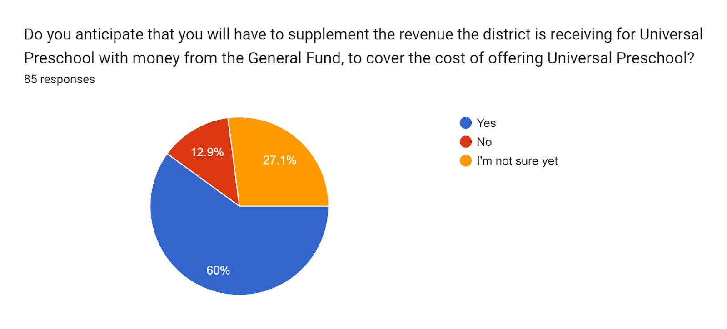
CSFP UPK Survey Results
The total anticipated General Fund investment for the 39 districts who responded is $33,112,052 to support the costs of implementing Universal Preschool this year.
December 2023

Slide 33
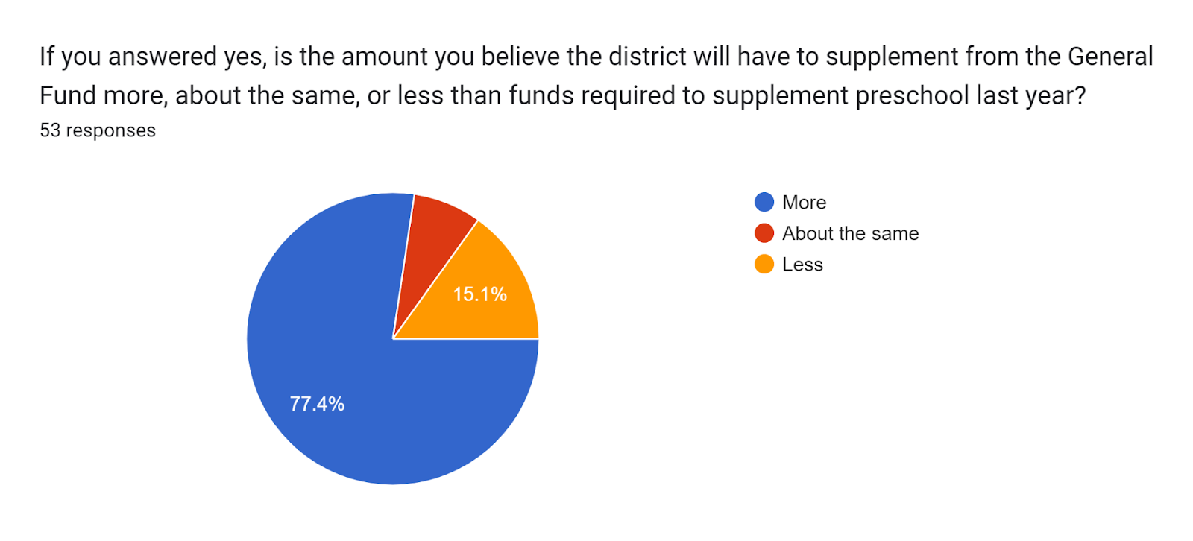
CSFP UPK Survey Results
December 2023

Slide 34
CSFP UPK Survey Results: Open Ended Responses
Despite challenges, the vision for UPK is important for Colorado children and families
Rollout was challenging
Responsiveness to questions and concerns has been lacking
Funding levels are lower
Enrollment process is cumbersome
Changing rules and guidelines has been challenging
December 2023

Slide 35
Question - UPK
What would you like to know more about with UPK?
December 2023

Slide 36
ESSER

Slide 37
ESSER coming to an end
All ESSER Funds need to be used by September 2024.
Monitoring by CDE.
How were your ESSER dollars used?
What can you share with your community and its impact?
How did these dollars make a difference?
How does this impact your budget for 2024-25?
December 2023

Slide 38
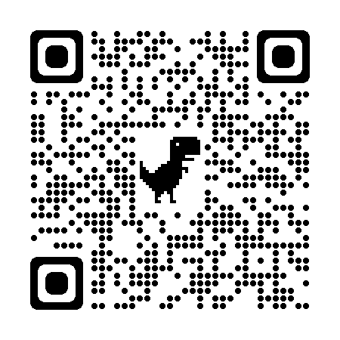
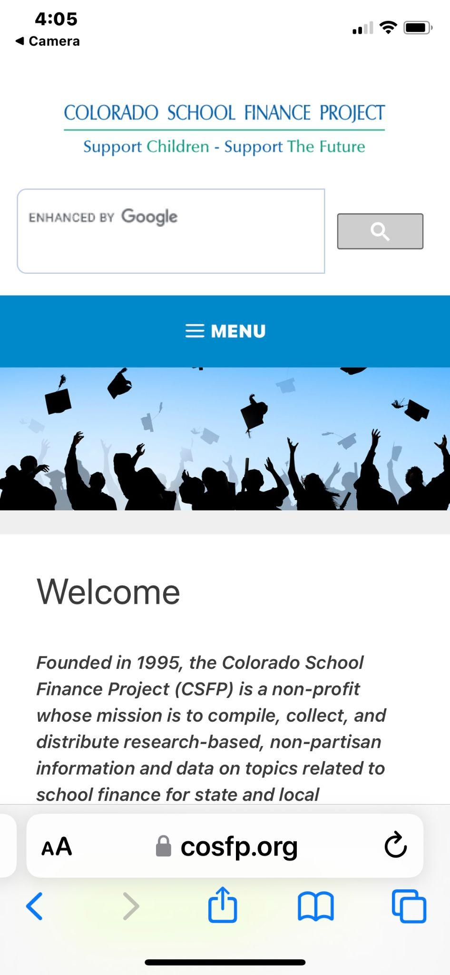
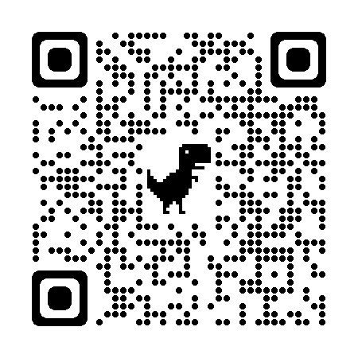
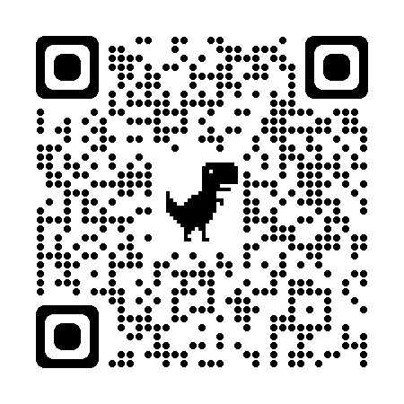
Place your screenshot here
District Key Stats
Link to documents
BOCES Key Stats
Link to documents
AU Key Stats
Link to documents

Slide 39
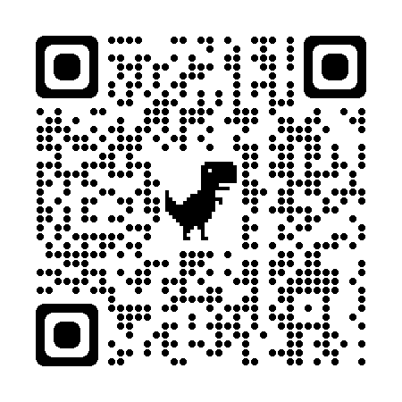
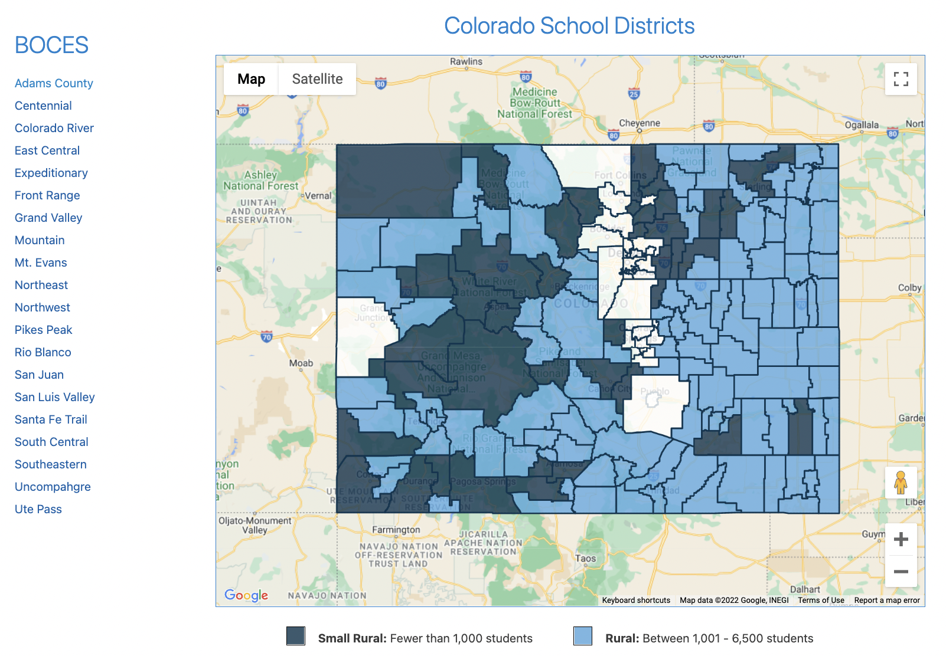
Interactive Website
Provides fact sheets for every district and BOCES
Place your screenshot here
Link to documents
December 2023

Slide 40
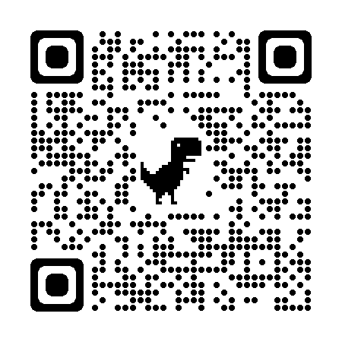
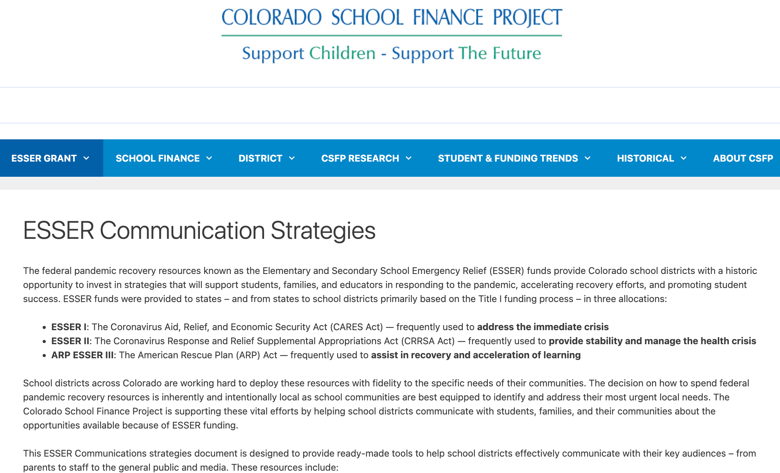
Communication Tools
For every investment area
Place your screenshot here
Link to documents
December 2023

Slide 41
Upcoming Changes in Spring of 2024

Slide 42
What to Watch For
December Economic Forecast
October count
Preschool a separate count
Inflation
Certifying mills
Recommendations from the School Finance Task Force on the school finance formula
Legislative Season starts in January
Supplemental Process
December 2023

Slide 43
Questions?
Tracie Rainey t.rainey@cosfp.org 303-860-9136
Stay connected
https://cosfp.org/
@COSFP
Colorado School Finance Project -Facebook

