Slide 1
School Finance 101 CASB Conference
Colorado School Finance Project
December 2023

Slide 2
Who is CSFP?
Non-profit, non-partisan
Supported by school district contributions
School finance analysis for local and state policy makers since 1995
Governed by a board comprised of national and state experts on school finance
Our Mission: To compile, collect and distribute research-based, non-partisan information and data on topics related to school finance for state and local policymakers. CSFP also supports school districts by providing expertise, technical assistance and capacity building related to best practices in school finance.
December 2023

Slide 3
Goals of Presentation
School Board governance in Colorado- responsibilities
Budgets and timelines
Revenue Sources
School Finance
Statewide issues – that impact your district
December 2023

Slide 4
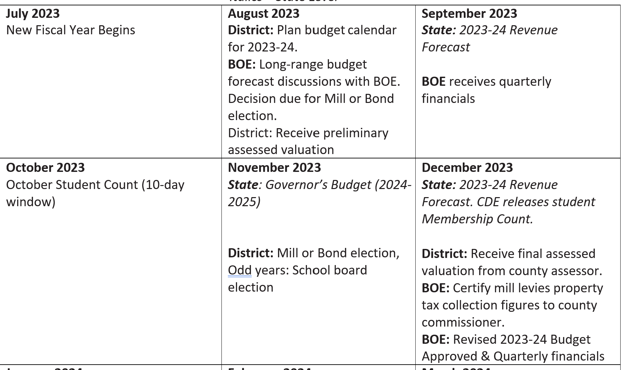
Timeline
December 2023

Slide 5
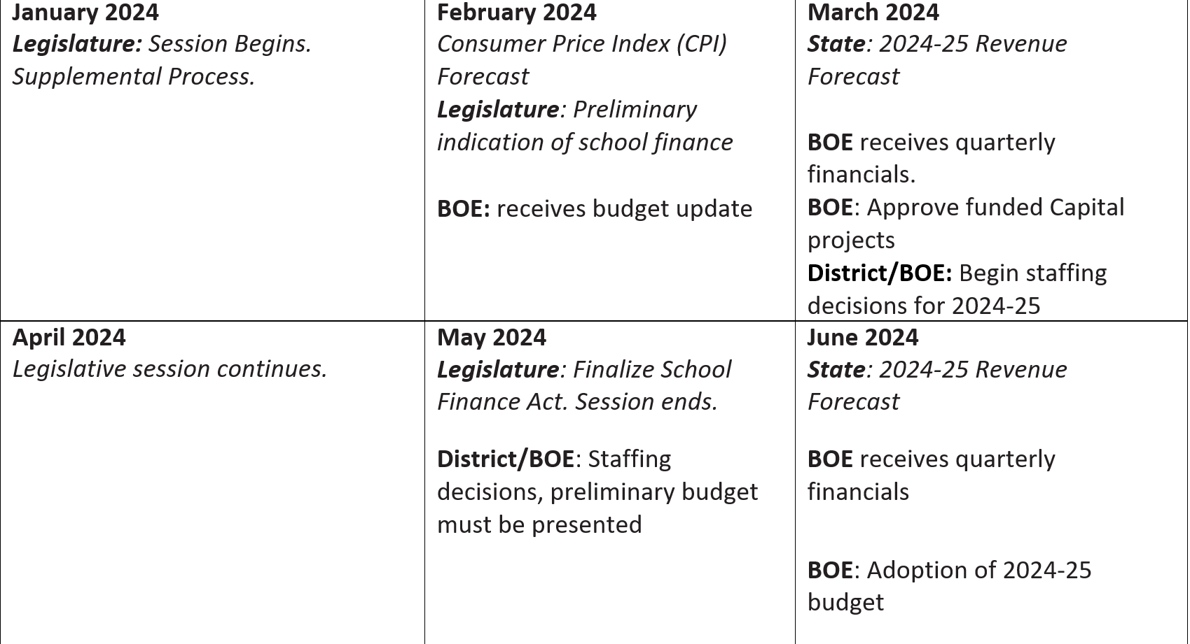
Timeline
December 2023

Slide 6
First 90 days: Timelines and Governance
October student count
Assessed value received from county by January 3rd, 2024
Certifying mills by January 10th, 2024
Mill Levy correction reflected in certification (special session may alter dates and timeline for this year)
This is a one year change to timelines
December 2023

Slide 7
First 90 Days Cont’d
December revenue forecast and October Student Count - inflation
Supplemental process in legislature – your revenue you are currently getting will be adjusted based on enrollment, at-risk and local share
Budget process begin for 2024-25 year at school district and state
December 2023

Slide 8
School Boards in Colorado
Colorado’s state constitution contains an education clause. This defines the following as responsibilities for local school districts:
Budgets/Audits
Hiring and salary at district level
Configuration of your education system
Curriculum / Graduation requirements
Board has taxing authority
Board hires superintendent and auditor
Thorough and uniform system
December 2023

Slide 9
School Boards Fiduciary Responsibility
Budget*
Fund Balance
Audits*
Hire auditor
Quarterly financials
Financial transparency*
Taxing authority* – mill levies for total program, bonds, overrides
* Boards are required to do
December 2023

Slide 10
Board considerations – good to discuss with Superintendent
Learn about your school district’s budget and audit process
What policies are in place?
Do you have a financial advisory committee or an audit committee?
How do you engage with your community in the budget process?
How do you engage with District Accountability Committee?
December 2023

Slide 11
Question – How long have you been a board member
Who were just elected for the first time?
Who have served two years or less?
Who have served four years or more?
December 2023

Slide 12
Who Are Colorado’s Students?

Slide 13
Colorado’s Students
883,264 students
354,966 (40.2%) students eligible for Free and Reduced Lunch
109,623 (12.41%) students receiving special education services
109,809 (12.43%) Emerging Bilingual students*
64,599 (7.3%) students identified as Gifted & Talented
*English Language Learners is a term CDE uses
December 2023

Slide 14
Colorado Landscape
178 school districts and CSI
100 districts small Rural – 1000 students or less
Smallest district is less than 50 students
Largest district is over 90,000 students
Over 250 languages reflected in the students
Student growth is slowing – many districts declining enrollment
December 2023

Slide 15
Student need has changed Requires more services-this costs more $
Students of poverty are 40.20% of population
- Approximately $.30 of every $1.00 is state funded
Students learning English are 12.43% of population
- Approximately $.20 of every $1.00 is state funded
Students with special needs are 12.41% of population
- Approximately $.30 of every $1.00 is state funded
Gifted students are 7.3% of population
- Approximately $.15 of every $1.00 is state funded
December 2023
Notes:
Tracie

Slide 16
Question - Enrollment
Show of Hands:
Is your district growing, stable or declining in enrollment?
December 2023

Slide 17
Mill Levies

Slide 18
What is a Mill Levy?
School districts have taxing authority to collect a property tax levy to fund local schools.
School districts levy (or collect) a certain number of mills (or amount), depending on a number of state and local factors, to raise these dollars.
December 2023

Slide 19
What is a Mill Levy?
Mill: One mill is equal to one tenth of one penny or one 1/1000 of a dollar.
Mills are used to calculate property taxes using a formula of mills x assessed (not total value) property value = property tax.
The assessed property value is the actual property value x the assessment rate.
Currently, the residential assessment rate in Colorado is 6.7%. The non-residential assessment rate is 27.9%.
December 2023

Slide 20
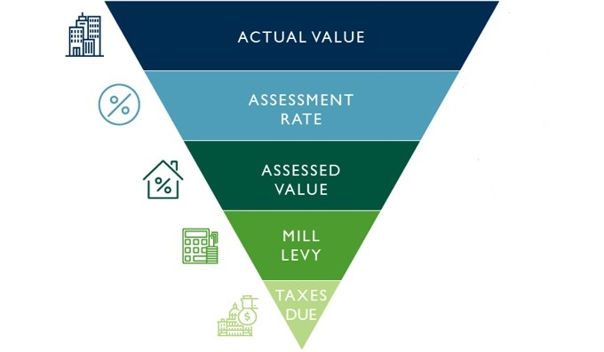
What is a mill levy?
Adapted from Faegre Drinker Biddle & Reath LLP

Slide 21
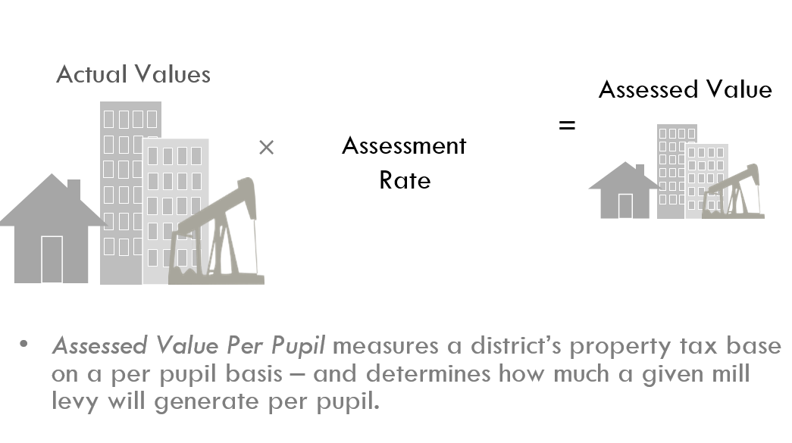
$300,000
Residential Assessment Rate (RAR)
$20,100
6.7%
27.9%
Non-Residential Assessment Rate
$83,700
$300,000
Understanding mills
$20,100
27
$542.70
$2,259.90
$83,700
27
December 2023

Slide 22
State & Local Share Varies (by design)
District A
District B
LOCAL SHARE
Local District Taxes:
Property Taxes
Ownership Tax
LOCAL SHARE
Local District Taxes:
Property Taxes
Ownership Tax
STATE SHARE
State Taxes:
General Fund
Education Fund
STATE SHARE
State Taxes:
General Fund
Education Fund
December 2023

Slide 23
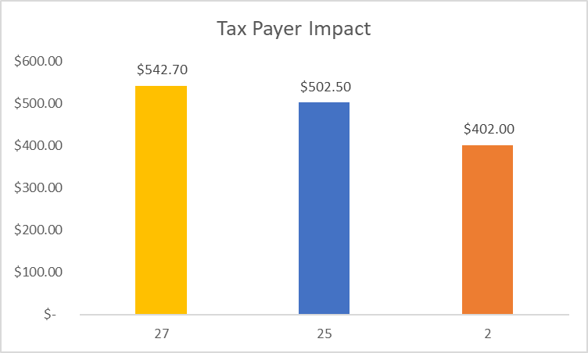
How are mills calculated?
Actual Value of Home= $300,000
Residential Assessment Rate (RAR)
= 6.7%
Home value x RAR =
Total Assessed Value= $20,100
Total Assessed value x mill levy = taxes paid (mill levies vary by district)
December 2023
Notes:
Glenn

Slide 24
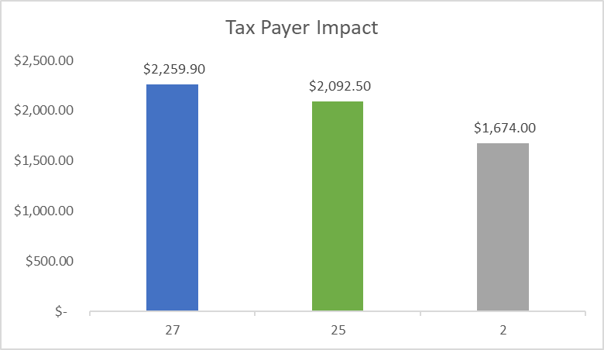
How are mills calculated?
Actual Value of Non-residential= $300,000
Non-residential Assessment Rate
(RAR)= 27.9%
Non-residential x RAR =
Total Assessed Value= $83,700
Total Assessed value x mill levy = taxes paid (mill levies vary by district)
December 2023
Notes:
Glenn

Slide 25
Types of Mill Levies for School Districts
General Fund Levy
Bond Debt Levy
Hold Harmless Levy
Mill Levy Overrides
Abatement Levy
Other Allowable Levies:
Technology
Capital Construction
Maintenance
Transportation
December 2023

Slide 26
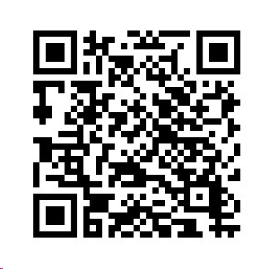
Mill Levy Certification by school boards
CDE’s Website on Mill Levy Correction
Mill Levies must be certified – by January 10th and reported to county.
Certification includes – total program, override mill levies, bond and hold harmless
Mill Levy correction
1st year of implementation
Some districts will be removing 1 tax credit
Will result in more local dollars for total program
December 2023

Slide 27
Letter from the Governor
What does it mean to lower your mill?
What’s the difference than lowering your assessment rate?
What are the implications from lowering your mill that districts must consider?
Contractual agreements – teachers, technology, transportation, food service, janitorial services, etc.
Bonds and COPs

Slide 28
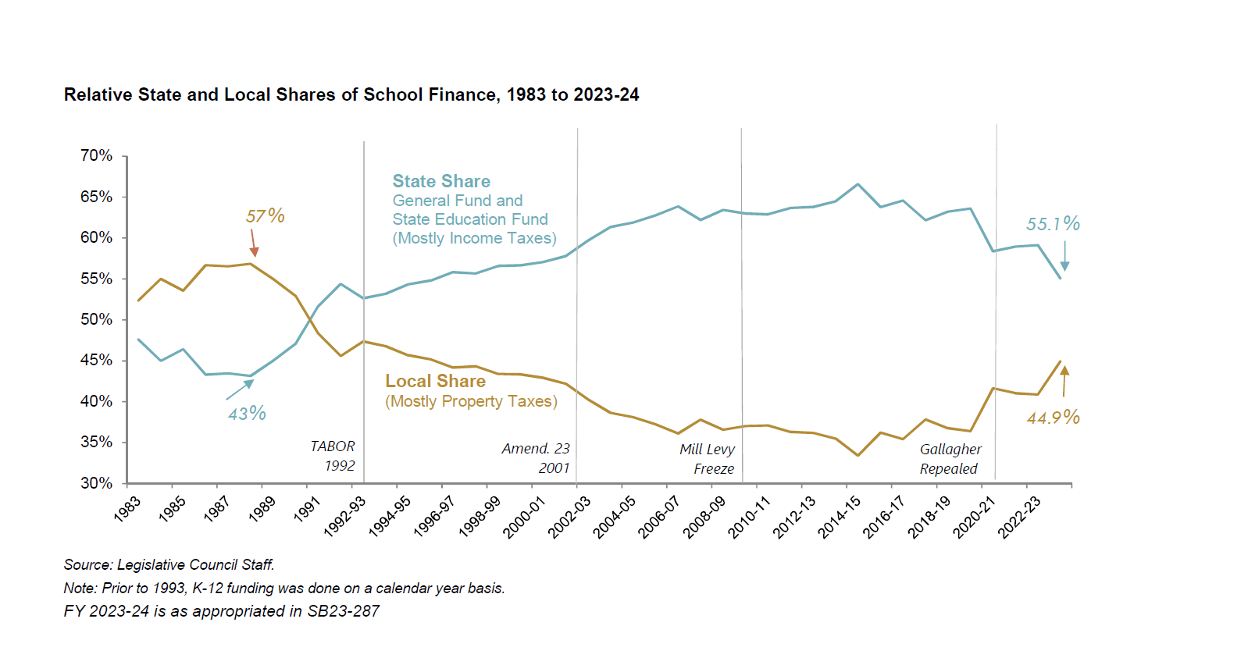
December 2023

Slide 29
Question –Do you know your state local share?
By show of hands:
Do you know your state and local share split?
December 2023

Slide 30
School Finance and Revenue Distribution

Slide 31
How is revenue distributed?
School districts receive the majority of their funding through the school finance act.
This distribution is a foundation formula-which should adjust for student and district characteristics outside of a districts control.
Colorado has never analyzed what the cost of the education system is therefore the base and adjustments aren’t reflective of actual costs.
December 2023

Slide 32
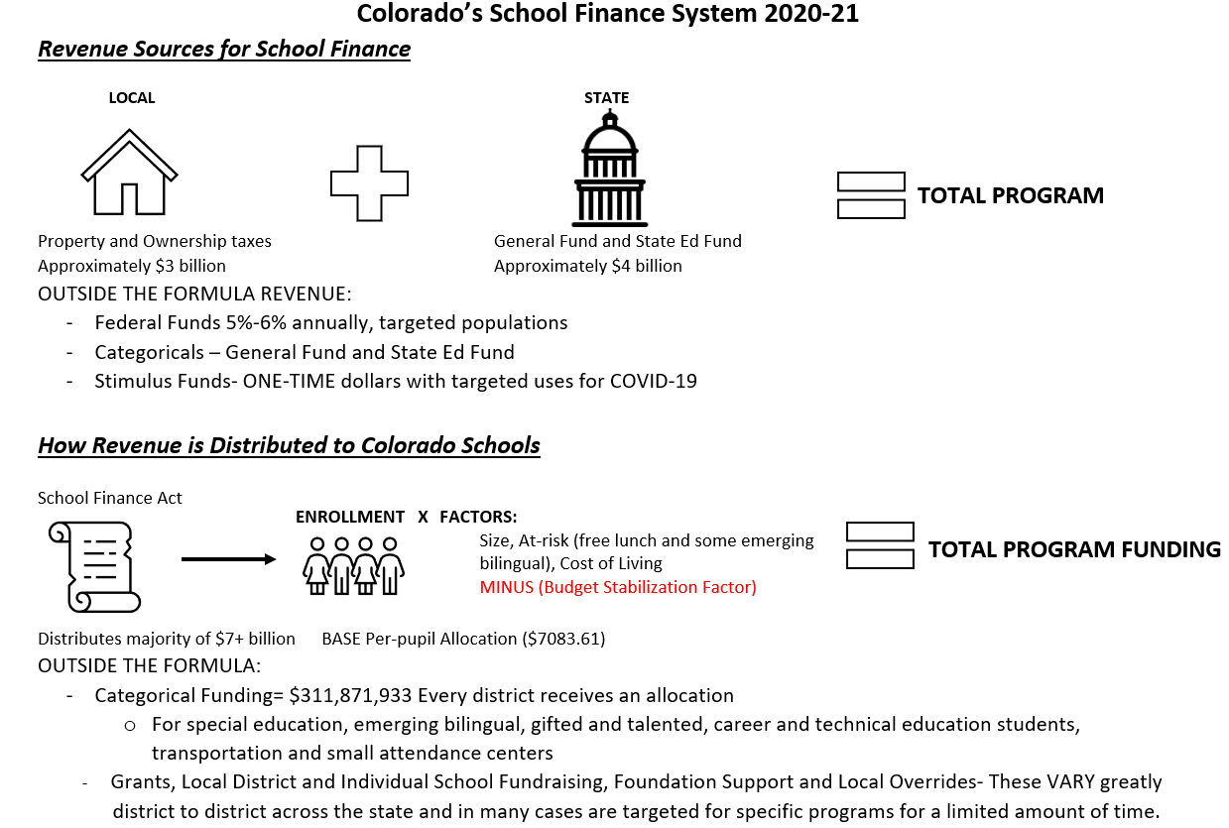
How schools are funded in Colorado
December 2023

Slide 33
School District Funding – Foundation Formula
First Dollars in – Local Revenue - property taxes – residential and non-residential and ownership taxes
State backfills difference so ever district’s “base funding” starts the same.
Then factors applied less the budget stabilization factor
Per Pupil Revenue = Total Program Funding
December 2023

Slide 34
Dollars are distributed to districts through a formula
Base funding
At-risk factor
ELL factor
District Cost of Living
District Size
Budget Stabilization Factor Applied (reduces funding)
December 2023

Slide 35
What is the Budget Stabilization Factor (BSF)?
The BSF is a tool the state legislature uses to help balance the state budget
After the state sets the budget, if more money is needed, money is subtracted from education budget-but only the factors (Dwyer lawsuit)
Since the creation of the BSF, schools have lost more than $10.5 billion
December 2023

Slide 36
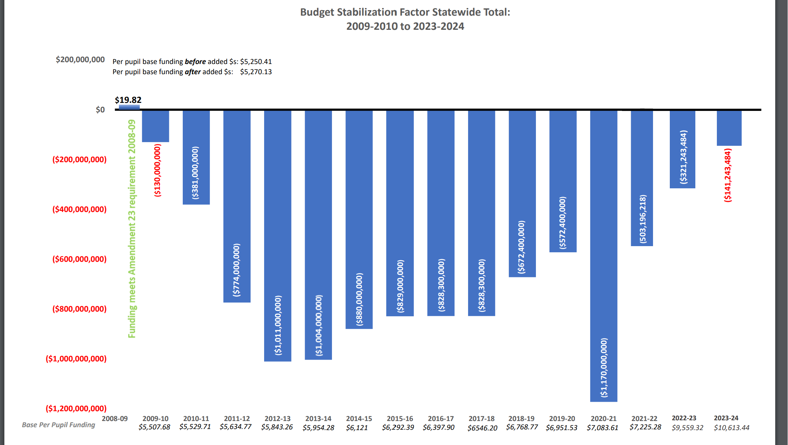
December 2023

Slide 37
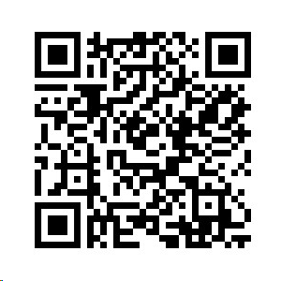
District Specific Losses
Once the BS Factor has been paid off, Colorado is back to 1988-89 funding levels, after adjusted for inflation. This is prior to the standards, assessments, accountability, and accreditation systems that are currently in place.
Scan here to look up how much your district has lost since 2009
December 2023

Slide 38
What items are funded outside the formula?
School districts also receive categorical dollars, additional dollars for:
Special Education students
English Learners
Gifted and Talented students
Career and Tech students
Transportation
Small attendance centers
School districts do not receive enough revenue to cover costs of these programs
December 2023

Slide 39
Potential Impacts for K12
At-Risk – New Definition
Universal Preschool – Changes for Year 2
School Finance Task Force – Potential impacts for 24-25 School Year
December 2023

Slide 40
Special Session

Slide 41
Special Session
On Nov.9th Governor Polis called a special legislative session for property tax.
Members of the legislature met from Friday, November 17th to Monday, November 20th.
7 bills were passed
HB23B-1001
HB23B-1002
HB23B-1003
HB23B-1008
SB23B-101
SB23B-102
SB23B-103
December 2023

Slide 42
Special Session (cont’d)
SB23b-101
Lowers property tax rate for residential properties to 6.7%
Non-residential 27.9%
Expands value deductions to $55,000
This is a 1-year fix
Counties must provide valuations by January 3rd
School districts must certify mills by January 10th
December 2023

Slide 43
ESSER $ End September 2024

Slide 44
ESSER Funds Overview
In 2020, schools were granted funds to address the immediate health, operational, and economic crises in an uncertain and evolving environment during the global pandemic.
The Elementary and Secondary School Emergency Relief Fund (ESSER) was allocated in three installments – March 2020, December 2020 and March 2021.
These one-time payments are to be used by September 2024
December 2023

Slide 46
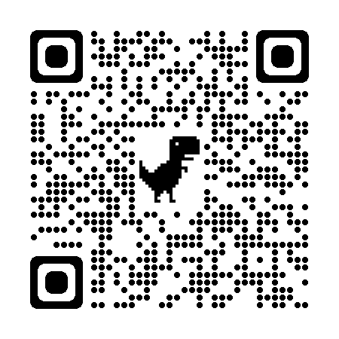
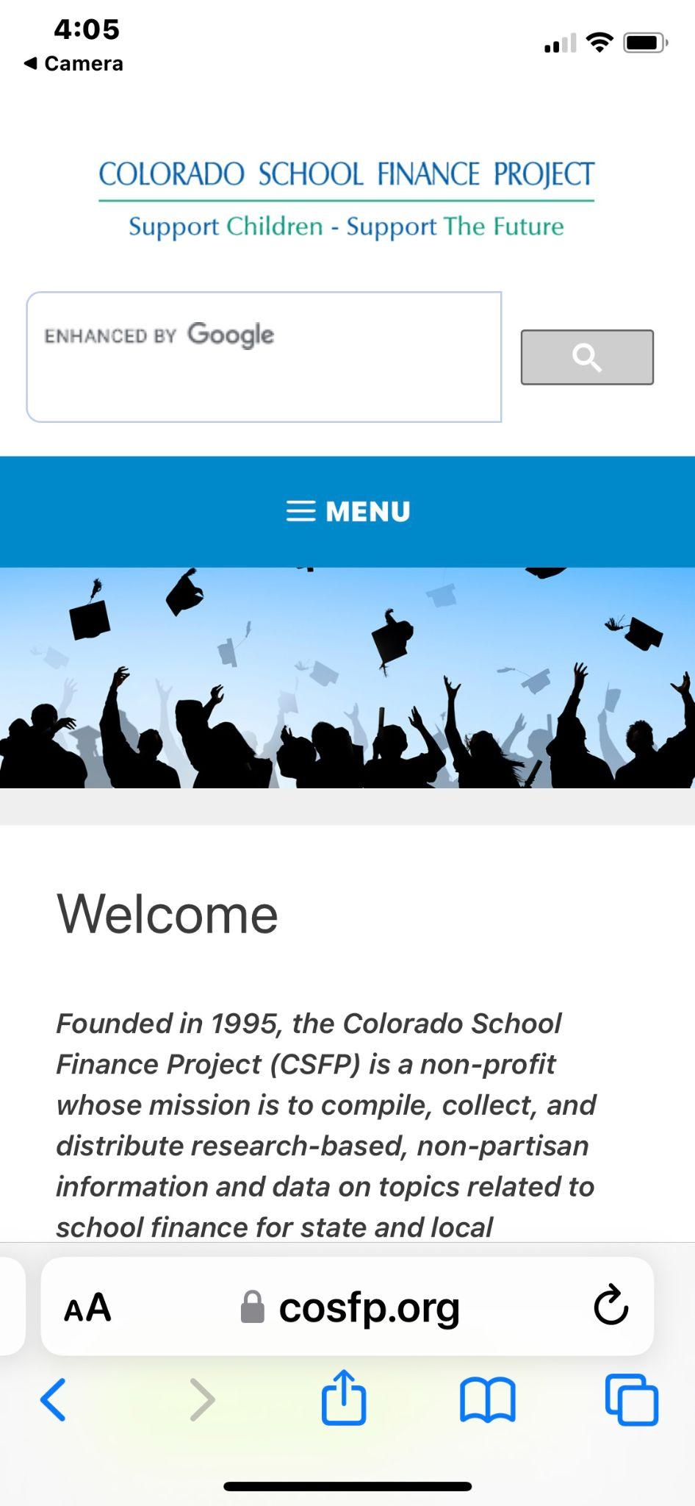
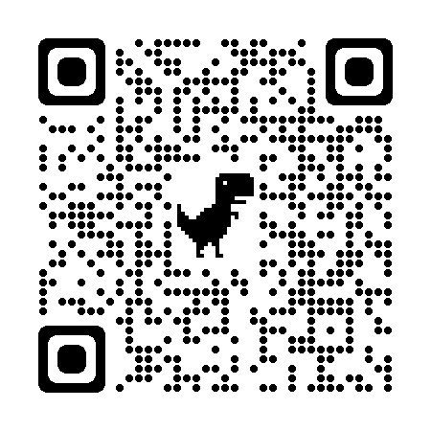
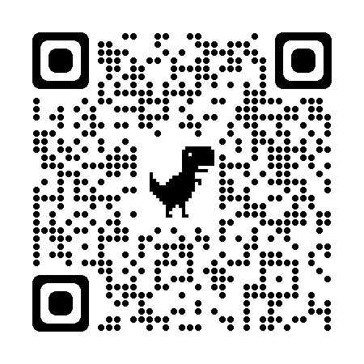
Place your screenshot here
District Key Stats
Link to documents
BOCES Key Stats
Link to documents
AU Key Stats
Link to documents

Slide 47
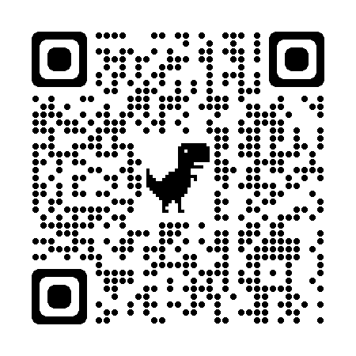
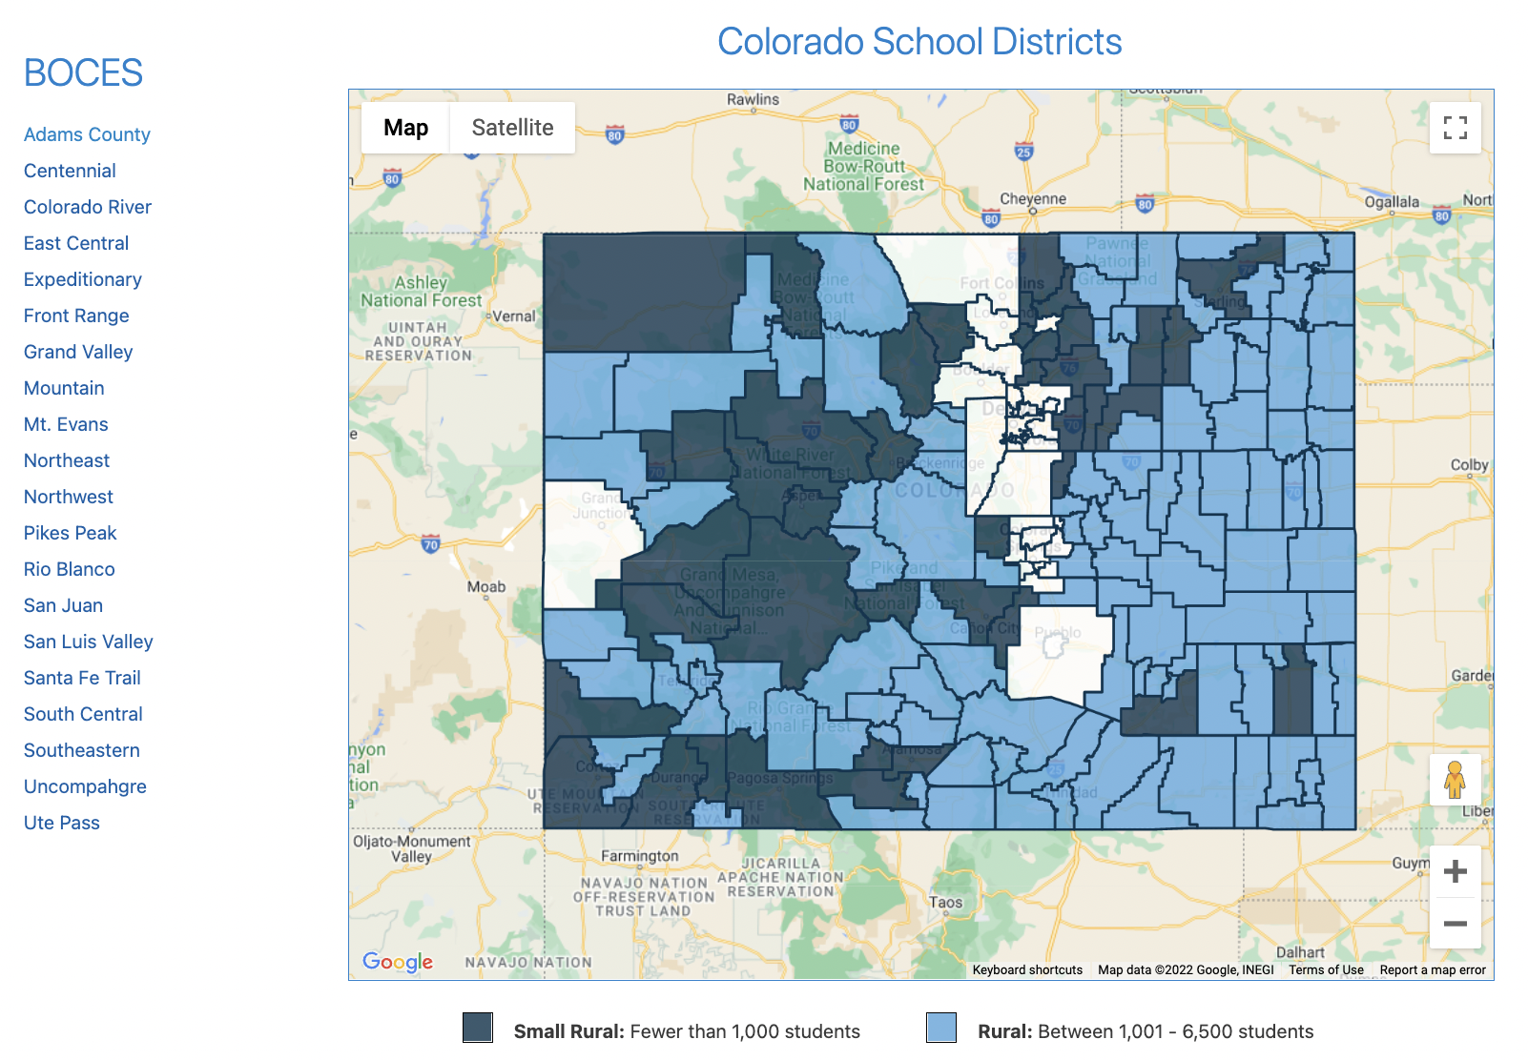
Interactive Website
Provides fact sheets for every district and BOCES
Place your screenshot here
Link to documents
December 2023

Slide 48
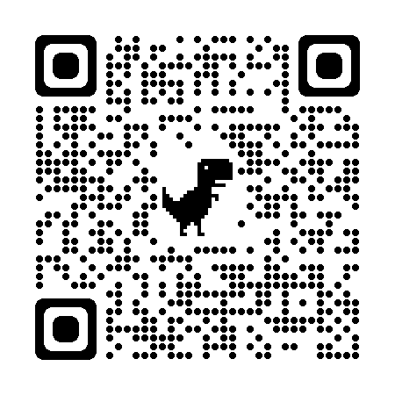
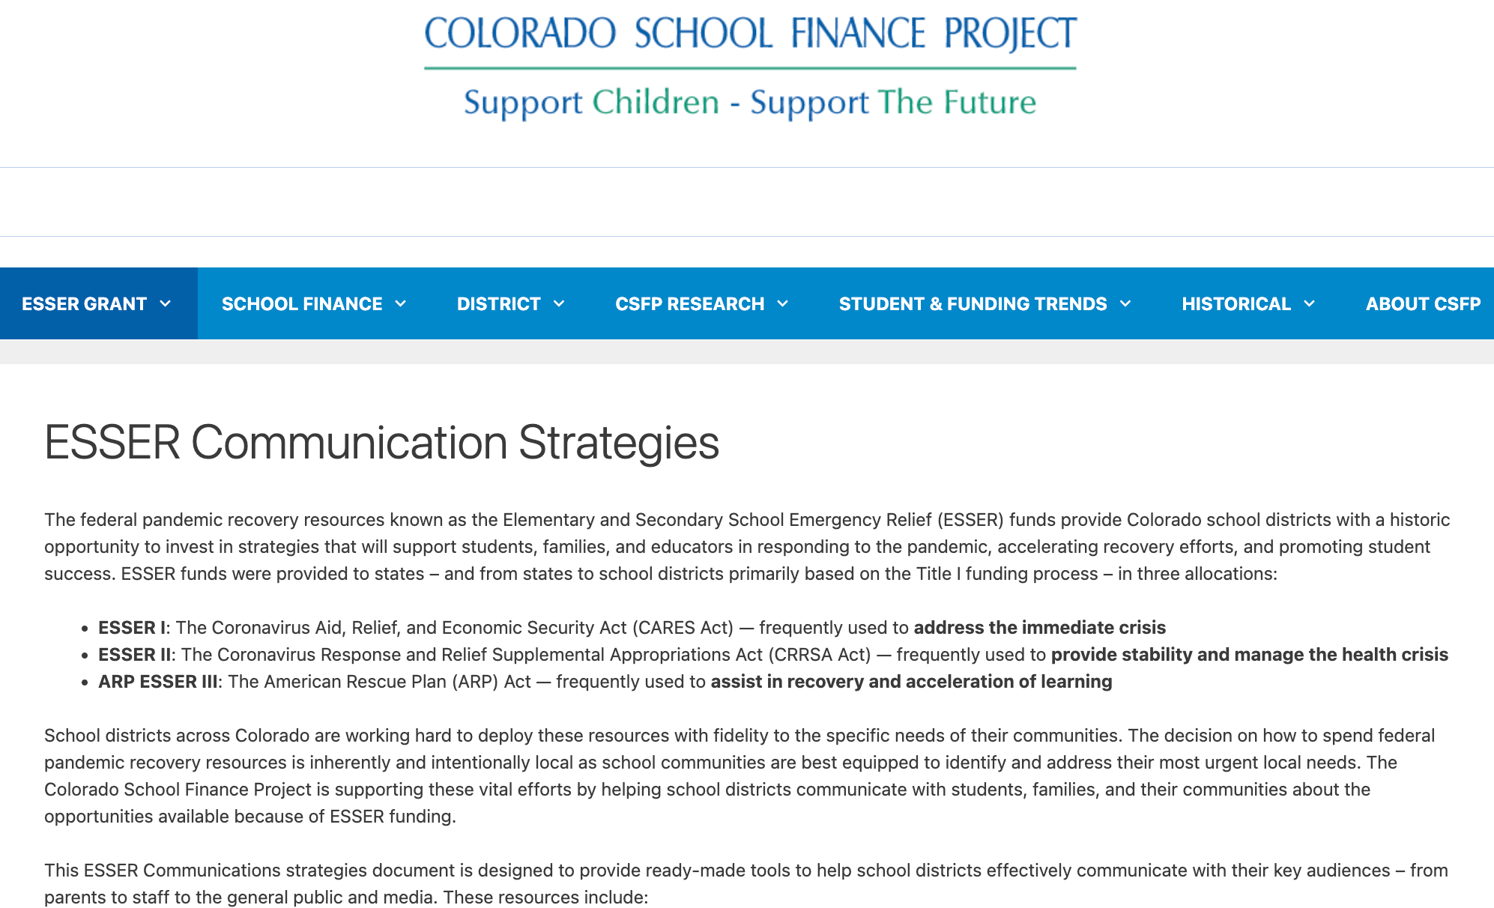
Communication Tools
For every investment area
Place your screenshot here
Link to documents
December 2023

Slide 49
Questions?
Tracie Rainey t.rainey@cosfp.org 303-860-9136
Stay connected
https://cosfp.org/
@COSFP
Colorado School Finance Project -Facebook

