Slide 1
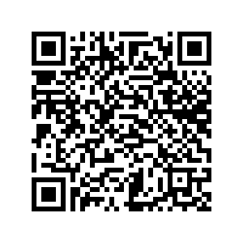
Assessing School Board Mill Levy Discretion CASB Conference
Scan here for CSFP’s FAQ on Governor’s Request
Colorado School Finance Project
December 2023

Slide 2
Who is CSFP?
Non-profit, non-partisan
Supported by school district contributions
School finance analysis for local and state policy makers since 1995
Governed by a board comprised of national and state experts on school finance
Our Mission: To compile, collect and distribute research-based, non-partisan information and data on topics related to school finance for state and local policymakers. CSFP also supports school districts by providing expertise, technical assistance and capacity building related to best practices in school finance.
December 2023

Slide 3
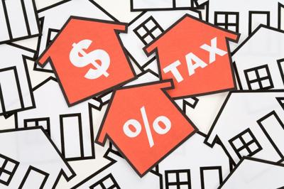
What is a Mill Levy?
School districts have taxing authority to collect a property tax levy to fund local schools.
School districts levy (or collect) a certain number of mills (or amount), depending on a number of state and local factors, to raise these dollars.
December 2023

Slide 4
What is a Mill Levy?
Mill: One mill is equal to one tenth of one penny or one 1/1000 of a dollar.
Mills are used to calculate property taxes using a formula of mills x assessed (not total value) property value = property tax.
The assessed property value is the actual property value x the assessment rate.
Currently, the residential assessment rate in Colorado is 6.7%. The non-residential assessment rate is 27.9%.
December 2023

Slide 5
What is the assessment rate?
The assessment rate reflects a small portion of the value of the property, which is used to calculate the mill levies.
It is a combination of residential and non-residential properties.
The assessed property value is the actual property value x the assessment rate.
December 2023

Slide 6
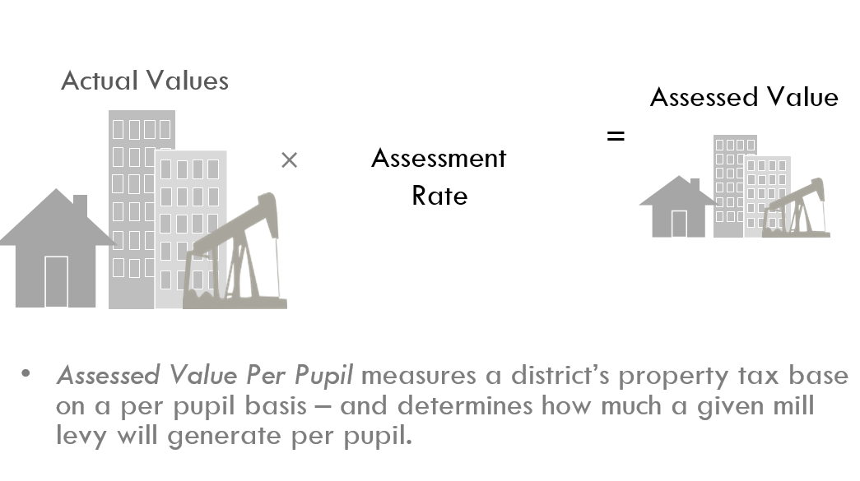
$300,000
Residential Assessment Rate (RAR)
$20,100
6.7%
27.9%
Non-Residential Assessment Rate
$83,700
$300,000
Understanding mills and assessment rates
$20,100
27
$542.70
$2,259.90
$83,700
27
December 2023

Slide 7
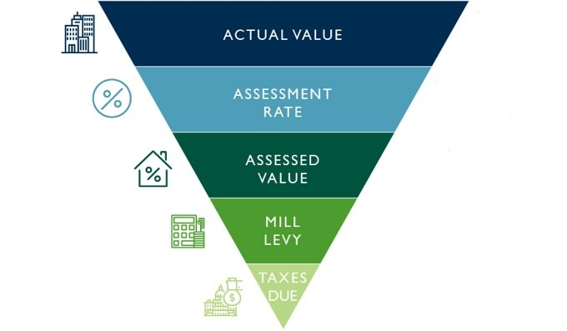
What is a mill levy?
Adapted from Faegre Drinker Biddle & Reath LLP

Slide 8
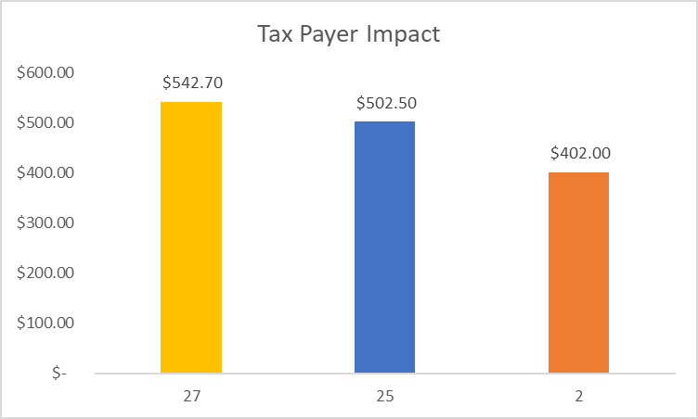
How are mills calculated?
Actual Value of Home= $300,000
Residential Assessment Rate (RAR)
= 6.7%
Home value x RAR =
Total Assessed Value= $20,100
Total Assessed value x mill levy = taxes paid (mill levies vary by district)
December 2023
Notes:
Glenn

Slide 9
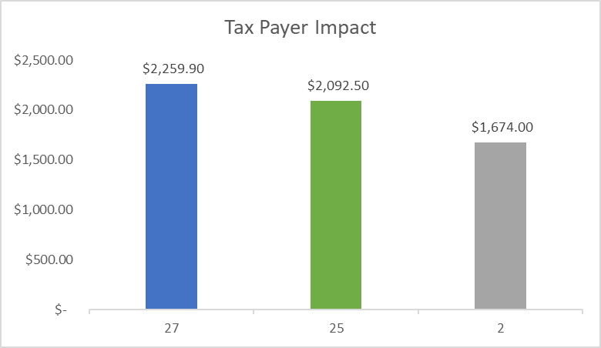
How are mills calculated?
Actual Value of Non-residential= $300,000
Non-residential Assessment Rate
(RAR)= 27.9%
Non-residential x RAR =
Total Assessed Value= $83,700
Total Assessed value x mill levy = taxes paid (mill levies vary by district)
December 2023
Notes:
Glenn

Slide 10
Two Kinds of Tax Collections / Mill Levies
Property taxes to fund Total Program for schools – Local Share
Determined by the school finance formula
Assessment rate is not locally determined – determined by the State
Varies annually
All districts
Local override taxes approved by voters
Mill levy overrides to fund operations
Bond levies to fund capital construction
Locally determined, within limits
Some districts (59) have no overrides
December 2023

Slide 11
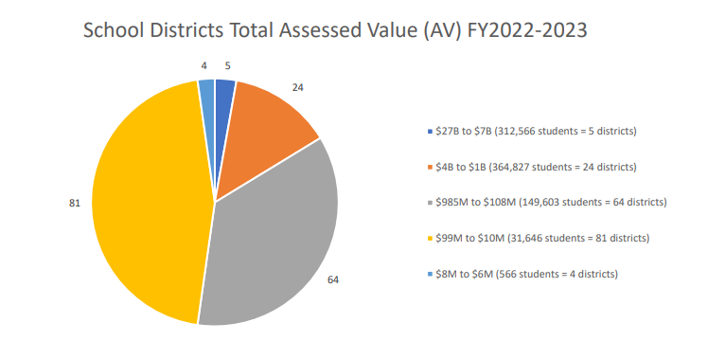
Assessed Valuation
Assessed Valuation (AV): The taxable portion of property value in the school district. As an index of property wealth, AV varies significantly between districts and can vary a lot from year to year (particularly for oil and gas districts).
December 2023

Slide 12
Mill Levy Certification
District must certify mills to county(ies) in order to collect property tax revenue
County assessors must have assessed valuation to districts no later than January 3rd, 2024.
Completed by the Board of Education no later than January 10th, 2024.
This is a one-year fix.
Important to certify all mills the district levies
CDE trainings on Mill Levy Certification
December 2023

Slide 13
Letter from the Governor
On November 29th, Governor Polis asked school boards to consider reducing their property tax mill levies to minimize the impact of higher property assessment rates, and therefore higher property taxes, on local property owners.
December 2023

Slide 14
Your Assessment rate changes impact your mill levies
Your final assessed valuations are being completed now by your county.
Currently, the exact data is not available for you to calculate the impact of reducing your mills.
December 2023

Slide 15
Implications of Request
Any reduction in a school district’s mill levies that are certified now will result in a reduction in the district’s revenue for the 2023-2024 school year.
Mill levy overrides and bond levies requests have been made with specific purposes in mind–for projects, construction of facilities, programs, and often for additional staffing.
Impact on community
Potential need for additional revenue
Please consult your district’s legal counsel before making any decision.
Scan here for CSFP’s FAQ on Governor’s Request
December 2023

Slide 16
Impact on Mill Levies
Total Program Mills - Total Program mills are established in state statute, and local school boards DO NOT have discretion to reduce them. This requirement also applies to districts that are fully locally funded. (If a district does not certify their mills correctly, there is a penalty imposed, in addition to not being in compliance with state law.)
Mill Levy Override (MLO) Mills - MLO mills are authorized by local voters to provide additional revenue to school districts. School boards MAY have discretion to reduce these mills.
December 2023

Slide 17
Impact on Mill Levies (cont’d)
Bond Mills - School boards LIKELY DO NOT have discretion to reduce these mills, as they are required to raise a certain amount of revenue to make the debt service payments required by the bond.
Other Mills - Districts may have voter-authorized mills in other categories, such as a technology, transportation or debt-free schools mill. School boards MAY have discretion to reduce these mills.
December 2023

Slide 18
Other Considerations if Mills are Reduced
There are significant legal issues raised when considering adjustments to mill levies and districts should reach out to bond and/or legal counsel prior to considering such action to determine:
whether such adjustments can be made;
the consequences of such adjustments with regard to district contracts and other legal obligations;
whether the board has authority to increase any mills that are reduced without going back to their voters.

Slide 19
Other Considerations (cont’d)
The School Finance Act requires districts to levy the Total Program Mills provided in statute and by CDE
If a district levies fewer Total Program mills than required, this is a violation of state law and may be a violation of a Board member's oath of office
If a district proceeds anyway, statute includes a penalty in the form of a reduction to the district's state share
Statute requires that the ratio of state to local share be maintained, even if the district chooses to reduce its local share by reducing its mill levy

Slide 20
Example: Penalty for Lowering Total Program Mills (violation of state statute)
Total Program per Statute: $10,000,000
Total Program becomes: $9,166,666
Total Loss: $833,334
LOCAL SHARE
Property Taxes
27 mills
$6,000,000
60% of Total Program
LOCAL SHARE
Property Taxes
24 mills
$5,500,000
60% of Total Program
District lowers its Total Program Mill Levy from 27 to 24
STATE SHARE
State Funds:
$4,000,000
40% of Total Program
STATE SHARE
State Funds:
$3,666,666
40% of Total Program
Statute requires ratio of local to state share to remain the same

Slide 21
Example: Penalty for Lowering Total Program Mills (violation of state statute)
Total Program per Statute: $10,000,000
Total Program becomes: $8,333,333
Total Loss: $1,666,667
LOCAL SHARE
Property Taxes
27 mills
$3,000,000
30% of Total Program
LOCAL SHARE
Property Taxes
24 mills
$2,500,000
30% of Total Program
District lowers its Total Program Mill Levy from 27 to 24
STATE SHARE
State Funds:
$7,000,000
70% of Total Program
STATE SHARE
State Funds:
$5,833,333
70% of Total Program
Statute requires ratio of local to state share to remain the same

Slide 22
Example: Penalty for Lowering Total Program Mills (violation of state statute)
Total Program per Statute: $10,000,000
Total Program becomes: $9,500,000
Total Loss: $500,000
LOCAL SHARE
Property Taxes
5 mills
$10,000,000
100% of Total Program
LOCAL SHARE
Property Taxes
3.5 mills
$9,500,000
100% of Total Program
District lowers its Total Program Mill Levy from 5 to 3.5
No state share impact; district is fully locally funded

Slide 23
Other Considerations (cont’d)
Voter intent
ESSER Funding ending September 2024
Contractual obligations
Buydown of the BS Factor
Can your mills be raised once they are reduced?
Counties have until January 3, 2024 to certify Assessed Valuations to school districts, and Boards have until January 10, 2024 to certify those mills.
December 2023

Slide 24
Questions?
Scan here for CSFP’s FAQ on Governor’s Request
Tracie Rainey t.rainey@cosfp.org 303-860-9136
Stay connected
https://cosfp.org/
@COSFP
Colorado School Finance Project -Facebook

