Slide 1
Making It Real: Bringing Our Portrait of a Graduate to Life
Dr. Karen Cheser, Superintendent
Erika Brown, Board Vice-President
Katie Stewart, Board Assistant Vice-President/ Secretary
Notes:
Karen, quick intro to topic

Slide 2
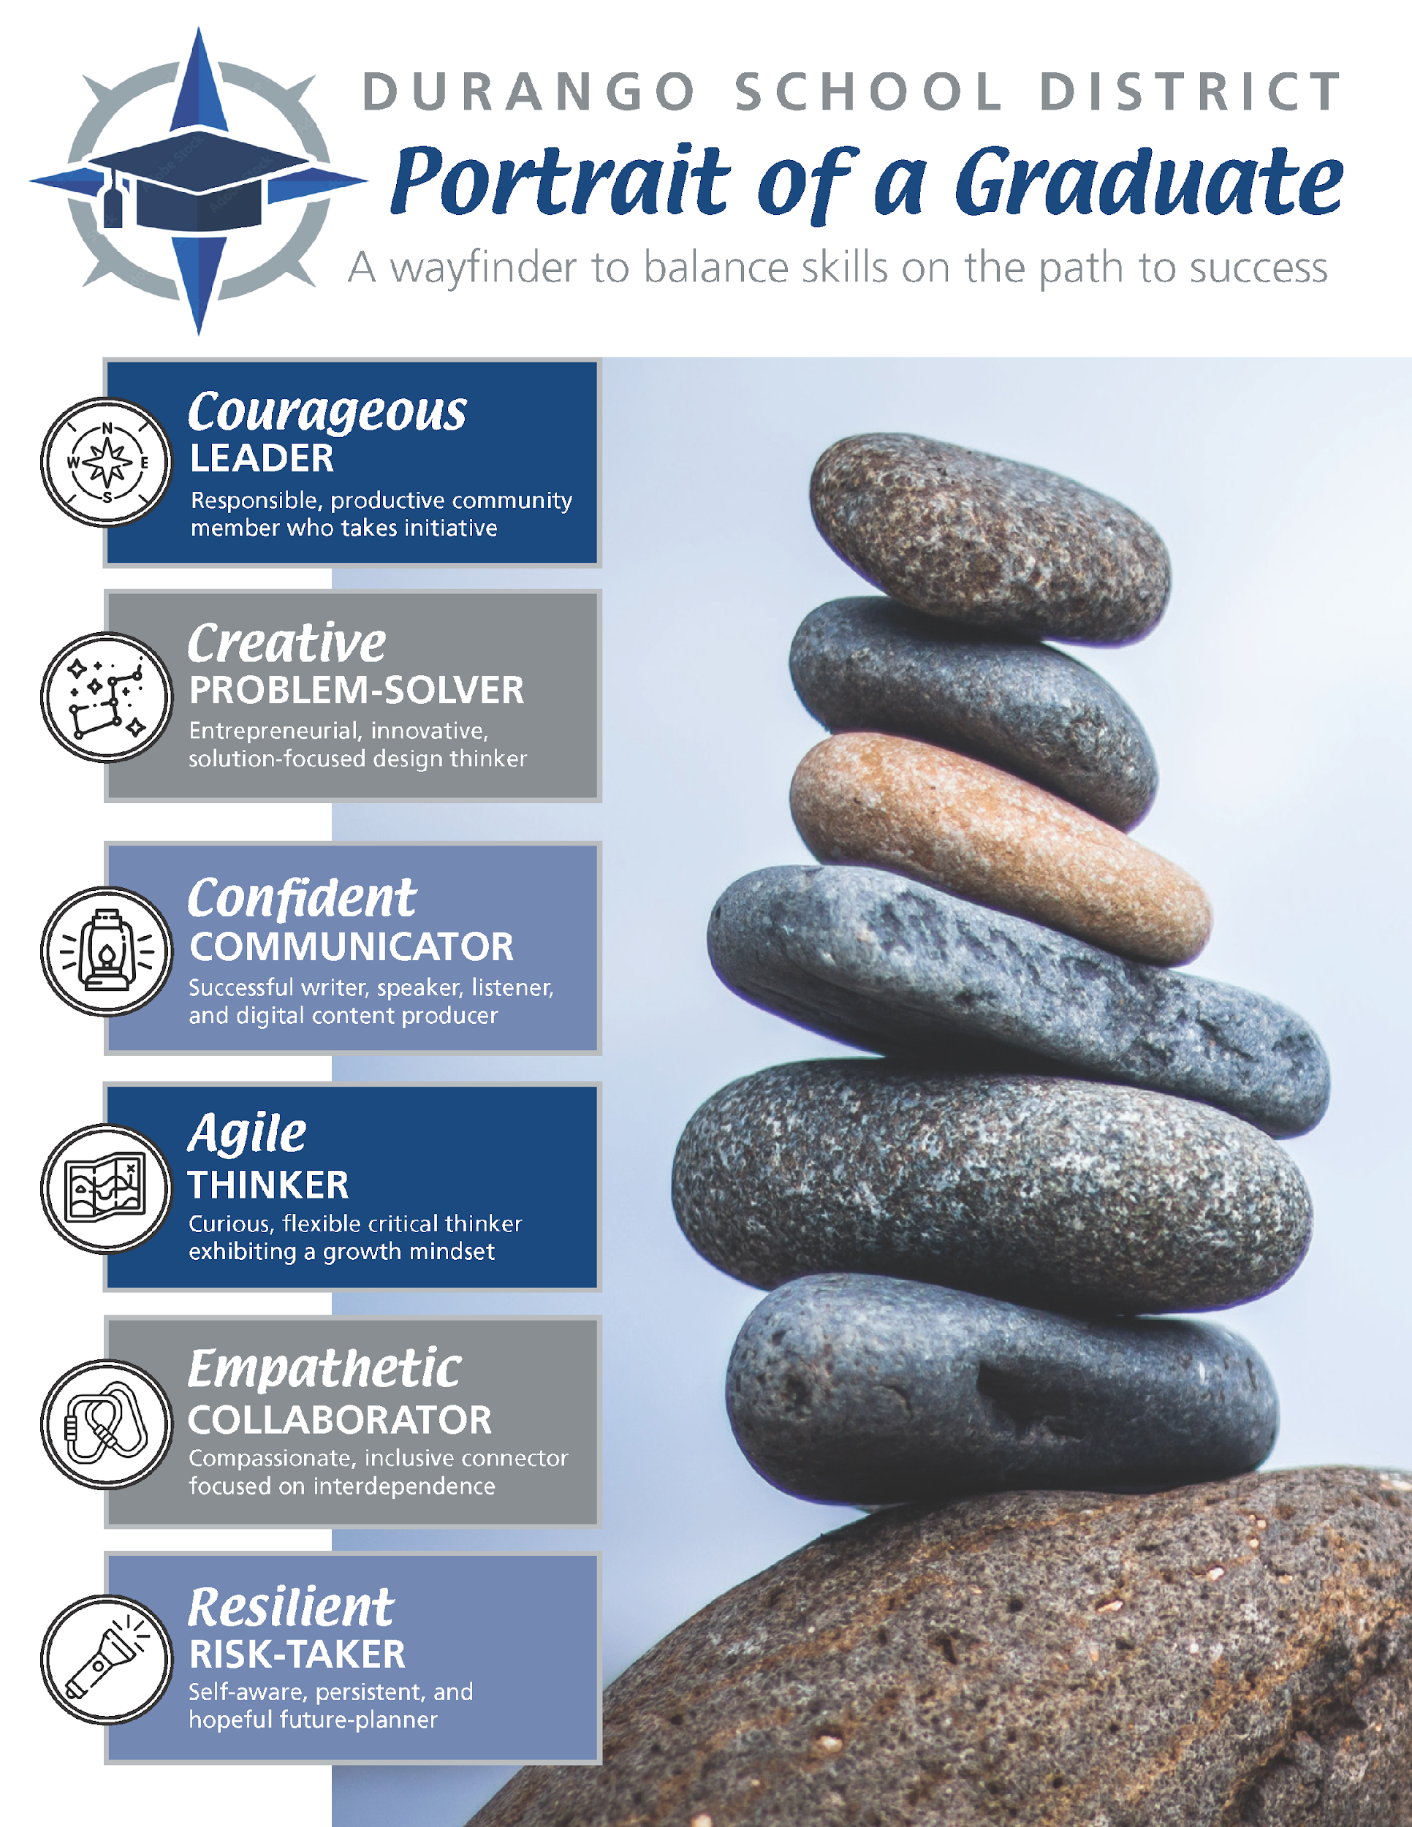
Notes:
Where we are-Karen

Slide 3
About Durango School District
Our Context
Notes:
Karen-intro to the district and context

Slide 4
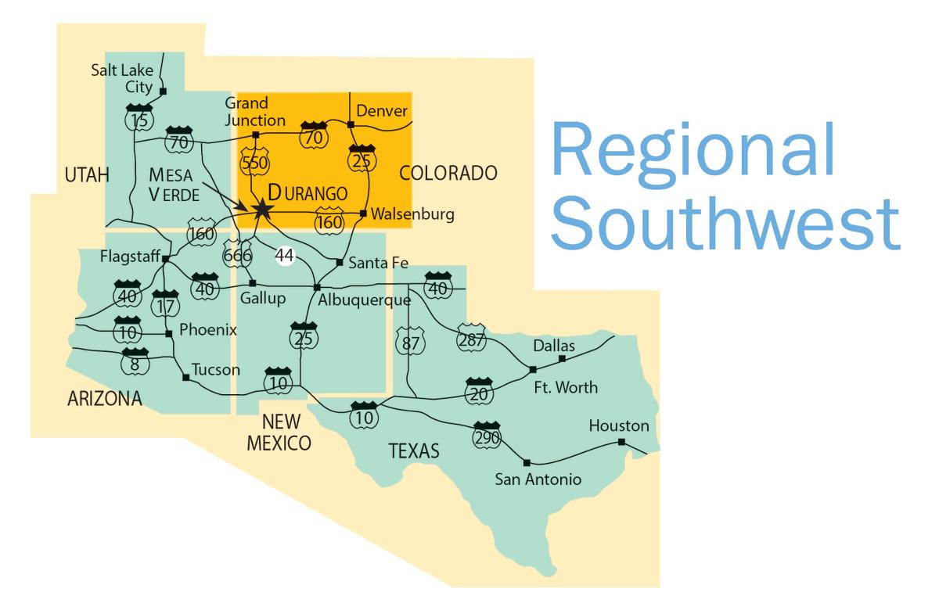
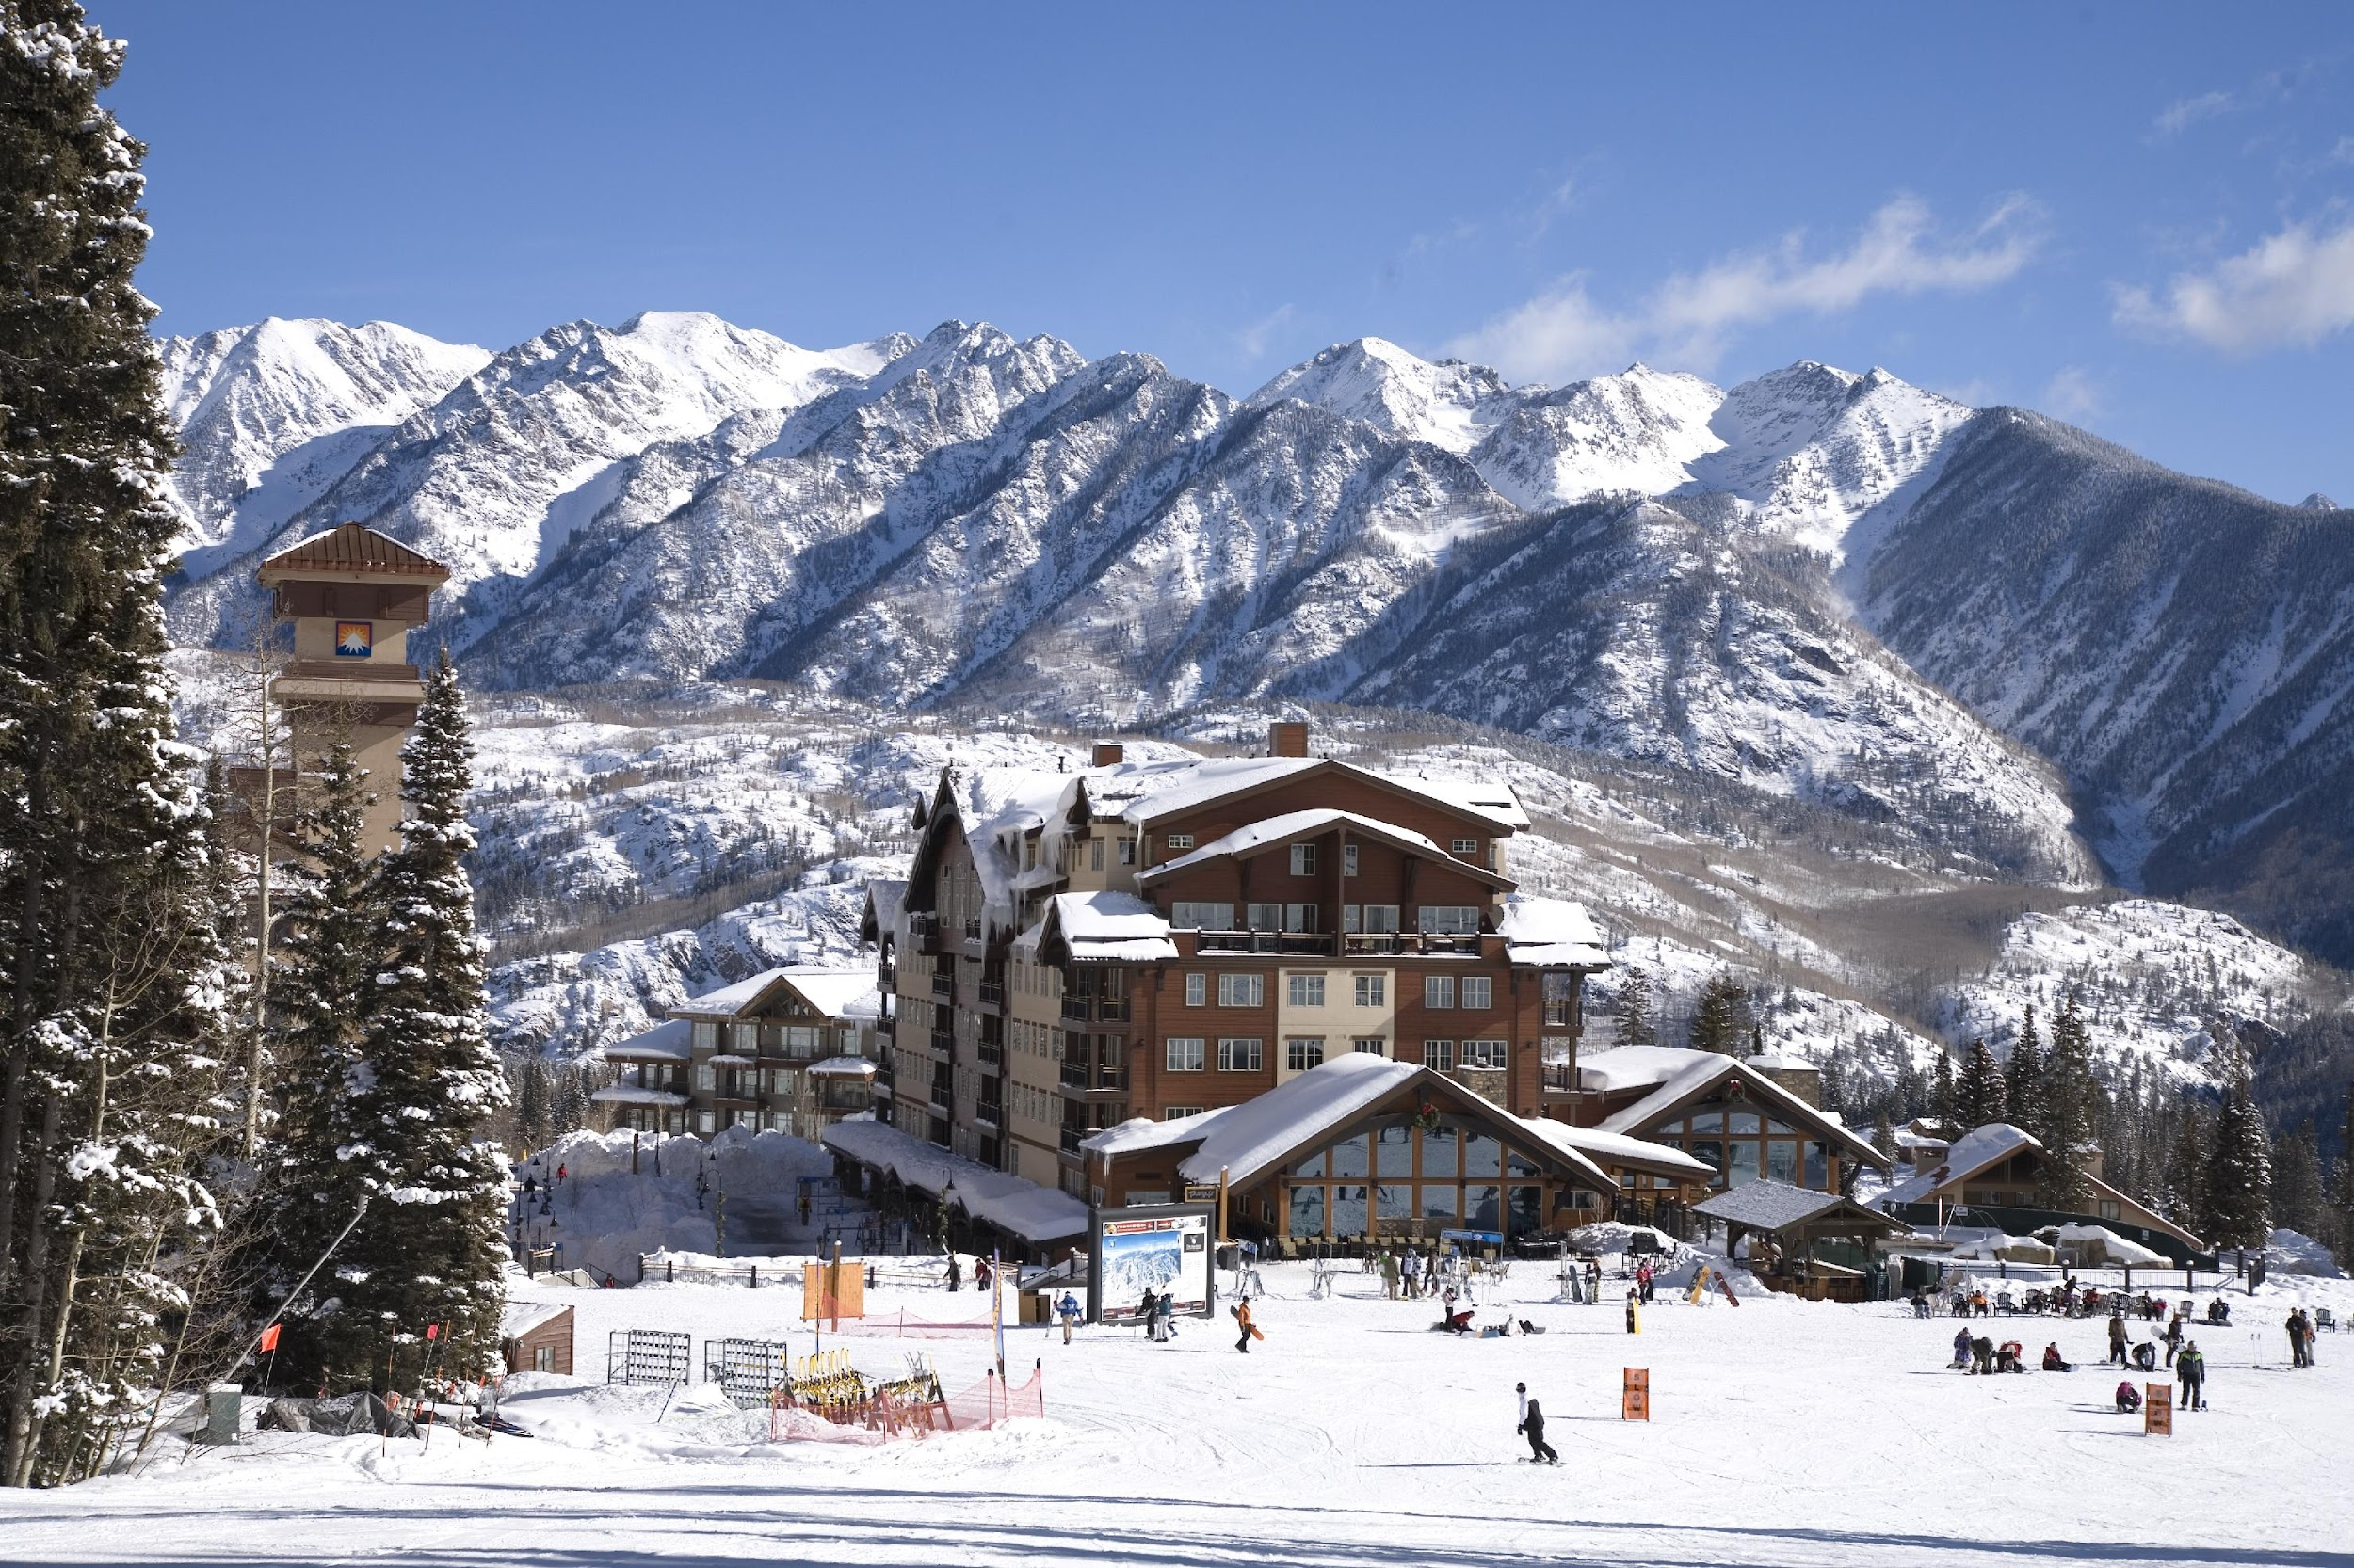
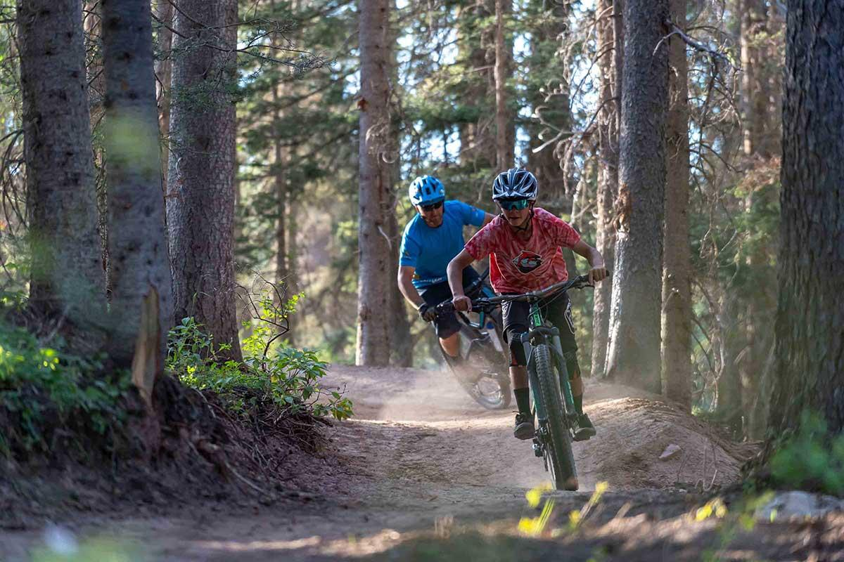
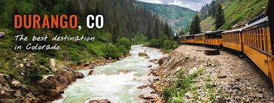
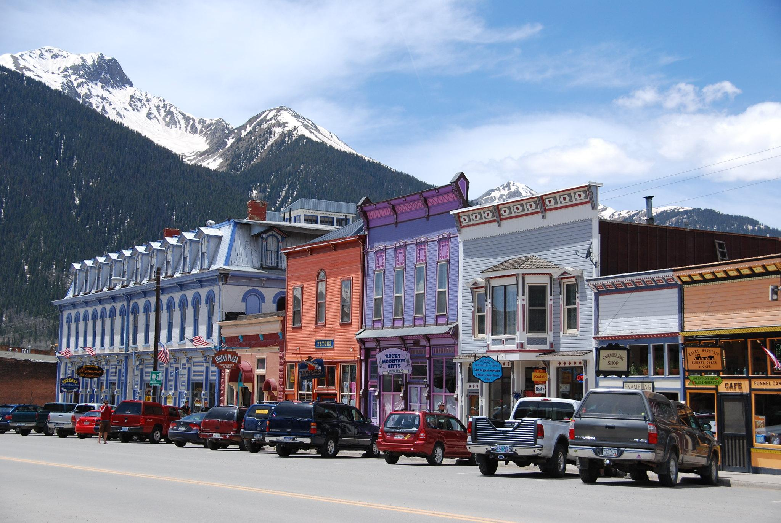
Notes:
Karen-more logistics

Slide 5
Durango School District
4500+ students
12+ schools
28% Hispanic,
10% Native American, 43% F/RL
Mountain Resort Town + Rural
Notes:
Karen-intro to district demographics

Slide 6
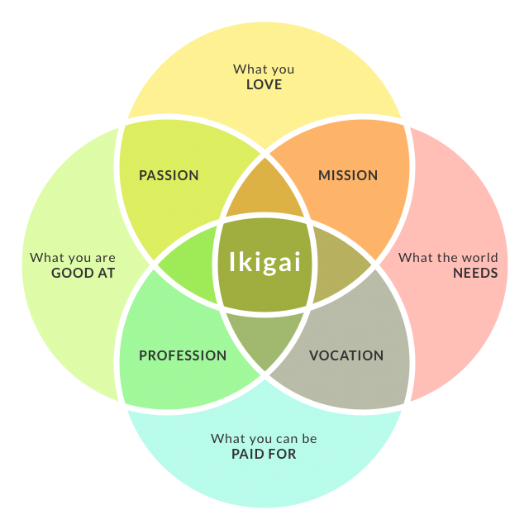
Notes:
Our story…Our ultimate goal-Ikigai, Karen

Slide 7
Where We Were-July 2021
autonomy
equity
accountability
instructional framework
curriculum/ standards
common purpose/ vision
Notes:
Karen-where we have come from
Erika and Katie-please elaborate on where you saw the district at this time, what were the needs

Slide 8
Building the Foundation
Elements of Effective Instruction (EEI)
Social-Emotional Learning Supports/ Behavioral Health
Guaranteed Viable Curriculum, Equity
Leadership Team, Communication
MTSS-standardized system, protocols, accountability
Common Purpose/ Vision/ Plan
Notes:
Karen

Slide 9
Notes:
Karen-brief

Slide 10
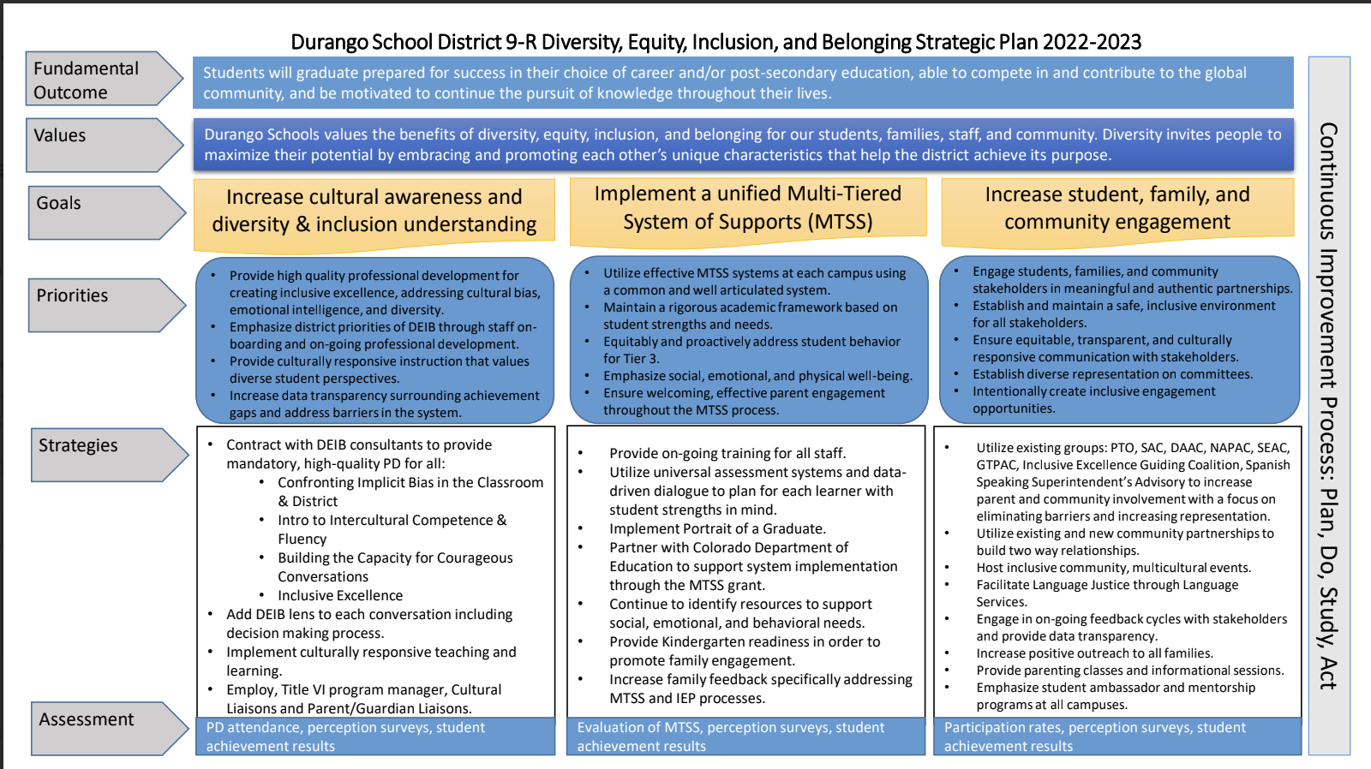
Notes:
Karen-brief-will showcase later

Slide 11
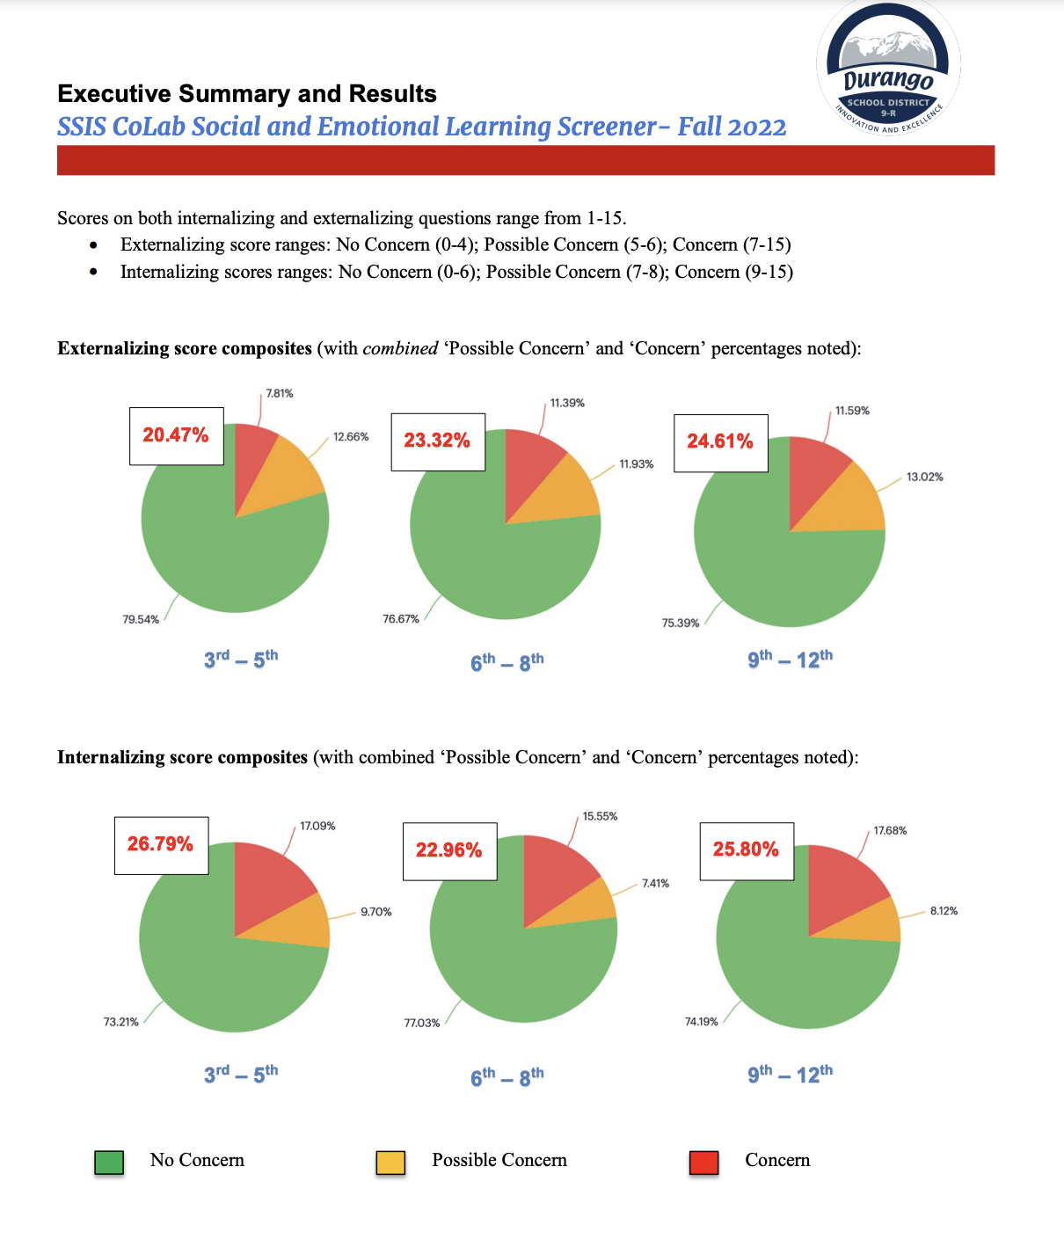
Notes:
Karen-social-emotional learning focus-brief

Slide 12
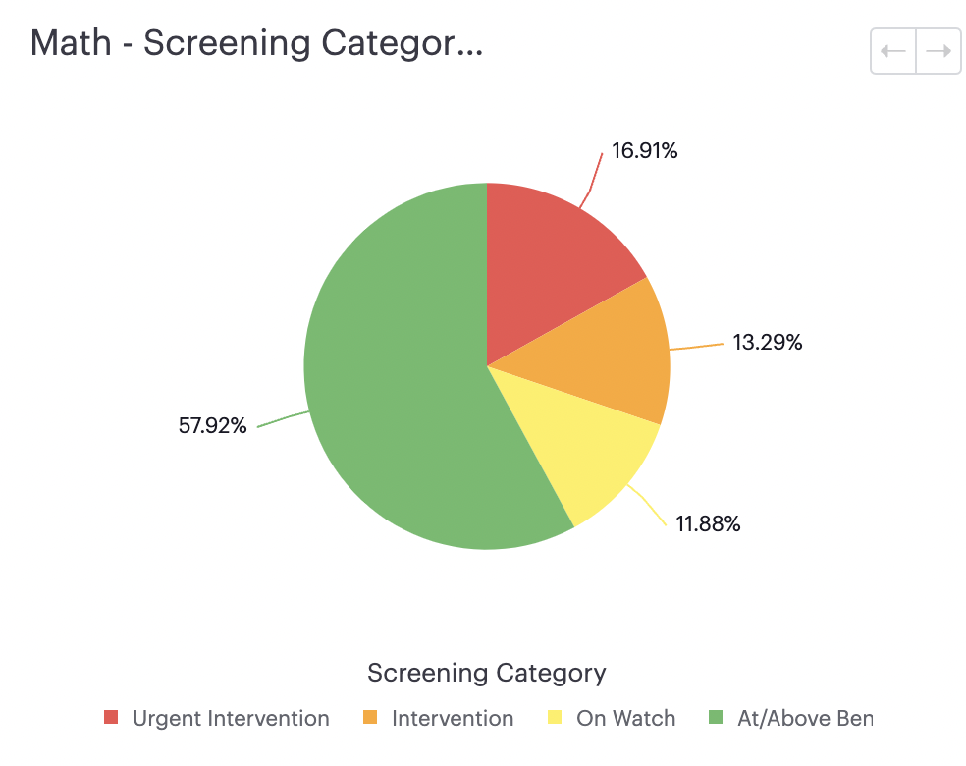
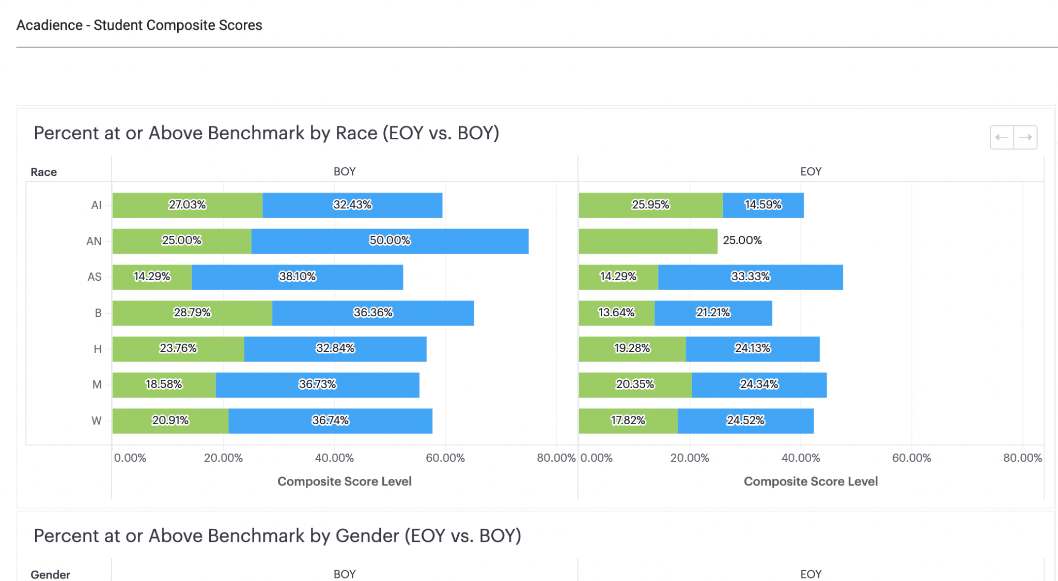
Abre Insights
Notes:
Karen-accountability, using data-brief

Slide 13
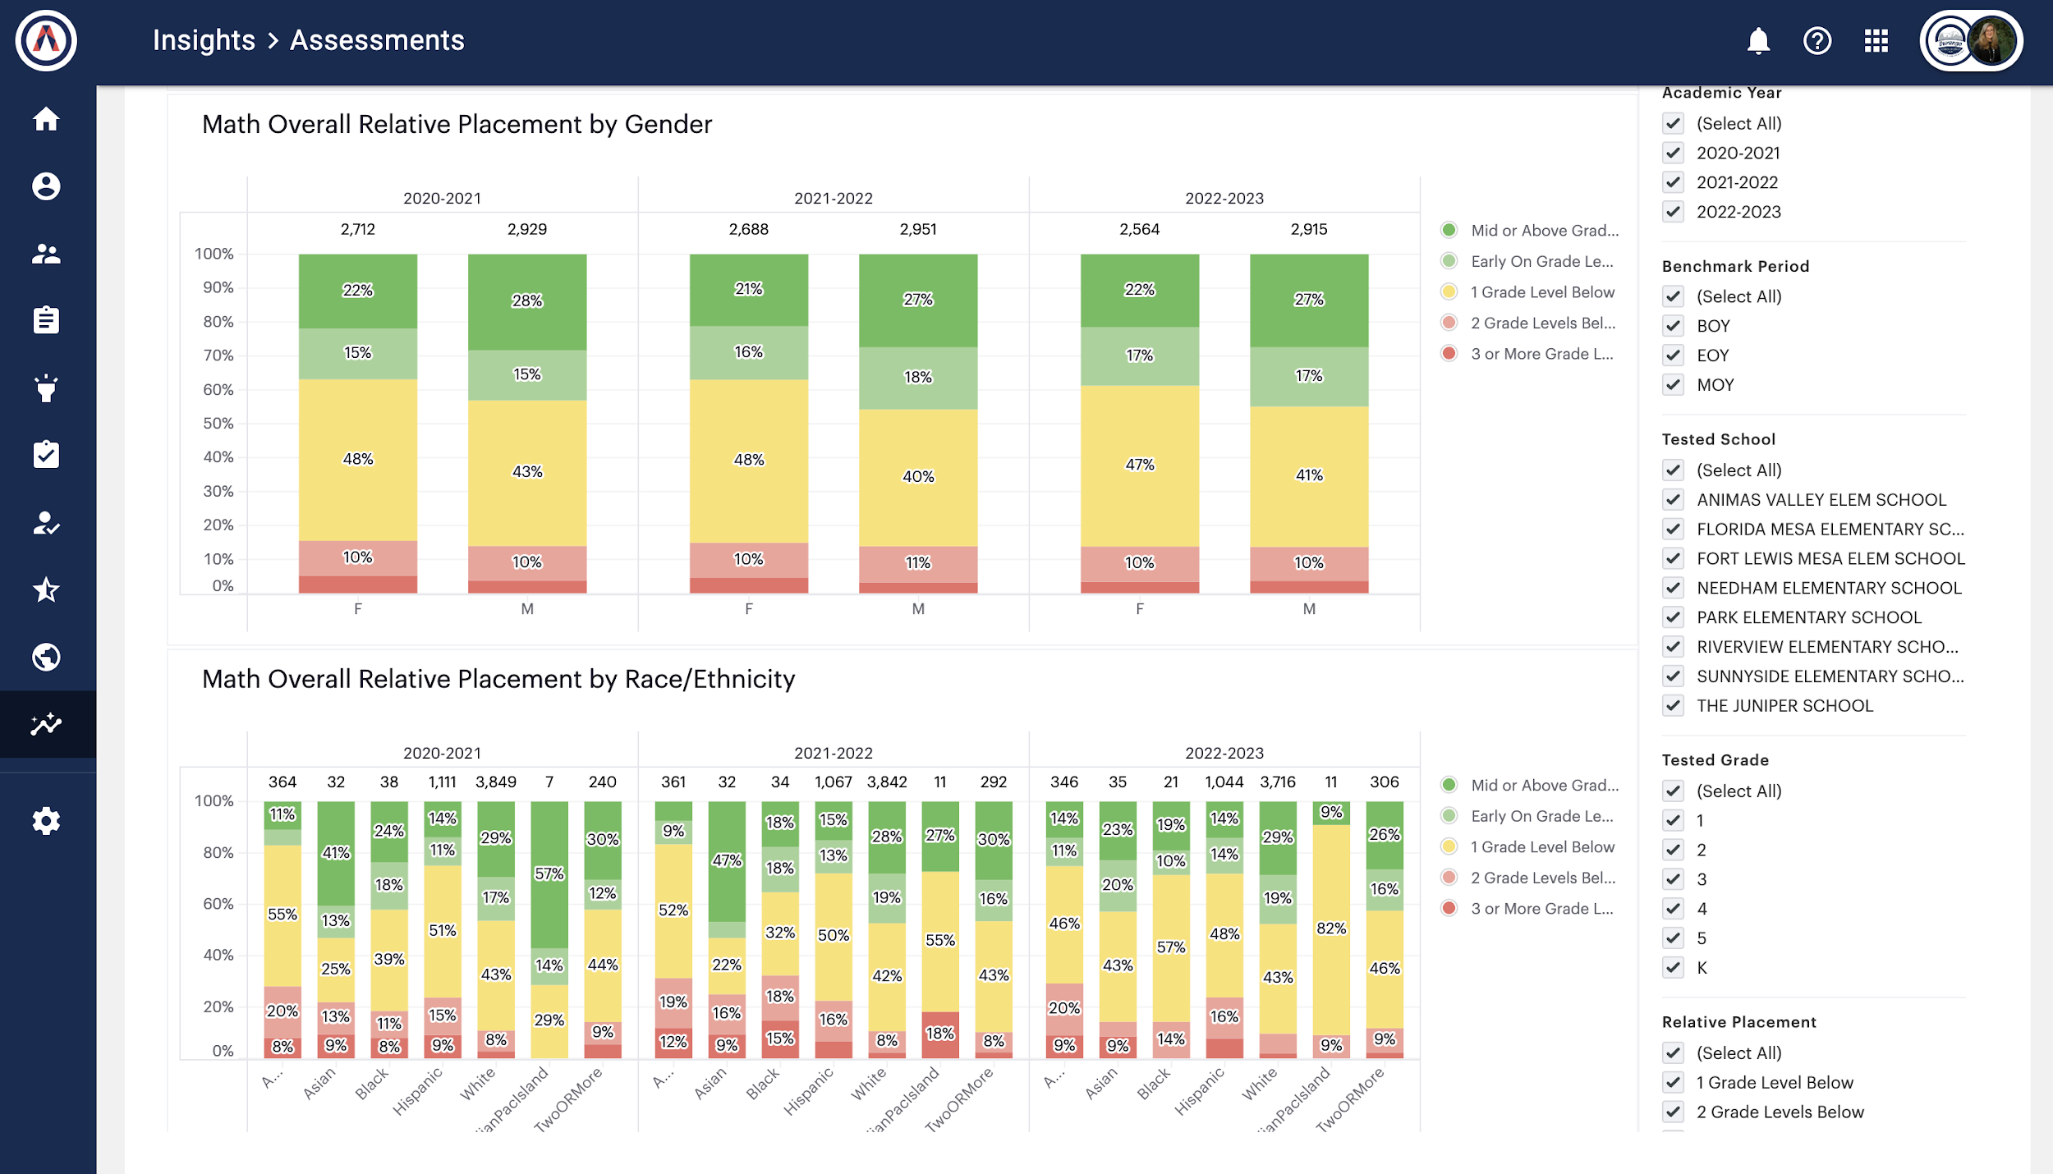
Abre
Notes:
Karen-brief

Slide 14
Balancing Autonomy and Unity
Notes:
Karen-why unity of purpose

Slide 15
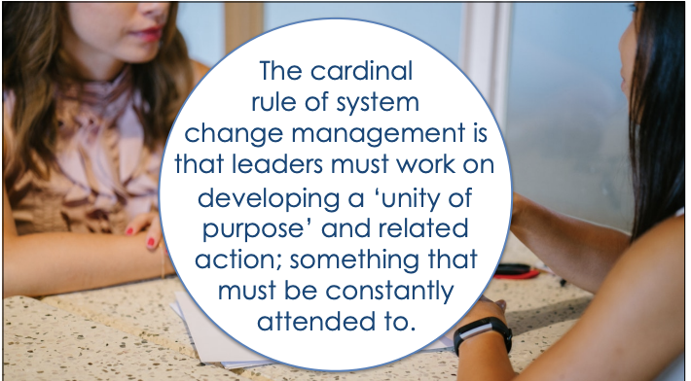
-Michael Fullan
Notes:
Karen-why unity of purpose

Slide 16
PoG Lessons Learned
Focus on the Why, Align everything
Opportunity for all teachers and staff to give input
5-6 Competencies Best, with Dispositions AND Skills
Voice and Choice, Commit
People only know what they know, start with experts
Model the Competencies, Celebrate Small and Big Attempts
Notes:
lessons learned-karen

Slide 17
Notes:
Karen-focus on Ikigai, how bring everyone together towards this goal

Slide 18
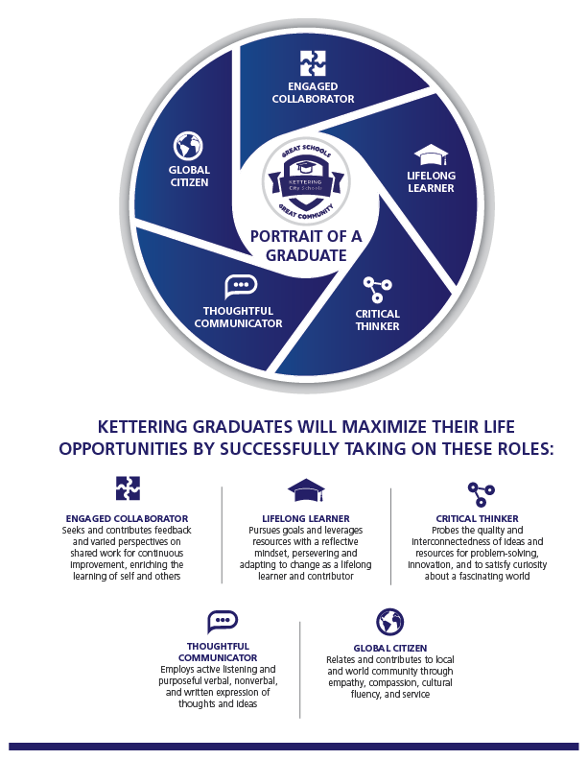
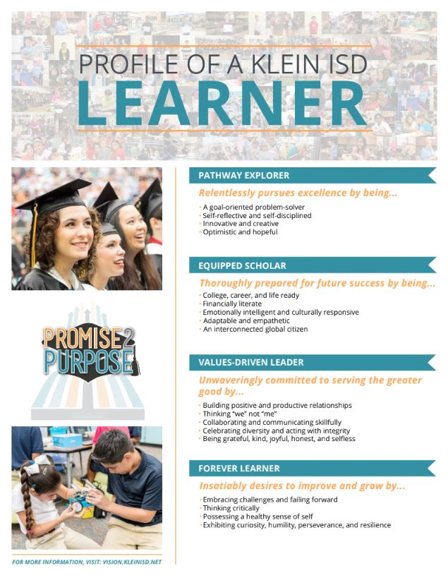
Portrait of a Graduate
Notes:
Examples-Karen

Slide 19
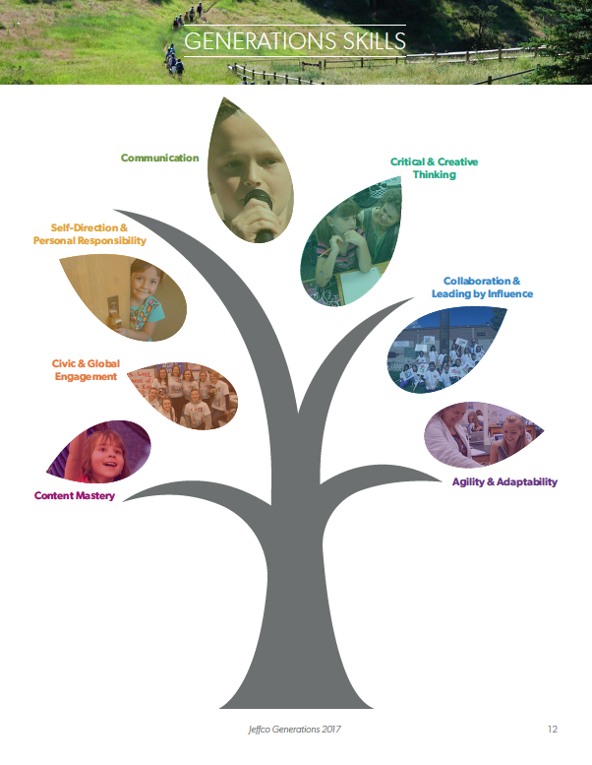

Slide 20
Portrait of a Graduate Development
Nov. 29, 2021: Industry Leader Think-Tank
Dec-Jan, 2022: meetings with principals
February, 2022: gather input from teachers and staff
March 2022: gather input from students
April 7 and 11, 2022: hold family and community member sessions to gather input
April 20, 2022: principal feedback on themes (virtual meeting)
April 21, 2022: send out surveys for feedback on the emerging themes
May 2022: finalize PoG and develop graphics and disseminate
2022-23 school year: collect examples, develop instructional blueprints, embed in instruction, highlight and recognize, etc.
2023-24 school year: artifact curation and capstones
Notes:
Timeline-Karen

Slide 21
Industry Leader Think Tank
Notes:
Karen

Slide 22
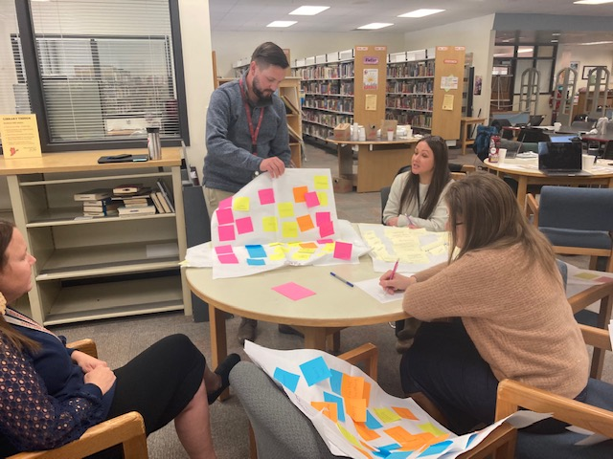
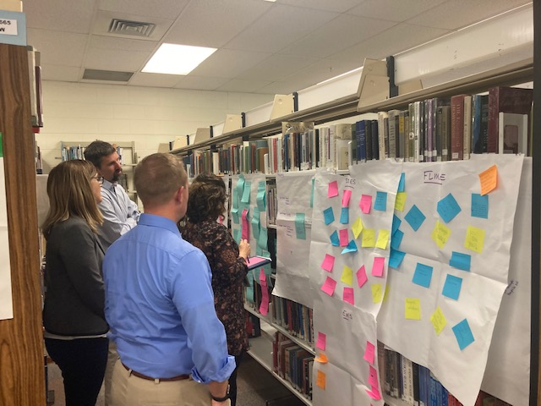
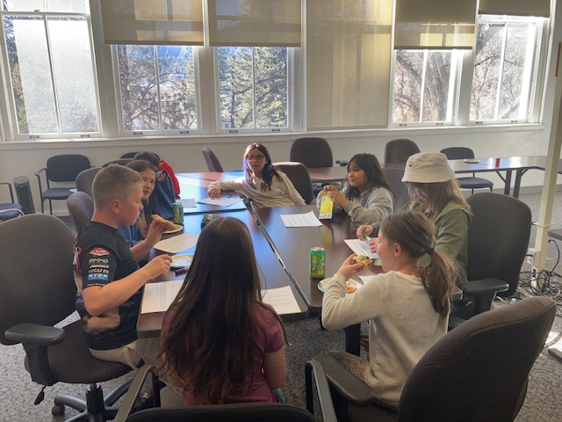
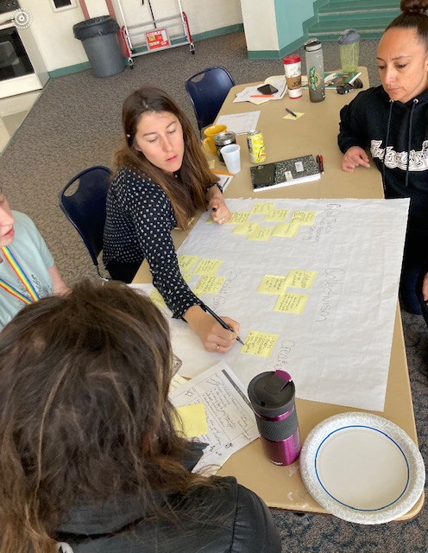
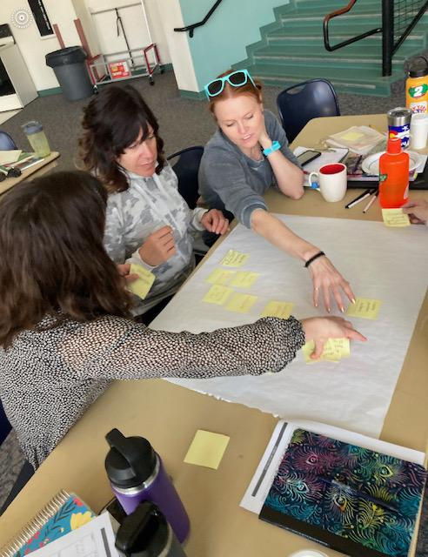
Notes:
Karen-stakeholder involvement

Slide 23
Durango School District PoG Emerging Themes:
Creative Problem Solver
entrepreneurial, innovative, solution-focused design thinker
Courageous Leader
responsible, informed, and productive community member who takes initiative to make an impact
Confident Communicator
successful writer, speaker, listener, and digital content producer
Resilient Risk-Taker
self-aware, persistent, and hopeful future-planner
Empathetic Collaborator
compassionate, inclusive connector focused on interdependence
Agile Thinker
curious, flexible critical thinker exhibiting a growth mindset
Notes:
Themes-Karen

Slide 24
Portrait of a Graduate Development
6,000+
30+
7 months
Stakeholders involved
Opportunities for input
In development
Notes:
Karen-discussion of PoG process

Slide 25
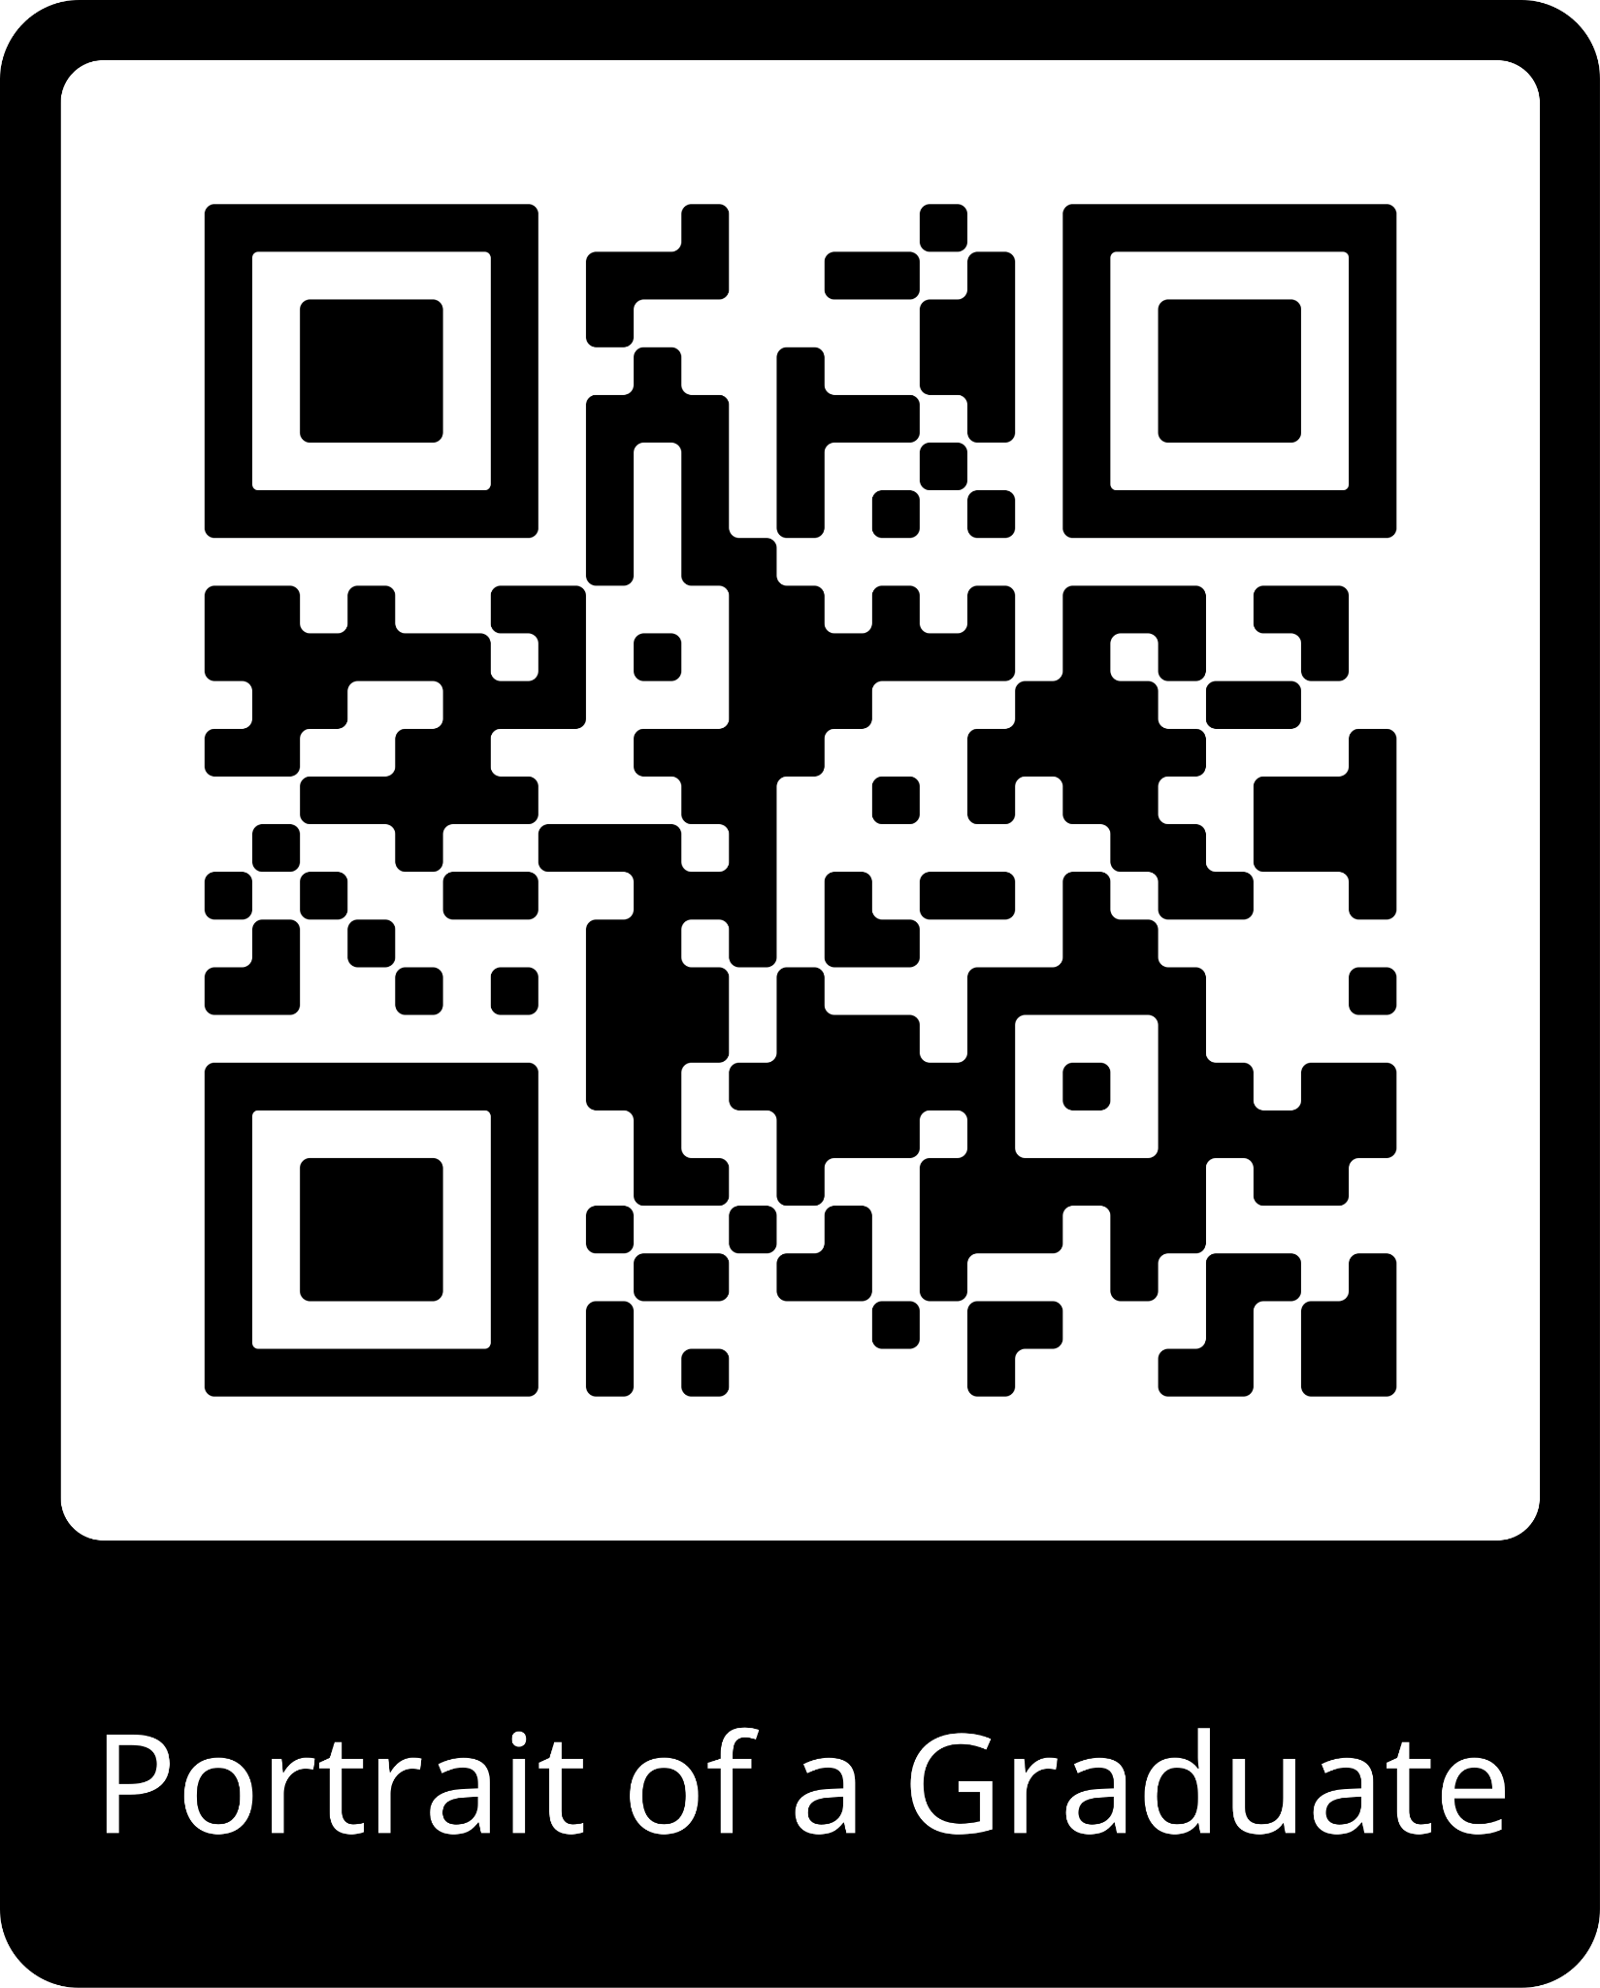
Notes:
Karen-Our unifying purpose

Slide 26
Next Steps
22-23
Strategic Plan
Communication Plan
POG Blueprints Developed
POG School Celebrations
Districtwide Digital Gallery
Instructional Rounds
Board Showcases, Board Awards
Staff Awards
23-24 and beyond
Embedded in Instruction/ Units
E-Portfolios, Artifact Curation
Capstones
Notes:
Karen-quickly review

Slide 27
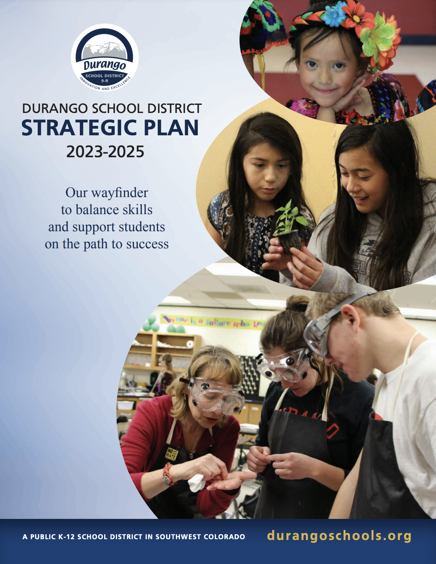
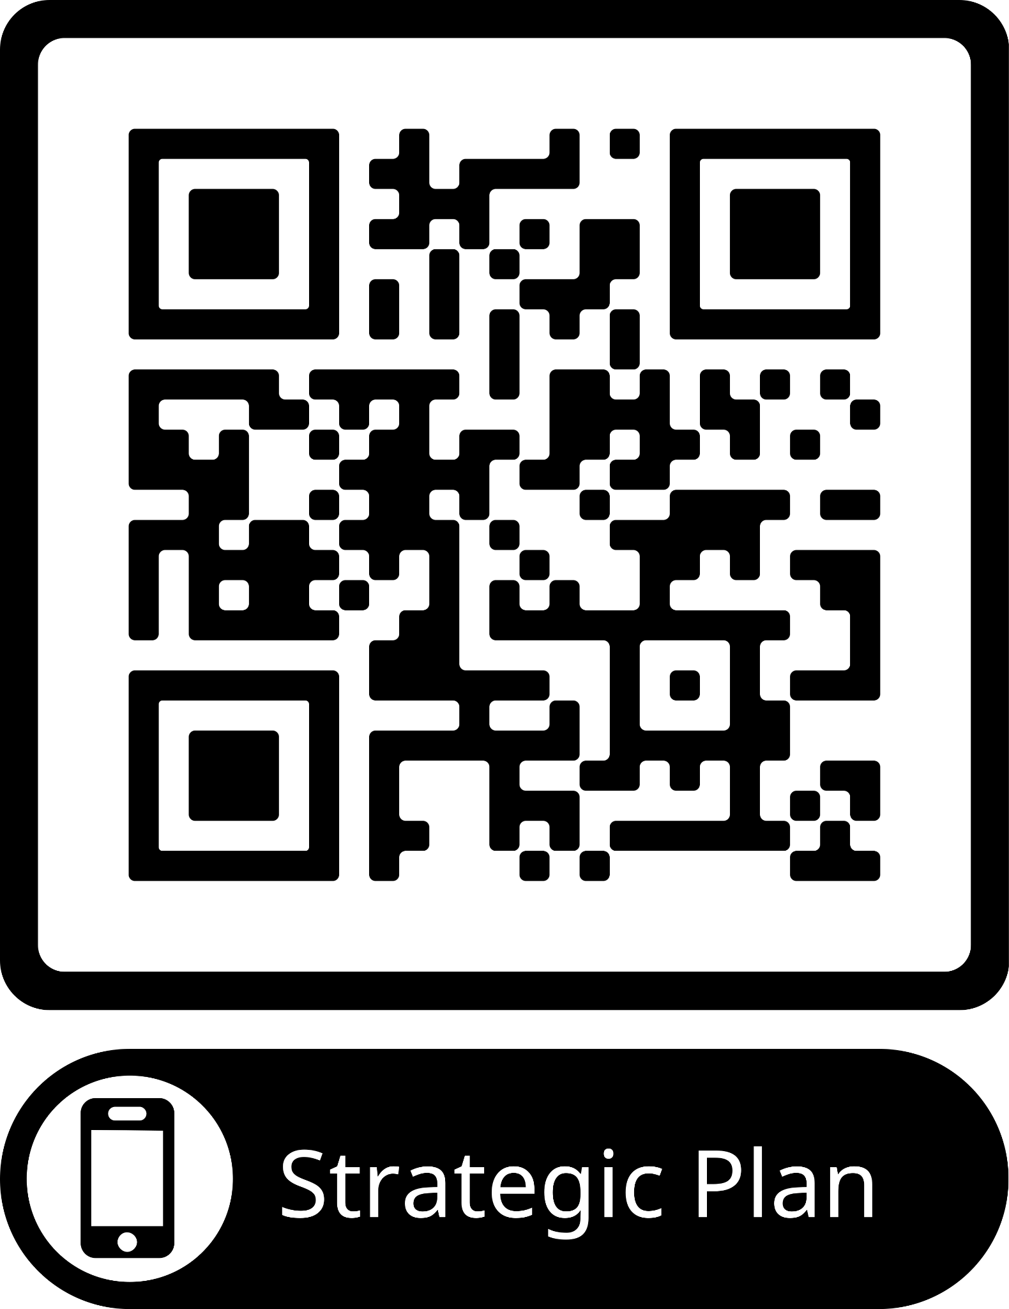
Notes:
Karen-quick overview of strategic plan, components and examples

Slide 28
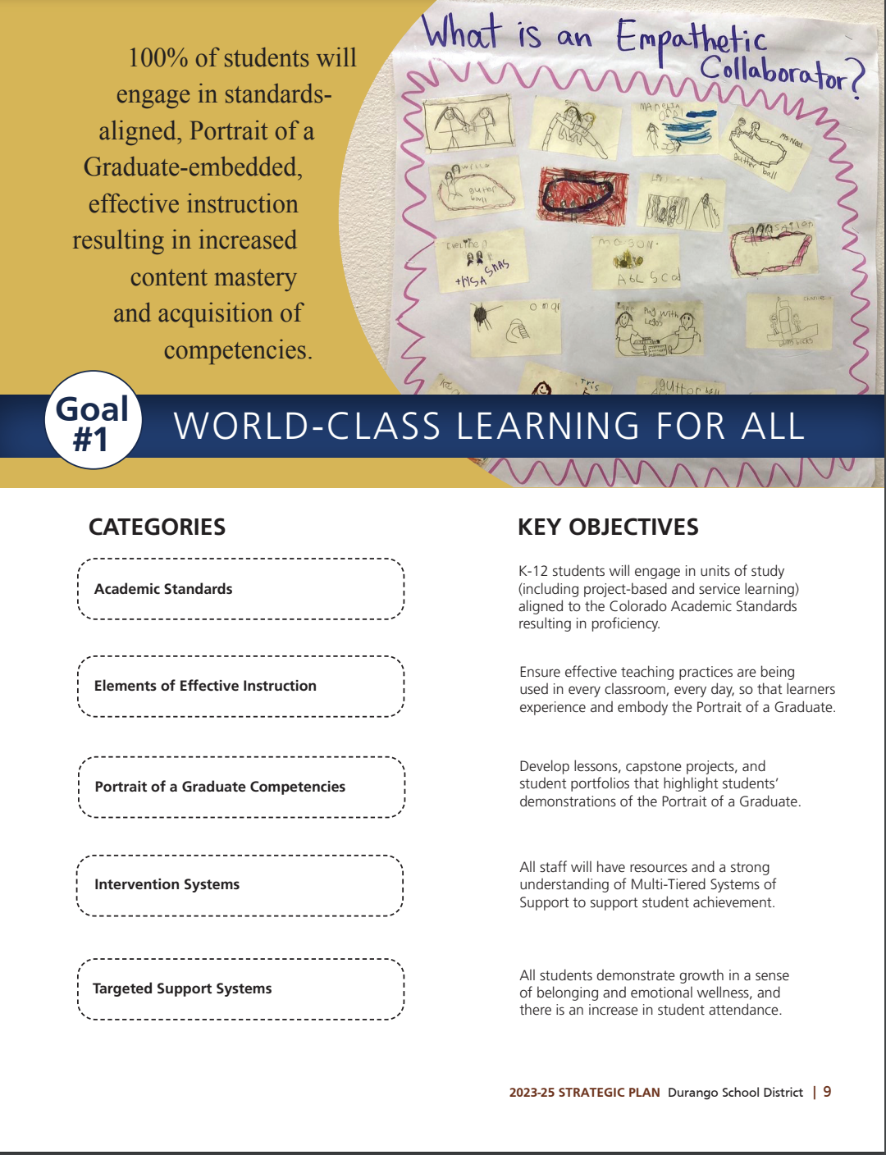
Notes:
Karen-quick overview

Slide 29
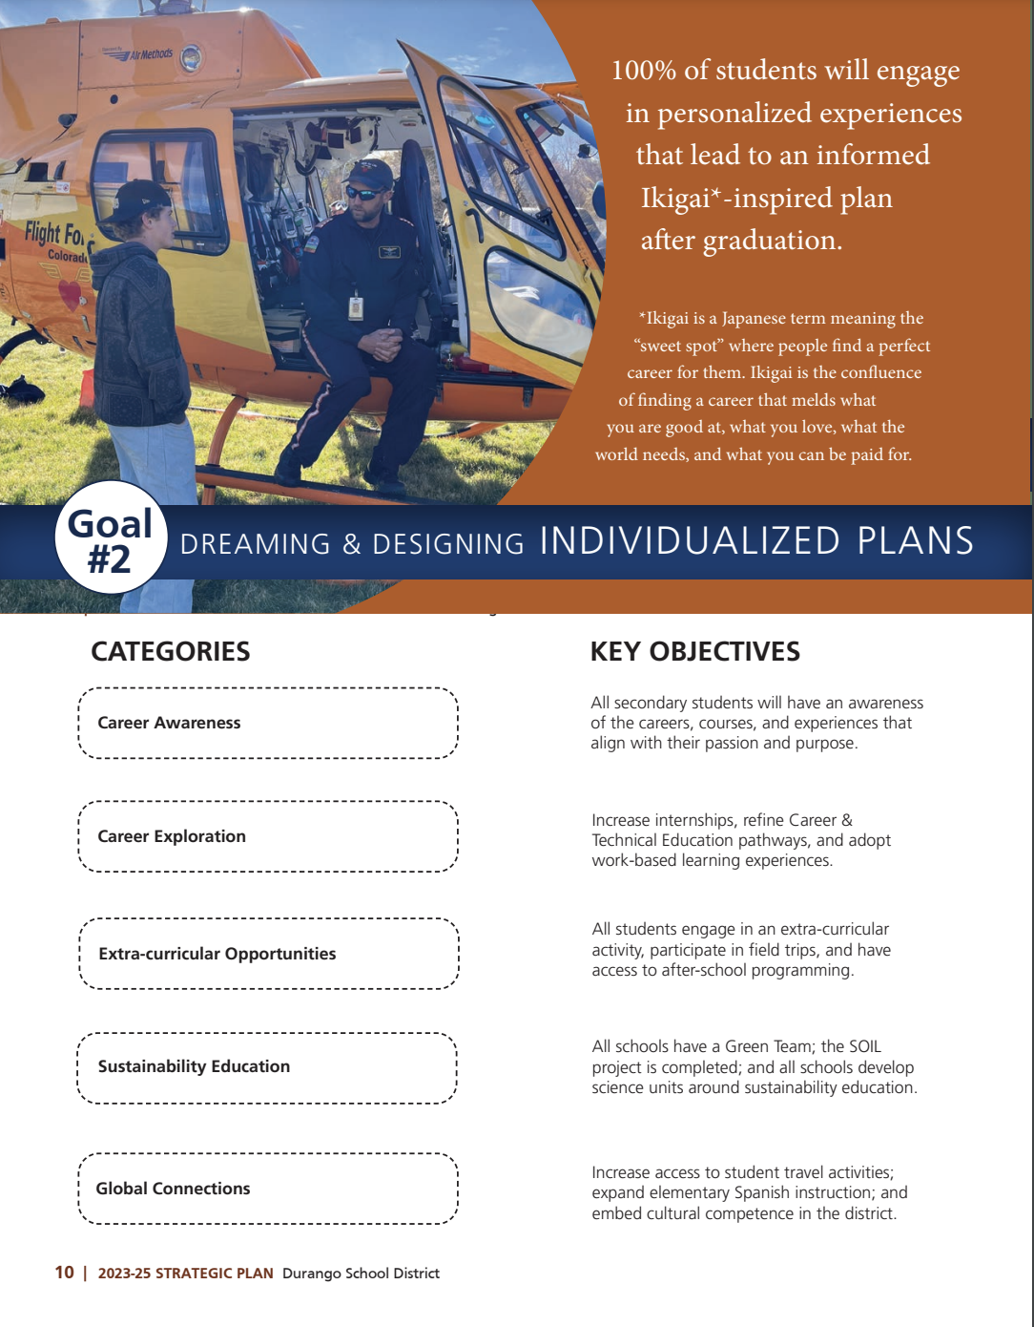
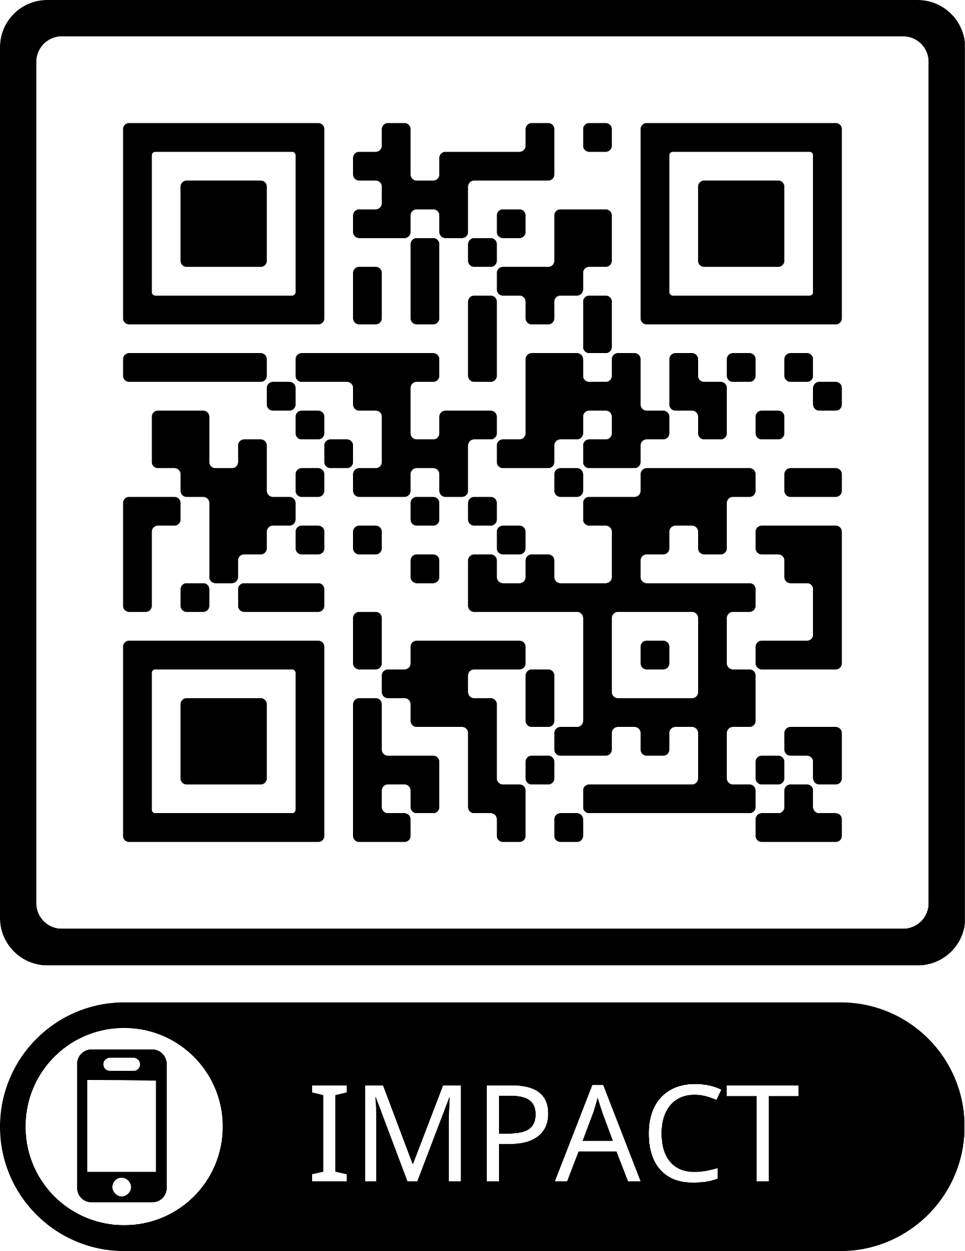
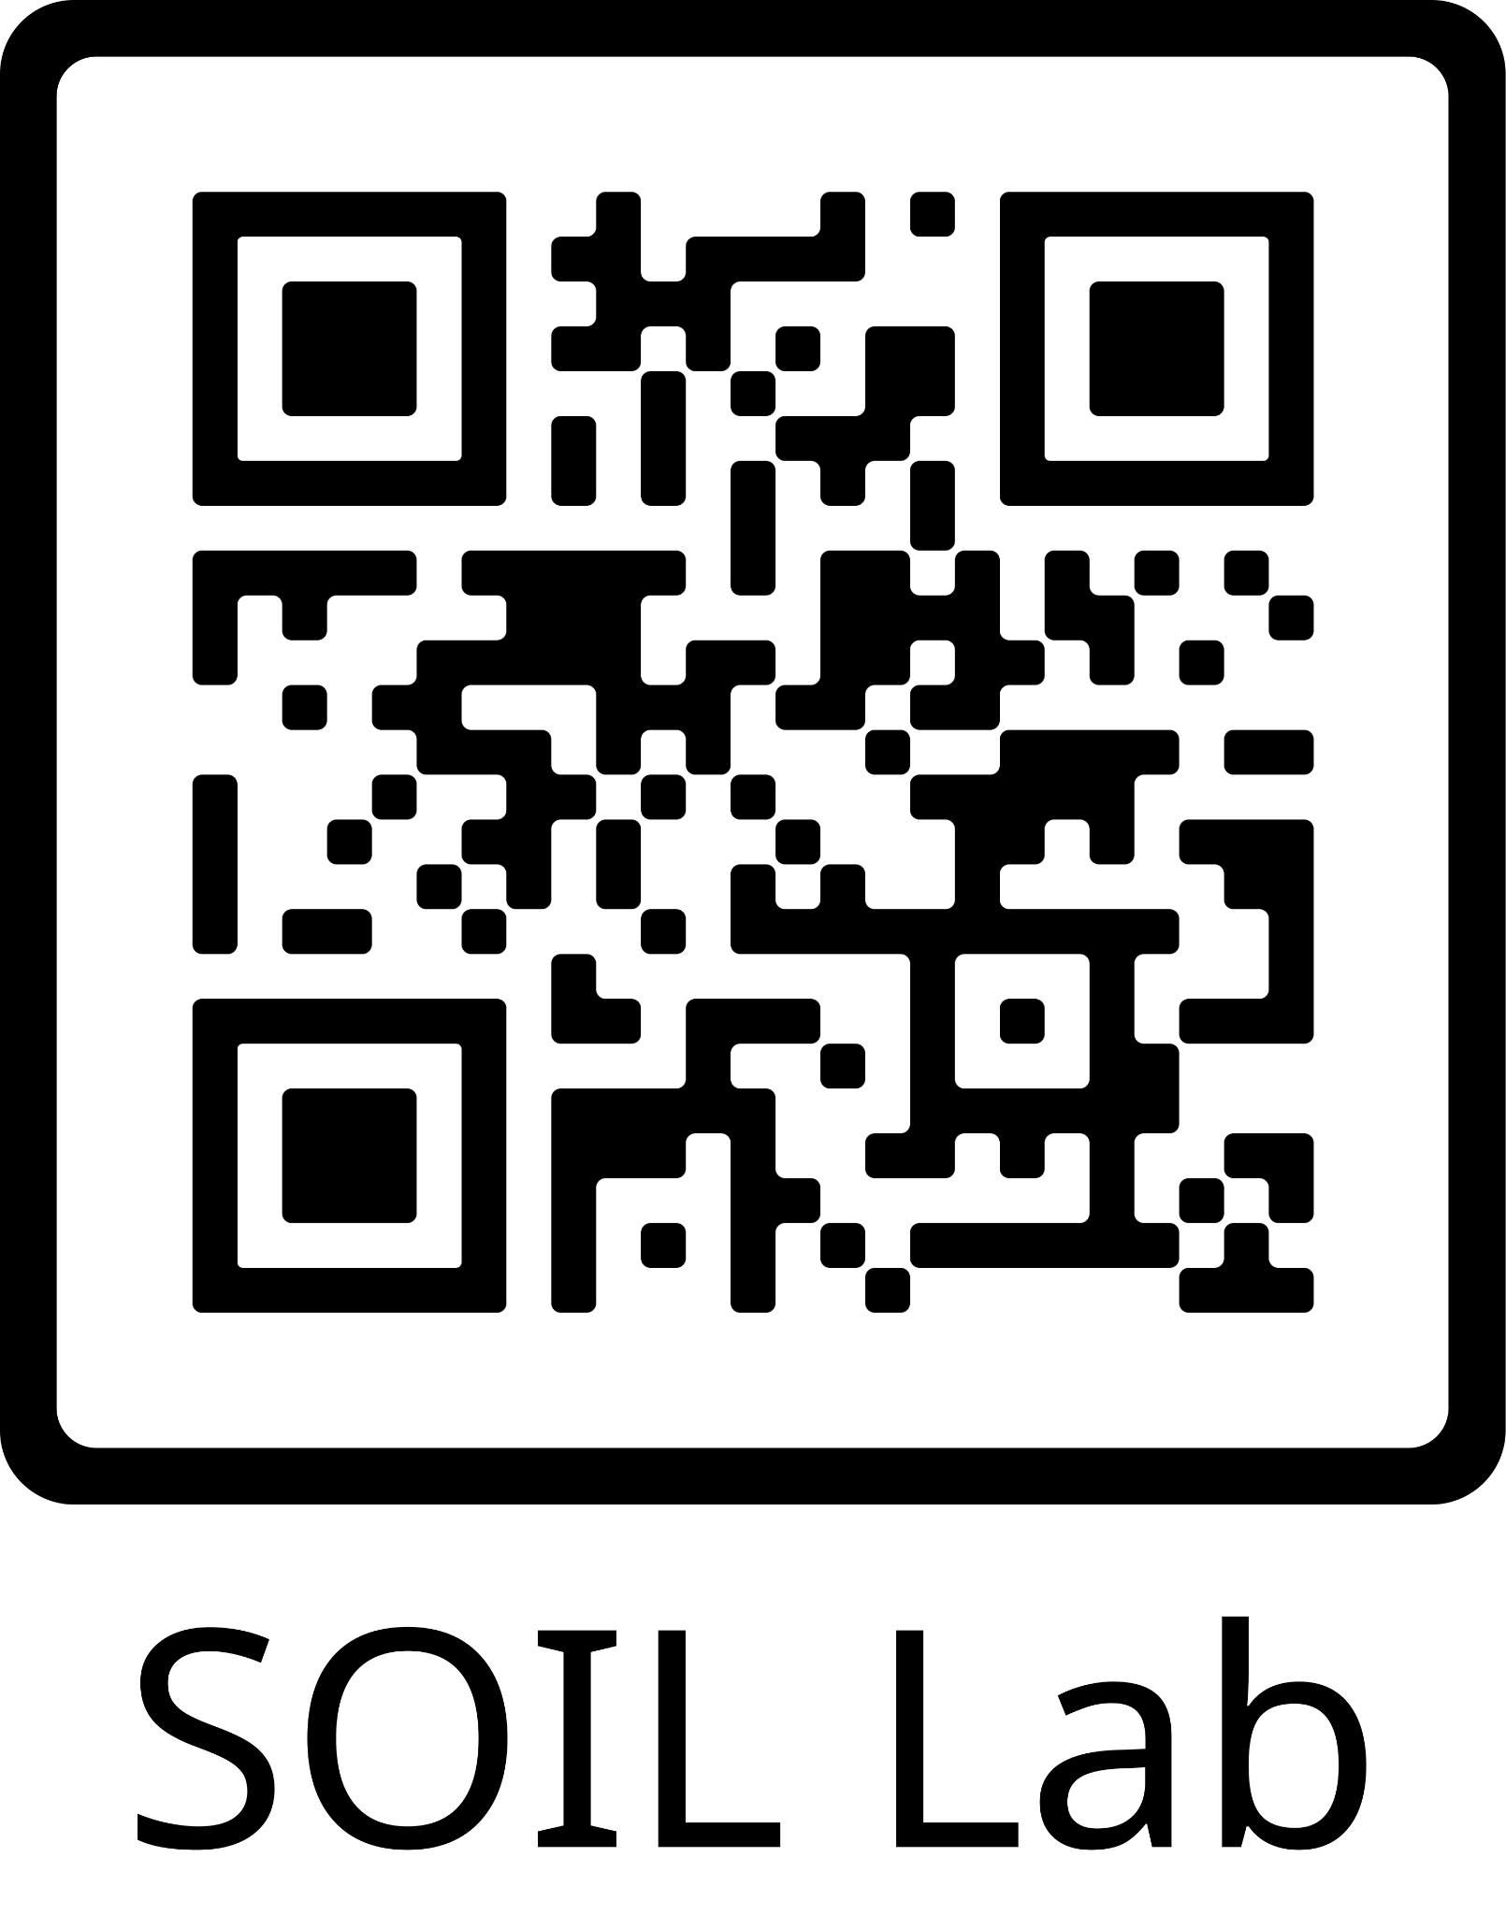
Notes:
Karen-quick overview

Slide 30
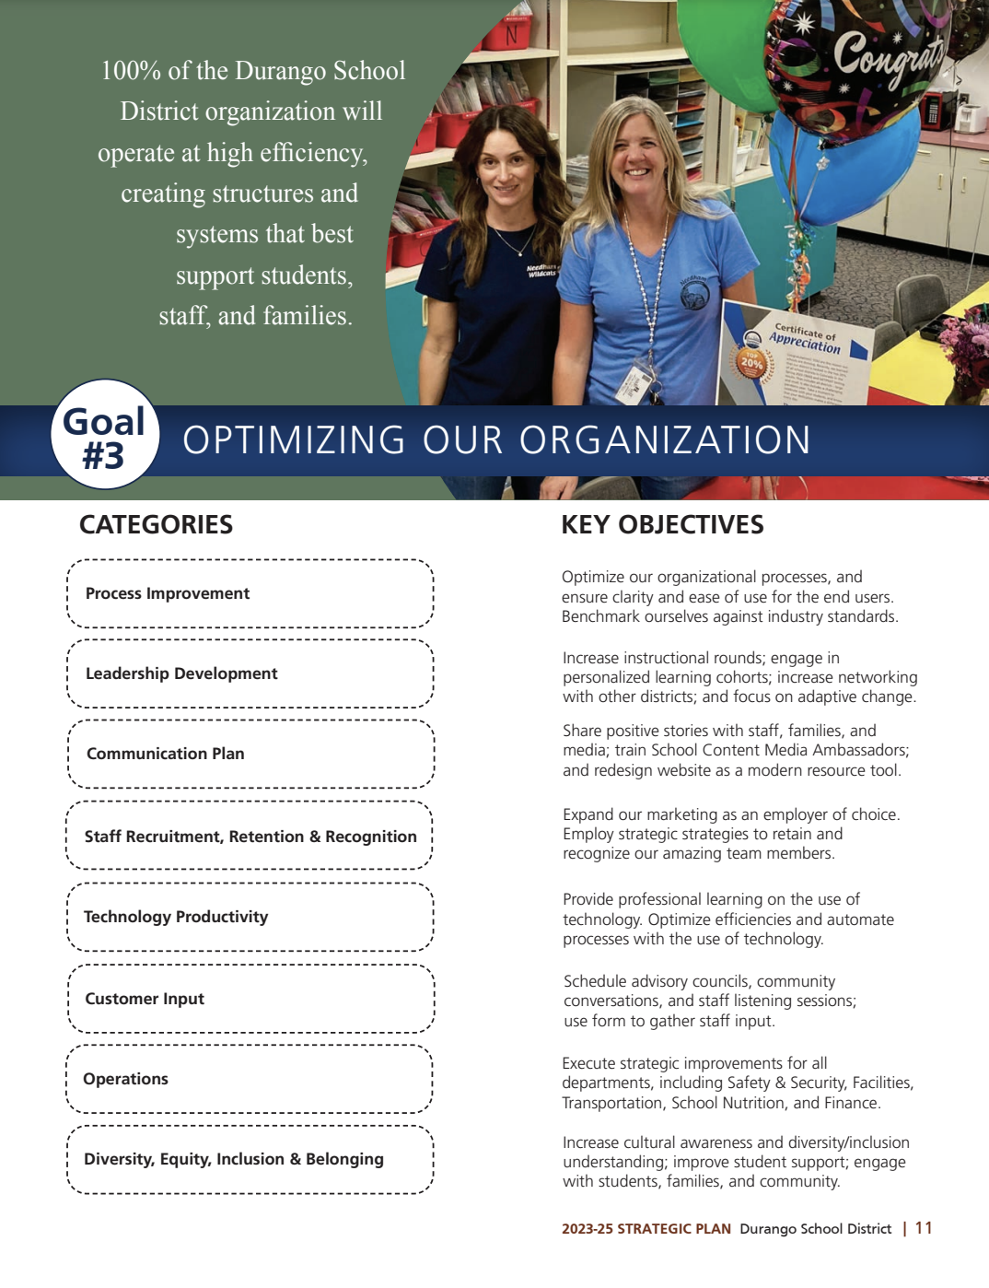
Examples from Abre, Link?
Notes:
Karen-quick overview-lead into a few examples/ strategies more in-depth-sustainability, career exploration and DEIB

Slide 31
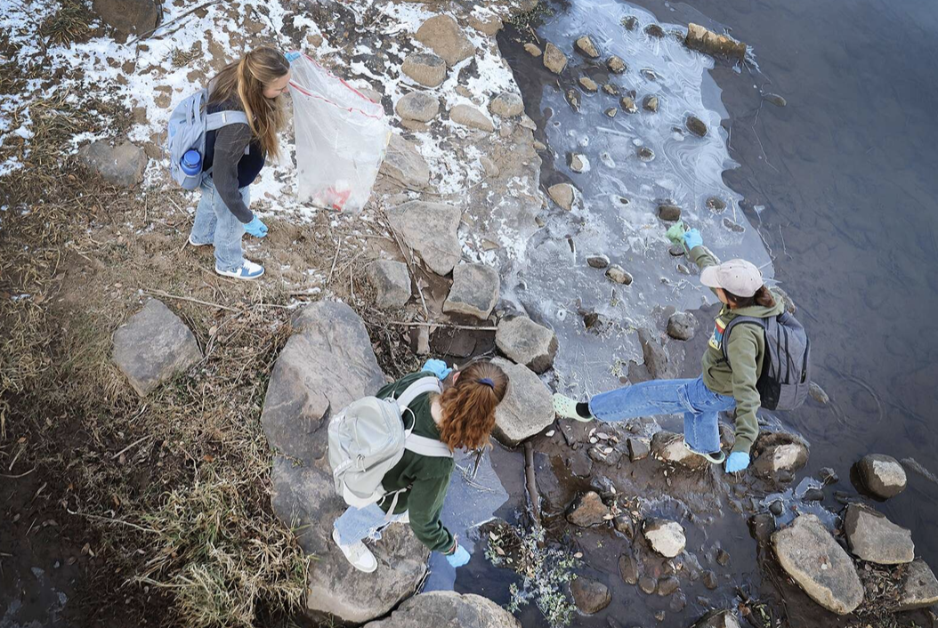
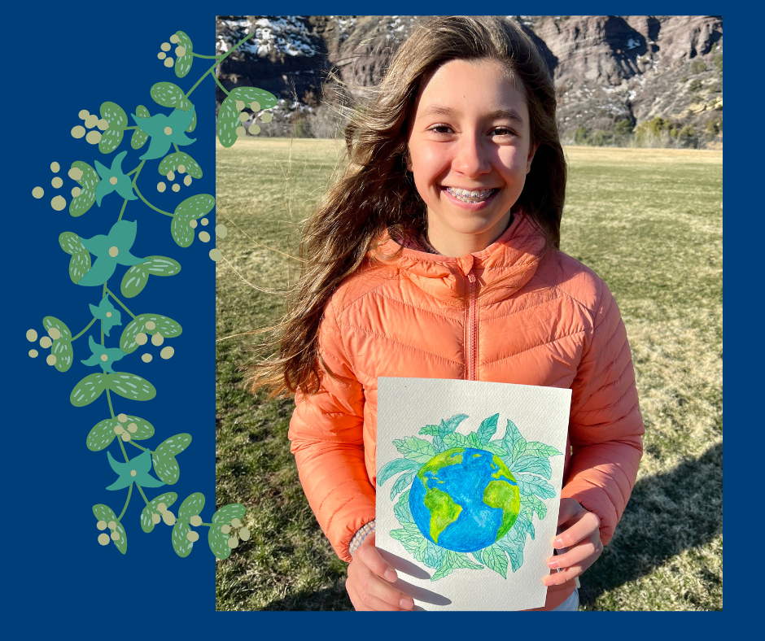
Sustainability
Sustainability Committee
Green Teams
Energy Audits, Benchmarking and Planning
Meeting CHPS (Colorado High Performance Standards) with construction projects
SOIL-Sustainability Outdoor Inspiration Lab
Notes:
Erika-describe the Board’s focus on sustainability as well as what we have addressed in the Sustainability Committee. You could discuss the upcoming energy projects as well

Slide 32
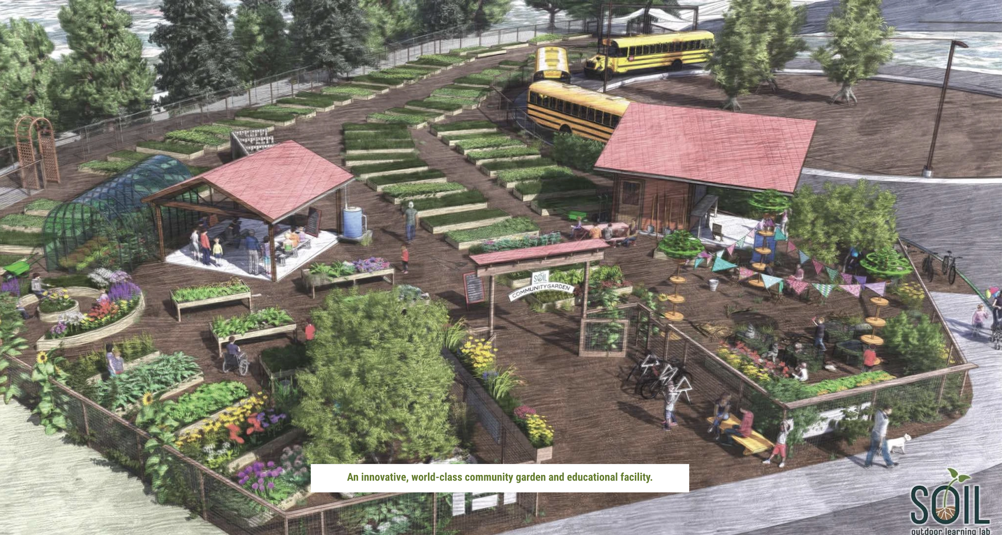
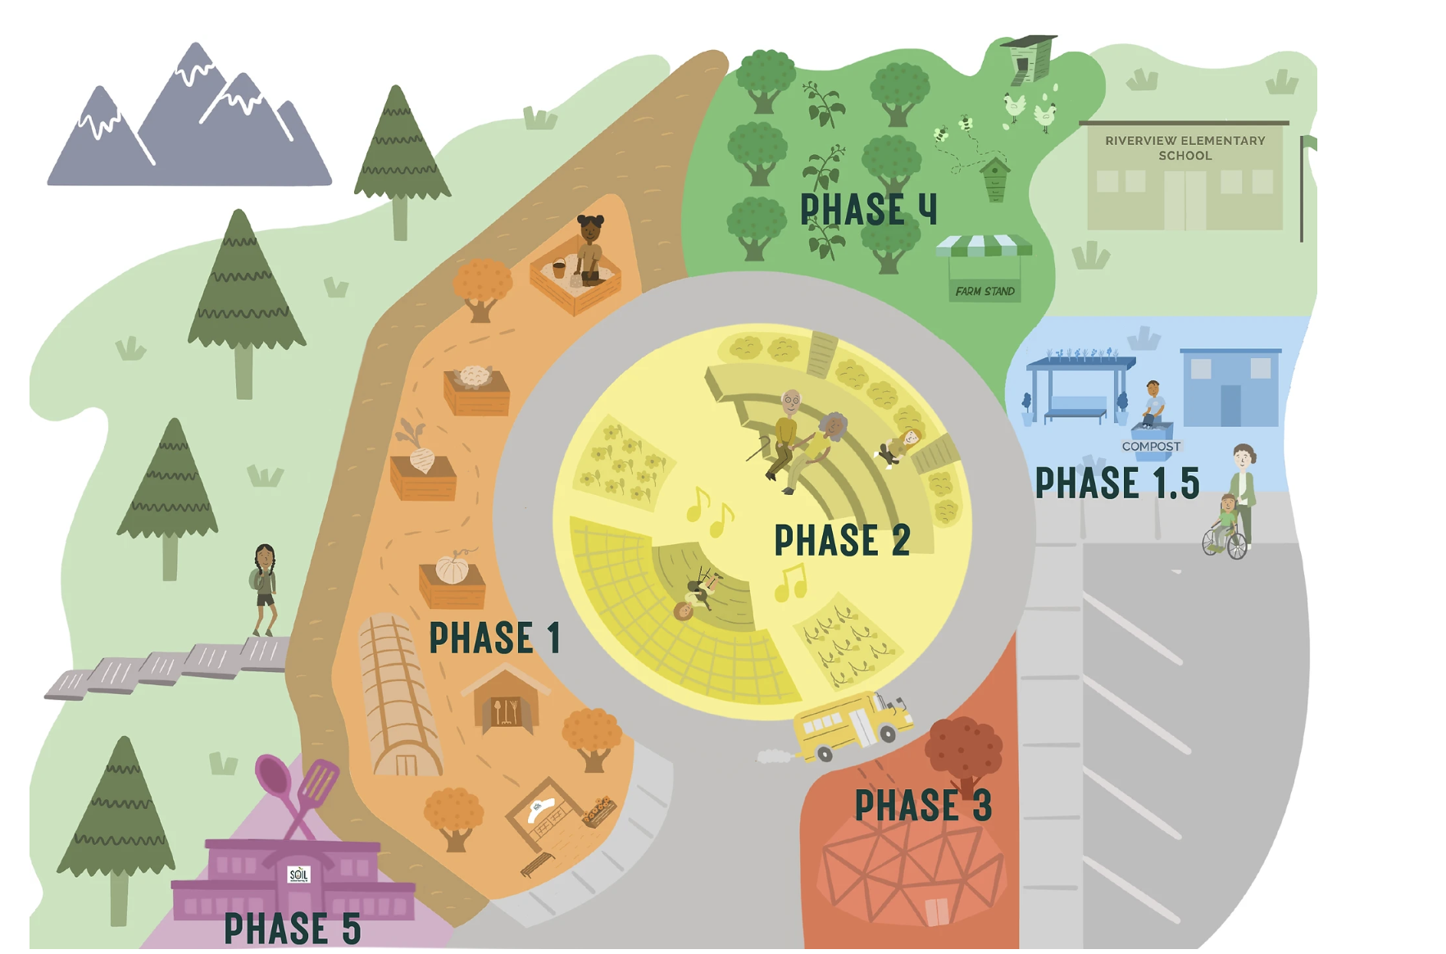
Sustainability
Notes:
Erika-describe SOIL and then if you click on the SOIL outdoor learning lab title the video will play

Slide 33
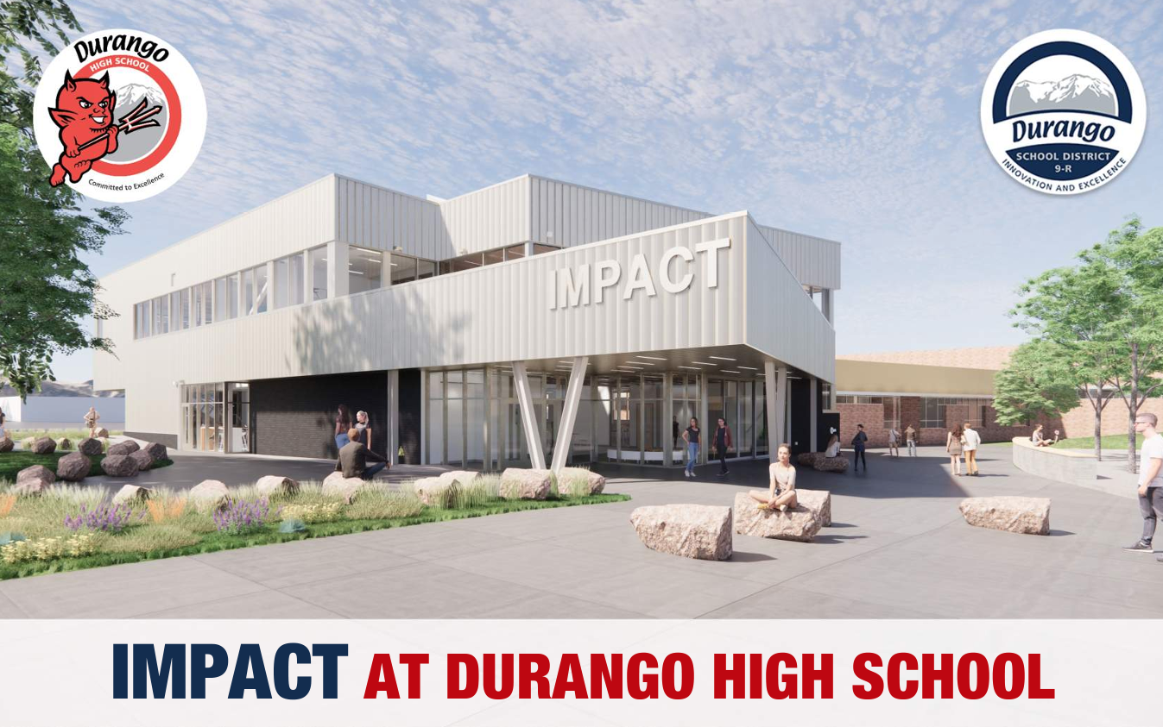
Career Exploration
Notes:
Karen-career exposure, exploration, experience

Slide 34
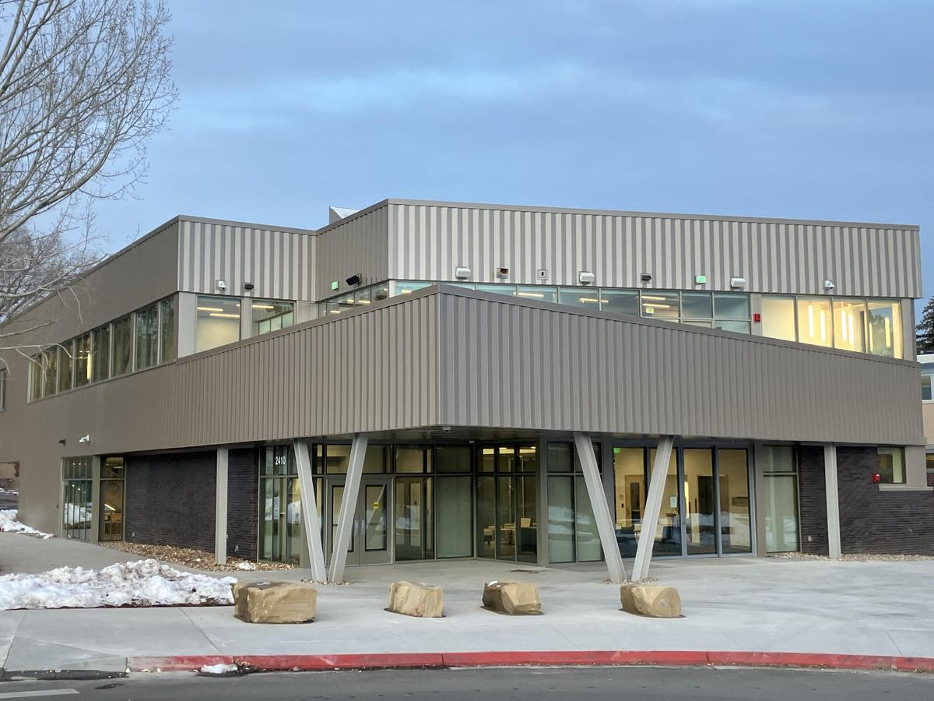
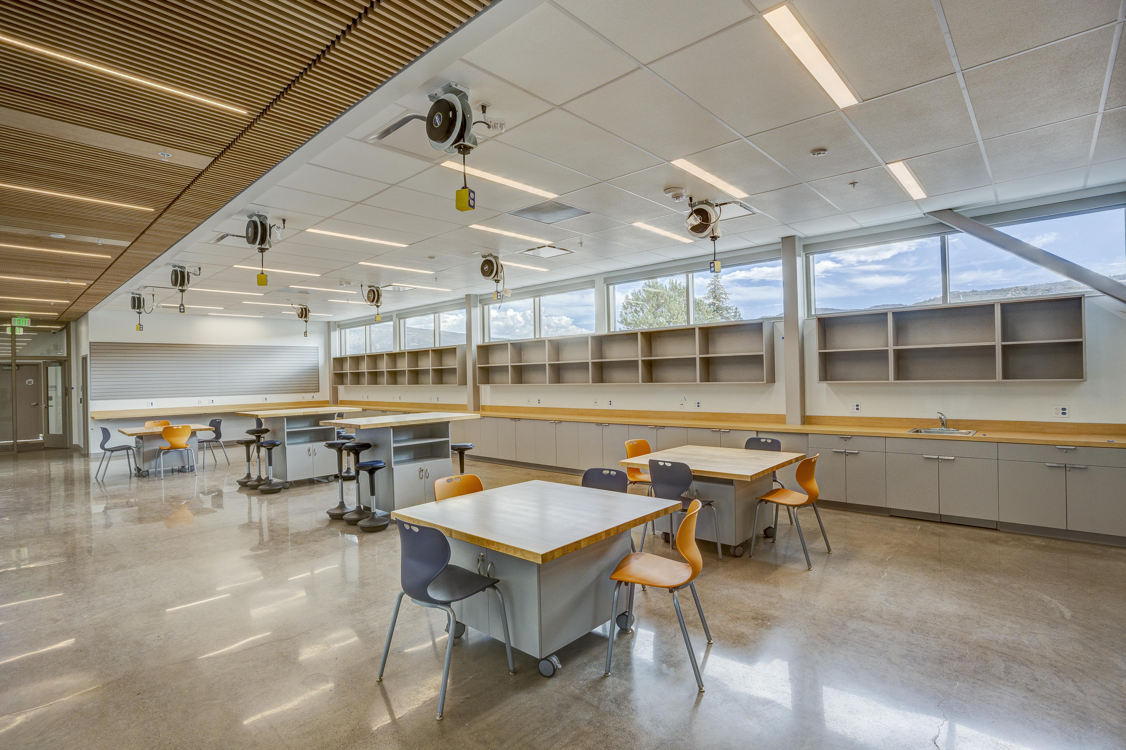
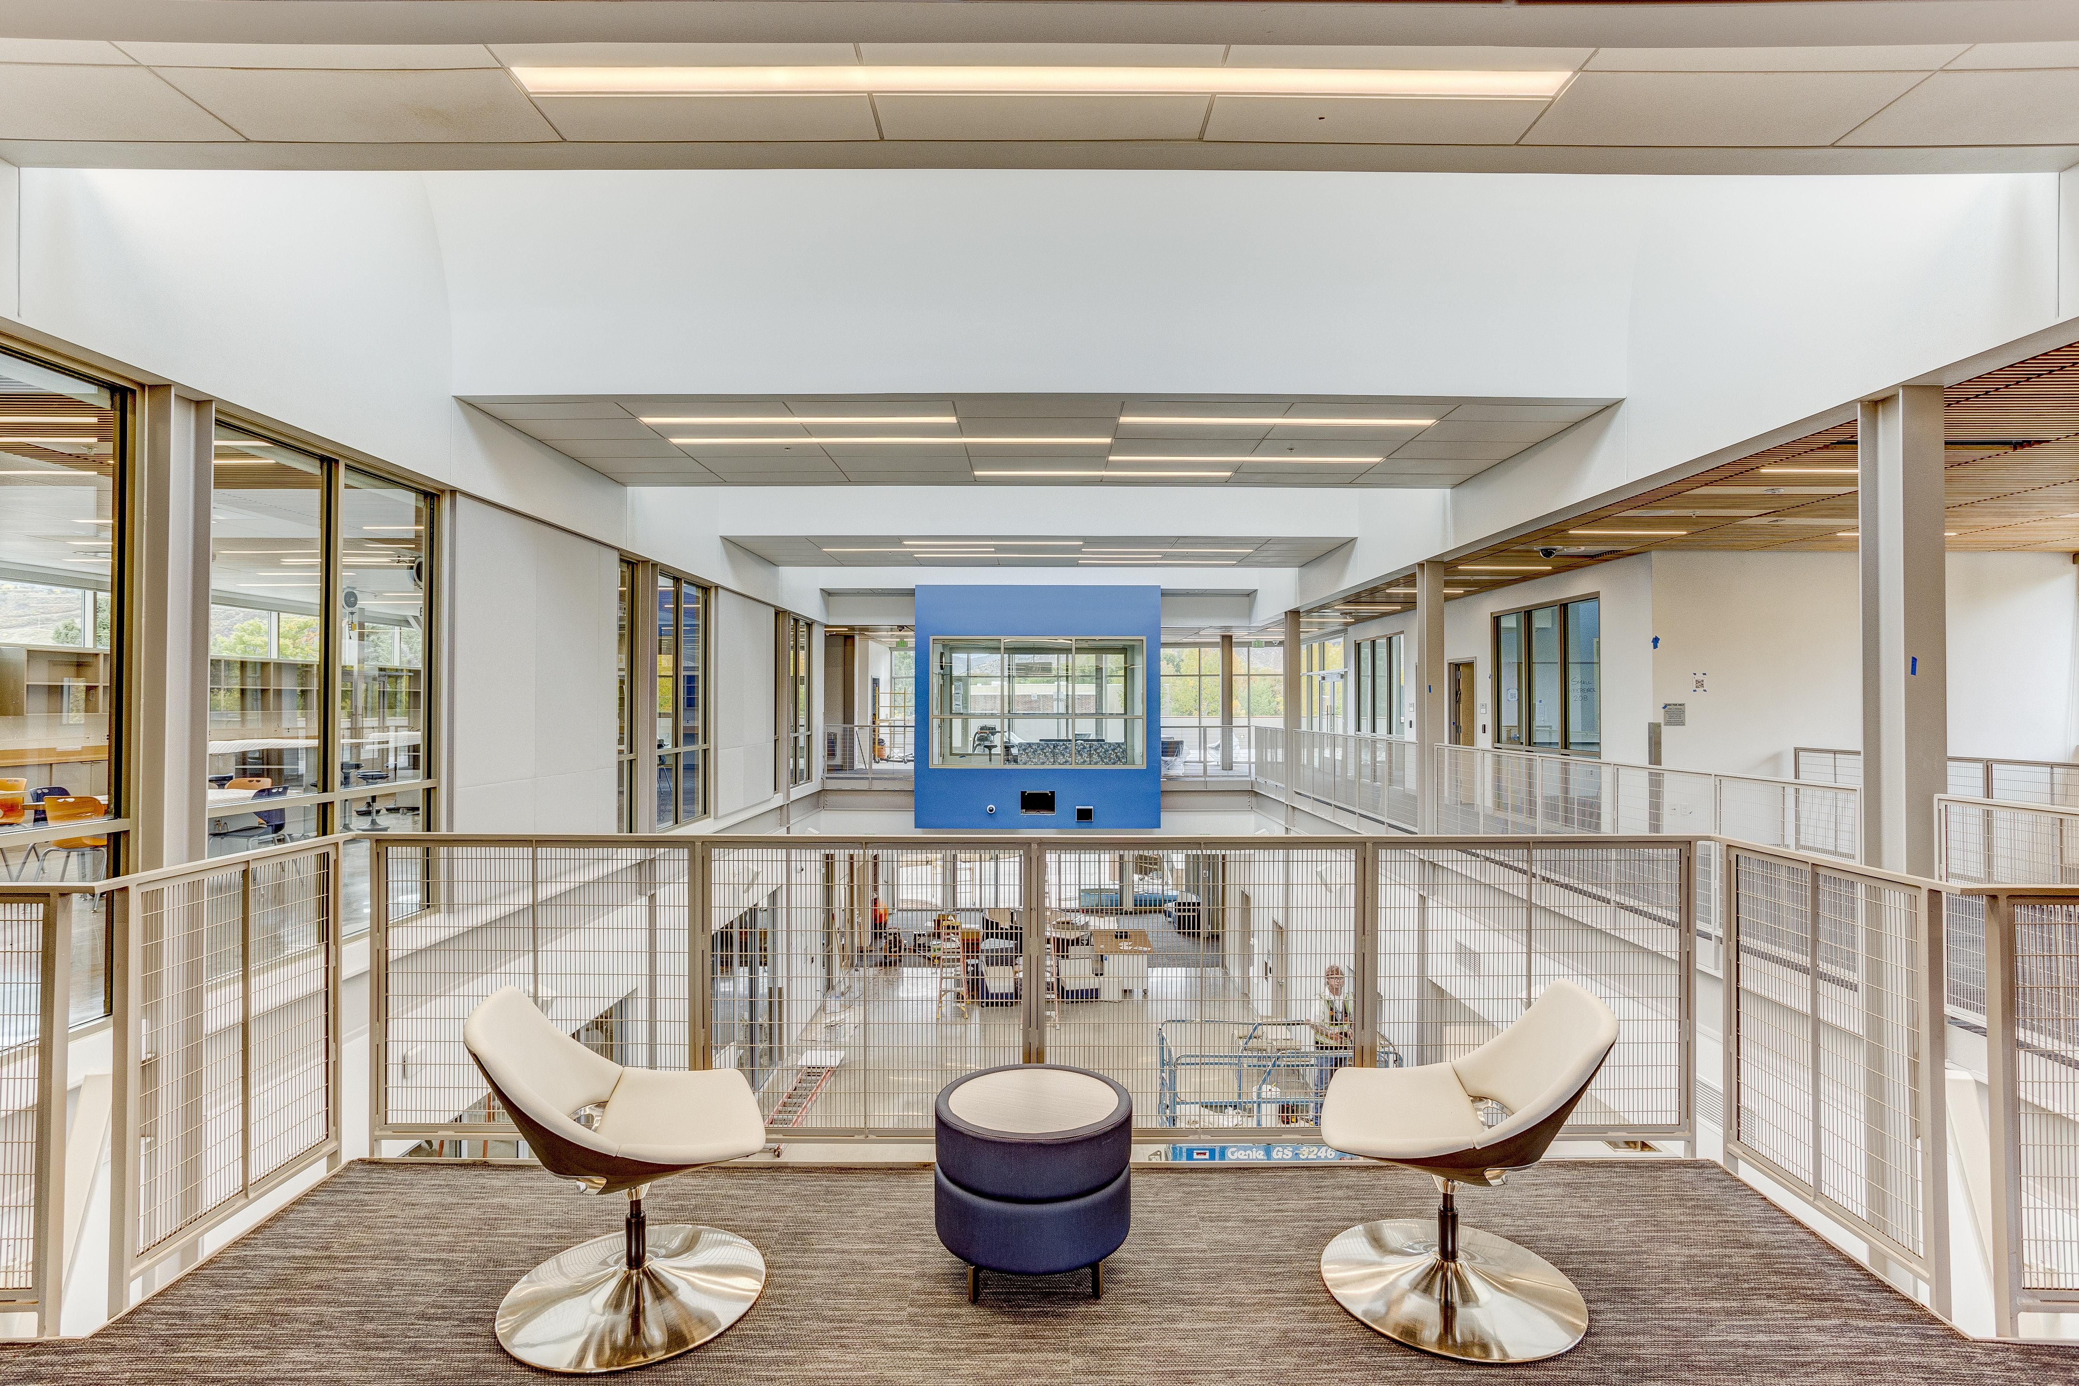
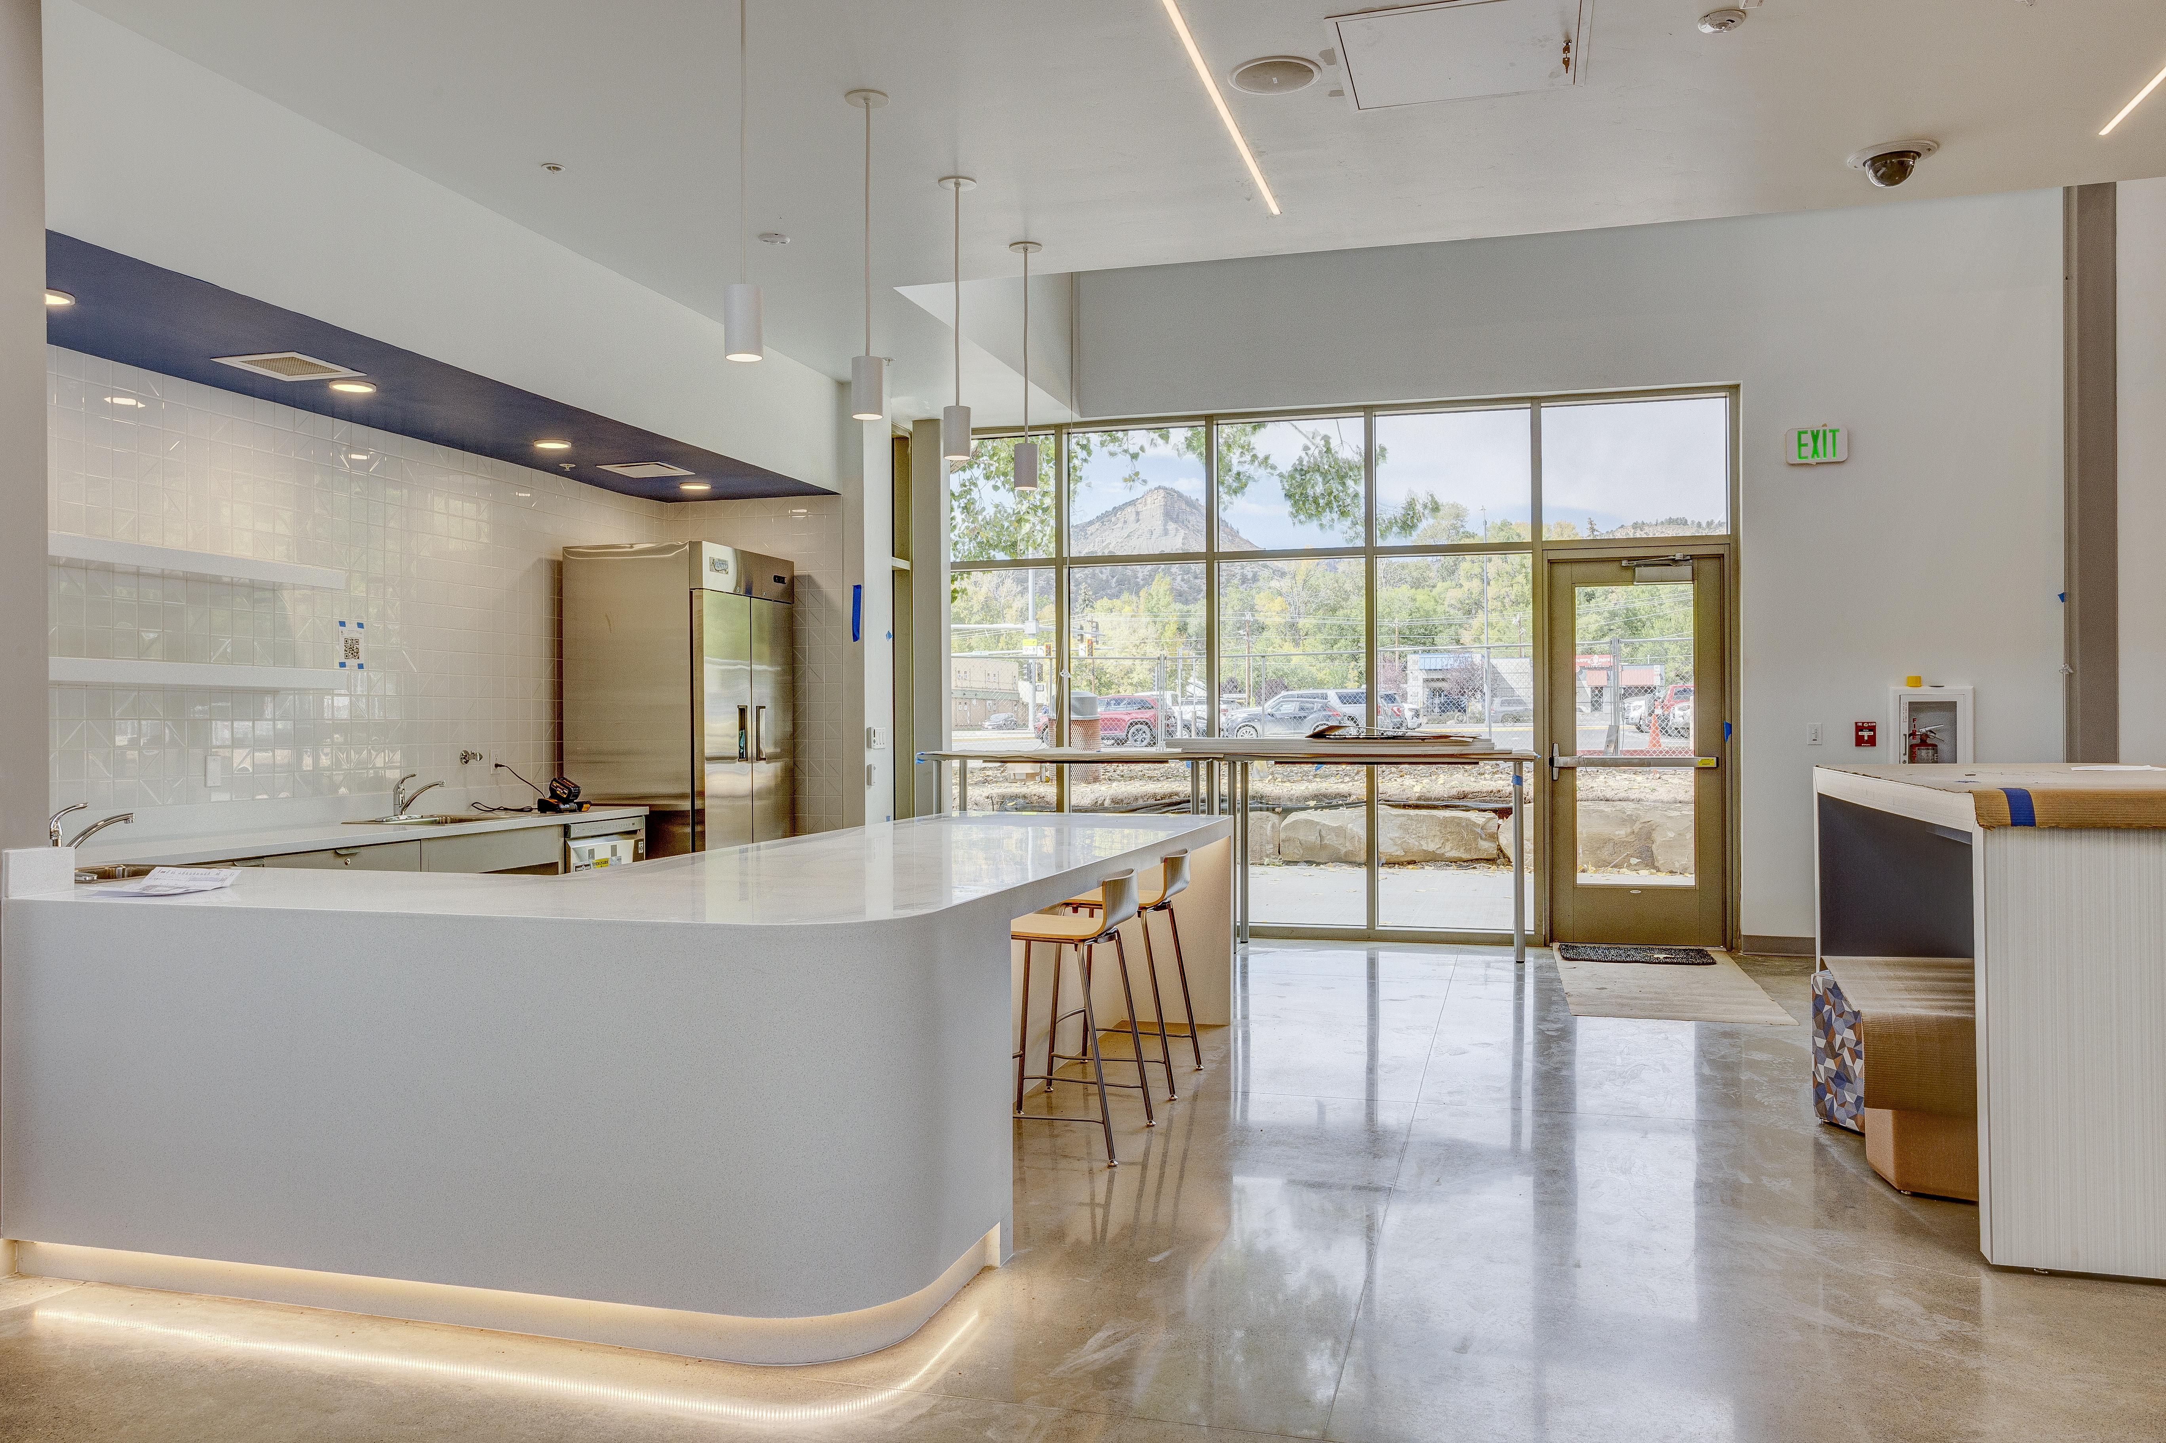
Notes:
Karen-more on Impact

Slide 35
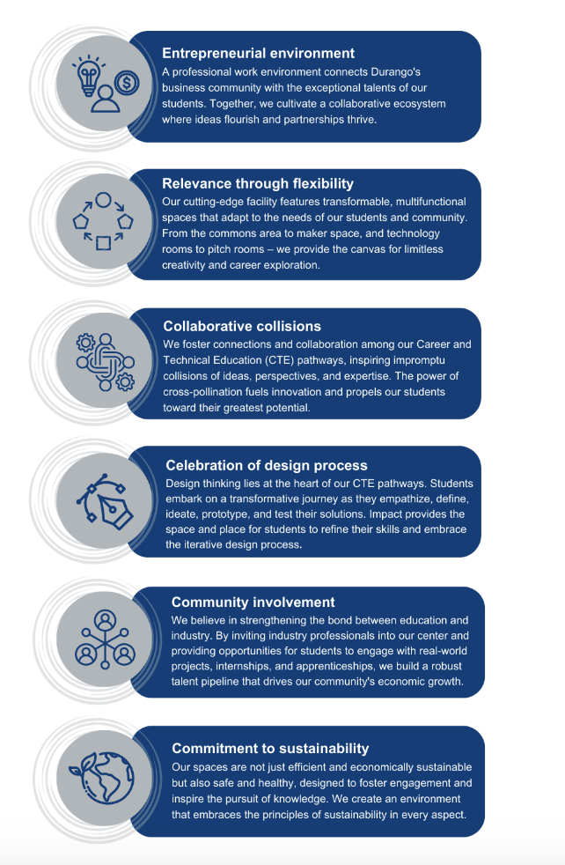
Notes:
Karen-why designed this way

Slide 36
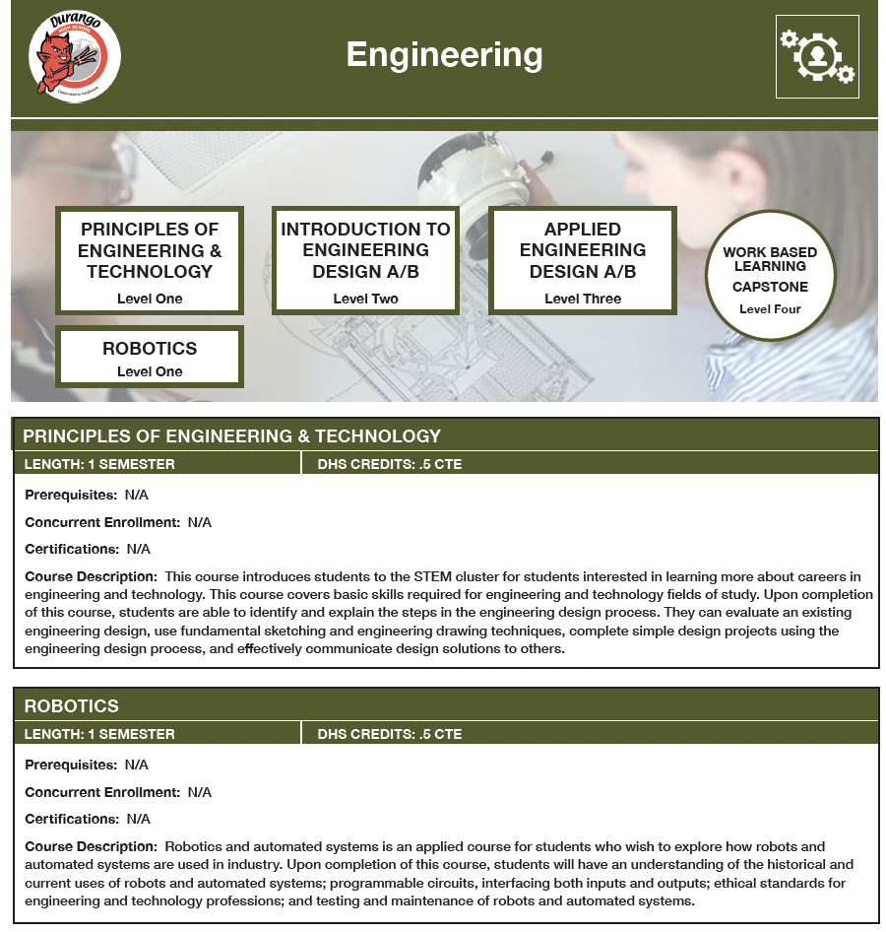
Notes:
Karen-career pathways

Slide 37
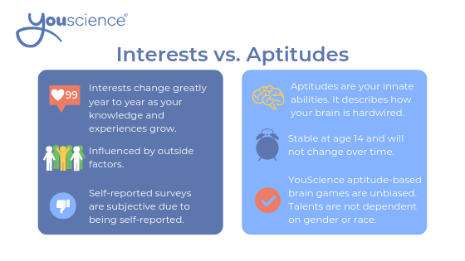
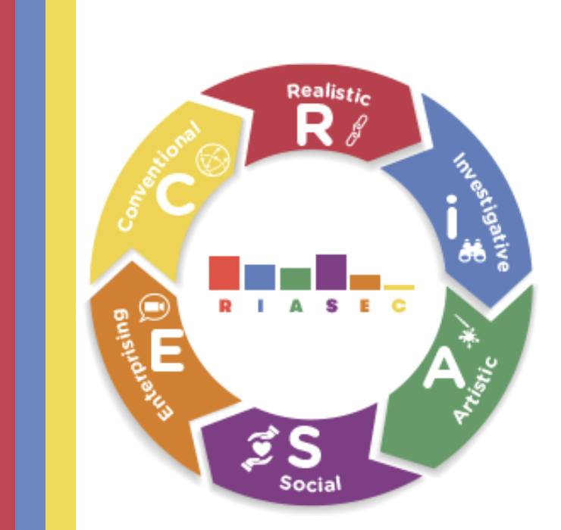
Notes:
Karen-more about careers-getting to Ikigai

Slide 38
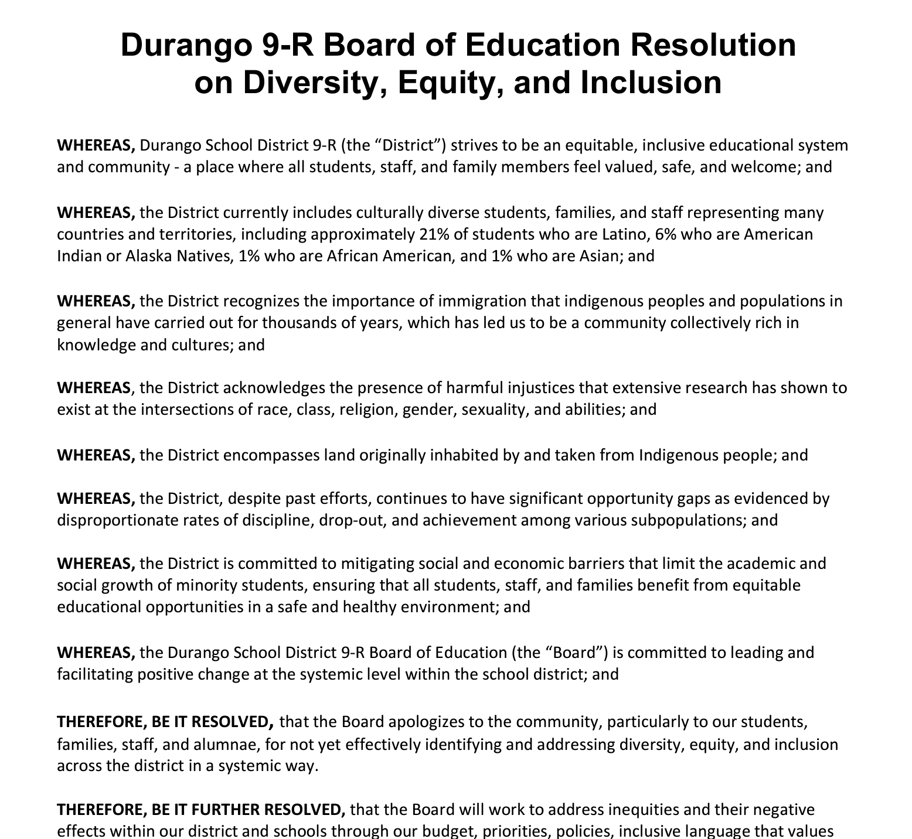
DEIB-Diversity, Equity, Inclusion, Belonging
Notes:
Katie-describe the Board’s focus on DEIB and the resolution

Slide 39
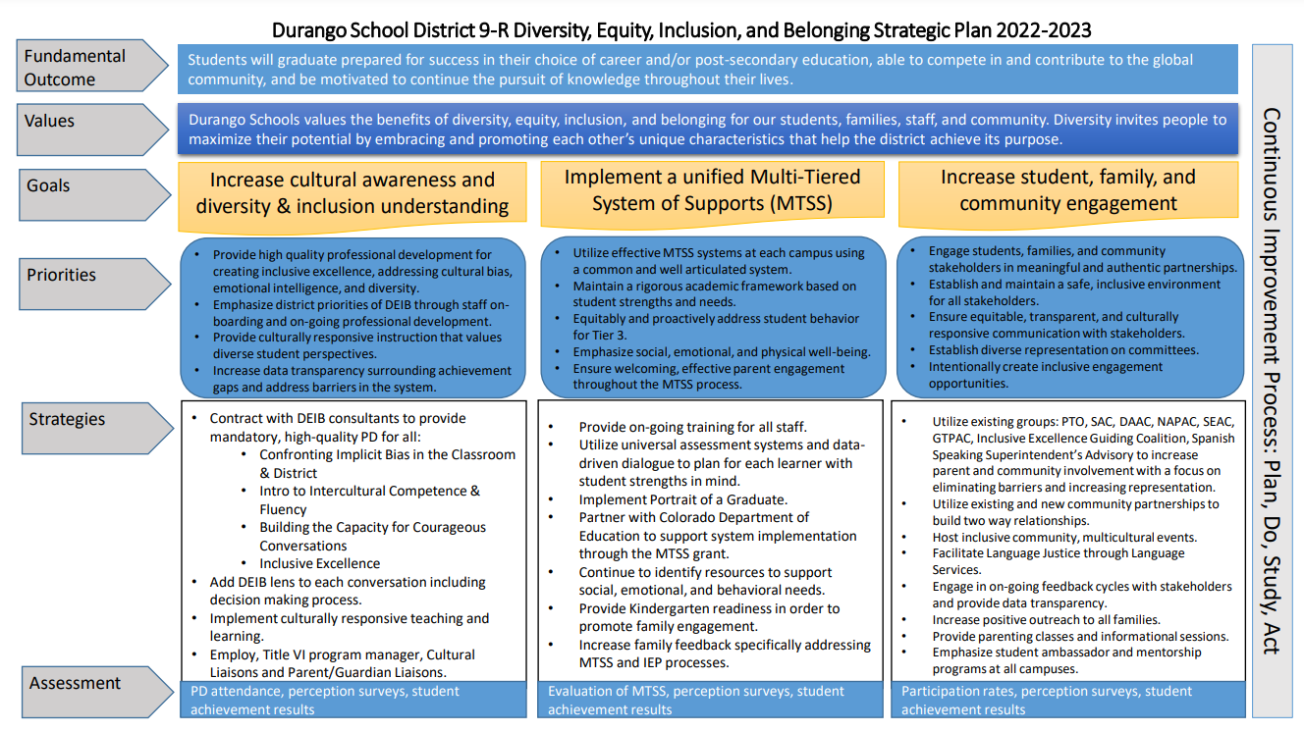
Notes:
Katie-discuss the plan for DEIB that we developed in 2021 and continue to implement. You can describe the three overall strategies

Slide 40
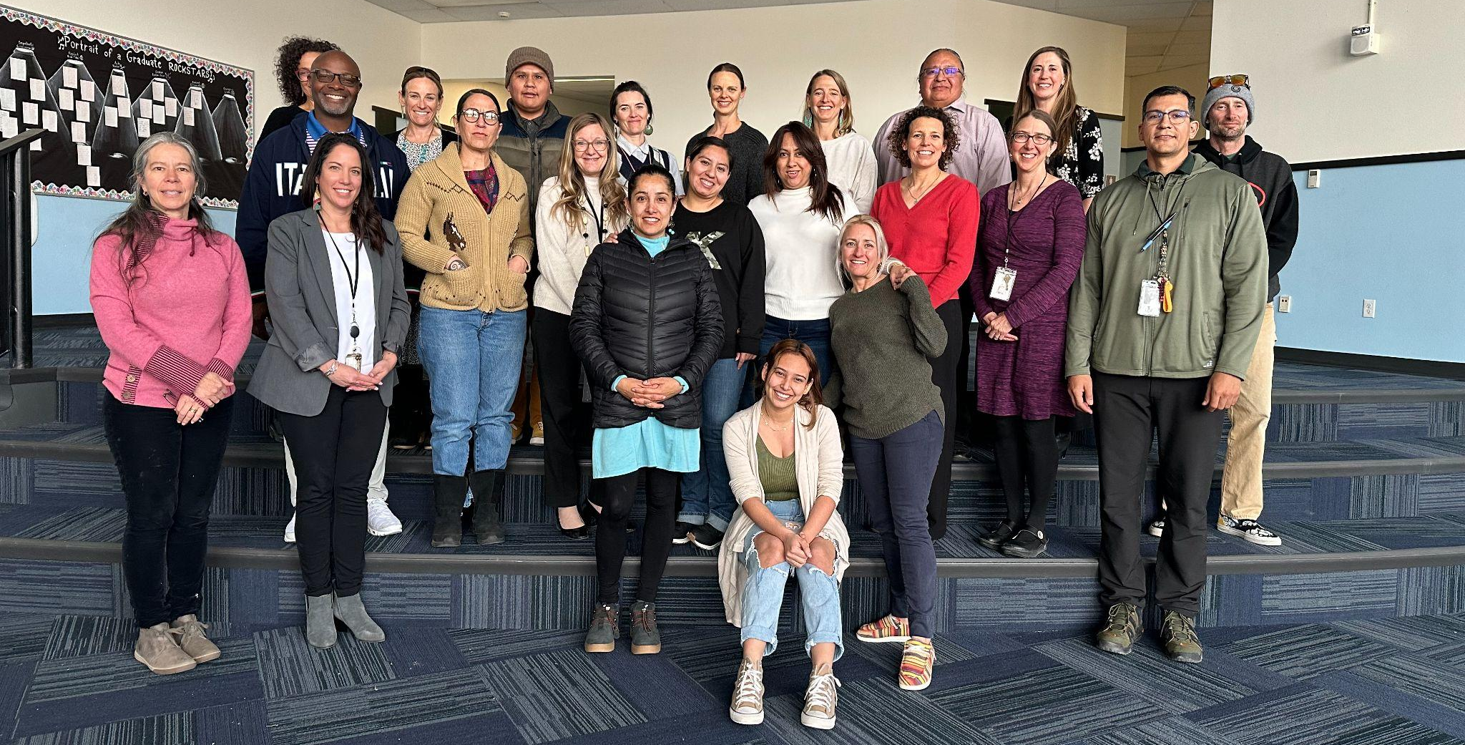
Inclusive Excellence Guiding Coalition
Notes:
Katie-we have a group of employees, community members, and students who meet 6 times a year to monitor the plan, discuss strategies, and identify ways to progress with our DEIB work

Slide 41
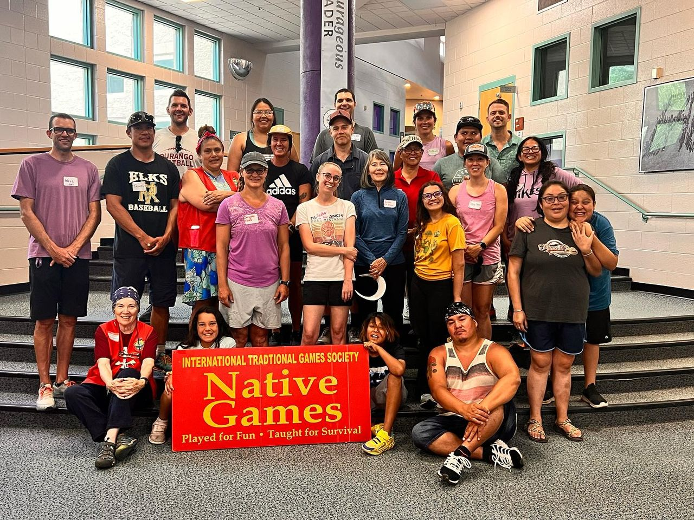
Accomplishments
All Staff Engaged in Professional Learning to Increase Cultural Awareness and Understanding:
Confronting Implicit Bias in the Classroom & District
PANEL DISCUSSION: Inspiring Future Generations: Strategies for Native American Student Engagement and Success
Intro to Intercultural Competence & Fluency
What? Now What?: Next Steps toward Inclusive Excellence
Science of Hope
Site Based DEIB Action Planning and Implementation
Inclusive Schooling Professional Development
Choice Based PD encompassing all areas of DEIB Strategic Plan
Native Games training for Physical Education Teachers
Notes:
Erika-goal 1 of DEIB plan

Slide 42
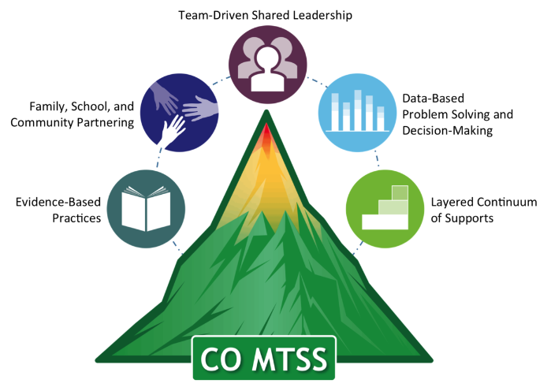
Continued Alignment of the Multi-Tiered System of Support (MTSS):
Principal MTSS Meetings
Every 4-6 weeks
Expanding to address Social Emotional Learning & Behavior
Site Based MTSS Meetings
Increased clarity & alignment across campuses
Increased Staff Awareness of Culture and Language Impact
Site based and district level discussions centered on culture and language to seek to understand student strengths and opportunities
Notes:
Erika-Goal 2 of DEIB plan

Slide 43
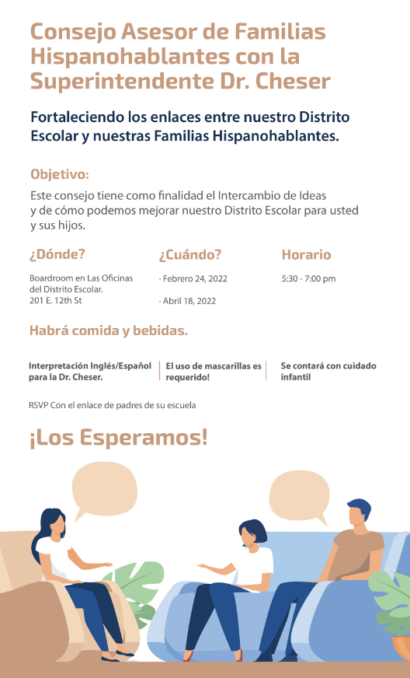
Increased Family Engagement:
Title VI Program & Liaisons
School Based Events
2nd Annual Multicultural Celebration
Parent/Guardian Liaisons
Superintendent’s Spanish Speaking Parent Advisory Council
Increased Meaningful Family Participation through Language Services
“We All Belong” Section in We Are 9-R and Community Updates
Increased Positive Communication Across our Communication Channels
Notes:
Erika-Goal 3 of DEIB strategic plan

Slide 44
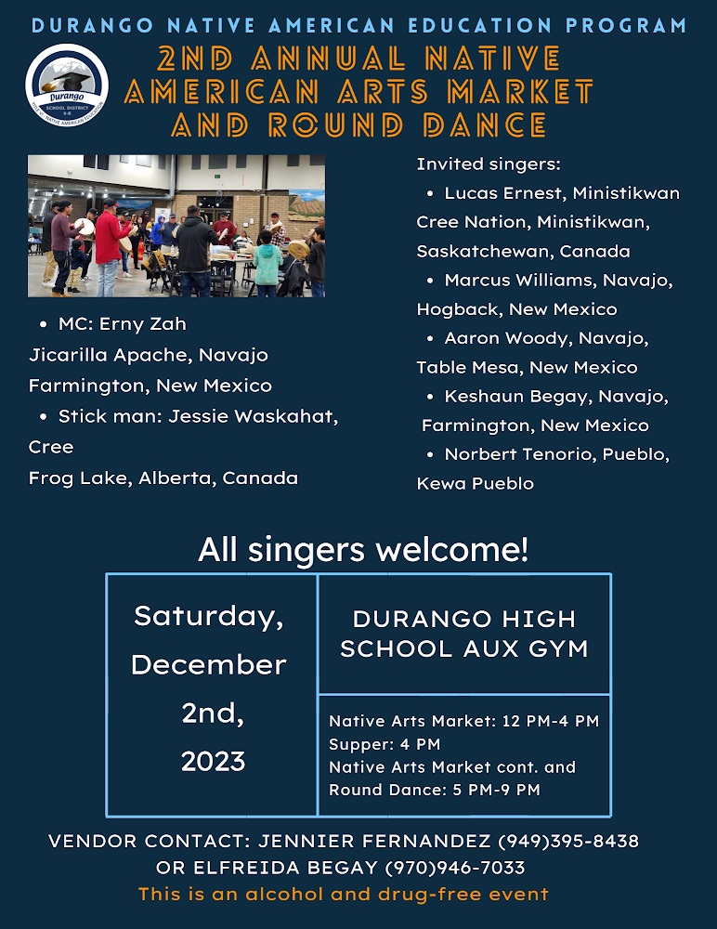
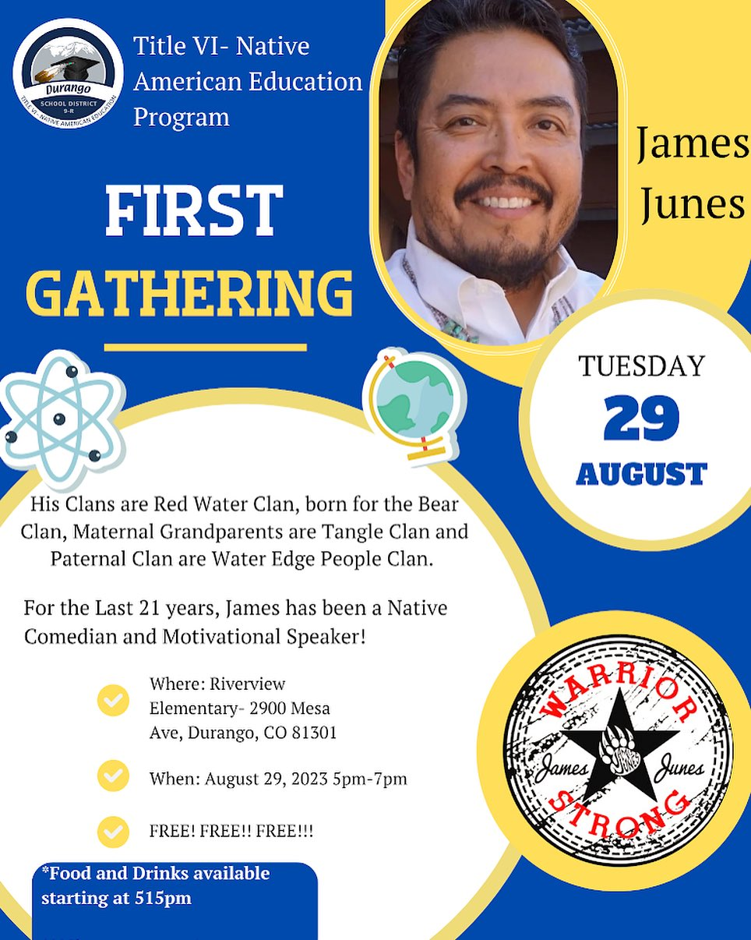
Notes:
Katie-these are some of the events we have hosted, also our NAPAC and Native American school liaisons and Title VI program manager have been very active in making our families and students feel valued and welcome

Slide 45
Notes:
Katie-highlight Elfreida being the only teacher licensed to teach Navajo in Colorado

Slide 46
Bilingual Book Club
The goal: To build a love of reading and strong reading skills through exposing children to a wide range of age-appropriate multicultural and bilingual books.
The program develops their reading fluency and comprehension skills as well as provides the opportunity for a diverse group of students to participate in enriching activities in English and Spanish.
Notes:
Katie-an example from Park-now expanding to other schools

Slide 47
Escuela de Padres
Examples of Past Agenda Items:
How to navigate school platforms (student management system etc.)
Parenting Strategies - Love & Logic
English Language Development Program Q & A
Restorative Practices and School Safety
Emotional Regulation & Mental Health
Notes:
Katie-an example from Park

Slide 48
Notes:
Karen-where are we now with PoG

Slide 49
Portrait of a Graduate
Celebrations
Badges
Spotlights
Board Meeting Showcases
Schoolwide Events
Digital Gallery
Notes:
Karen-22-23 school year

Slide 50
Notes:
Karen-showcasing through digital museum

Slide 51
Notes:
Karen-field guide-23-24

Slide 52
Notes:
Karen-23-24 school year-blueprints

Slide 53
Notes:
Karen-curating artifacts in Abre

Slide 54
PoG Timeline
Development:
Skills & Dispositions
2021-2022
Discovery:
Exploration & Blueprints
2022-2023
Document:
Artifacts & Capstones
2023-2024
Disperse:
Way of Life
2024-2025 & Beyond
Notes:
Karen-where we are going

Slide 55
I like….
I wish…
I wonder…
I will…
Notes:
Participants share next own steps based on our story-Karen

Slide 56
Portrait of an Educator, of a Community
Courageous Leader
Agile Thinker
Creative Problem-Solver
Empathetic Collaborator
Confident Communicator
Resilient Risk-Taker
Notes:
Goal is that we exemplify PoG competencies as adults/ educators and community, too-Karen

Slide 57
Address
District Office: 201 E. 12th St., Durango, CO 81301
Email
kcheser@durangoschools.org
Website
www.durangoschools.org
Phone
(970) 247-5411
Notes:
closing

