Slide 1
Robert’s Rules of Order

Slide 2
WELCOME AND
INTRODUCTIONS
Matt Cook
CASB
Director of Public Policy and Advocacy

Slide 3
WELCOME!
OUR GOALS FOR THIS SESSION...
Understand the basics of Robert’s Rules of Order
How the correct use of Robert’s Rules of Order can make your Board meeting more effective and efficient
Learn from each other
Enjoy our time together

Slide 4
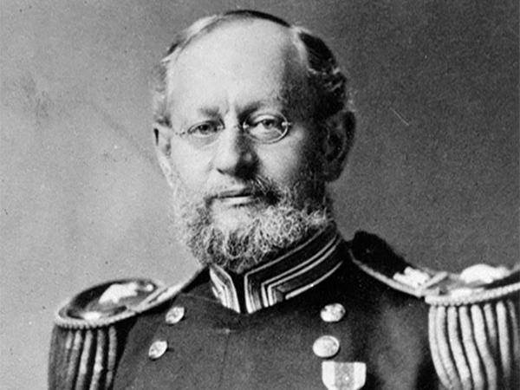
Col. Henry Marytn Robert
Colonel Henry Martyn Robert
Born - 1837 Died -1923
U.S. Army Engineer
Robert’s Rules of Order first published in 1876
Robert’s rules were first drafted when Col. Robert was asked to assist with a business meeting of his church

Slide 5
WHY FOLLOW ROBERT’S RULES?
Robert's Rules of Order is a tool used by representative bodies of all kinds to bring order to meetings and allow the group to take care of business in an efficient and predictable manner. Robert's Rules of Order and other kinds of parliamentary procedures are a proven way of conducting meetings.

Slide 6
WHY FOLLOW ROBERT’S RULES?
More simply the reason to use Robert’s Rules of Order is so that everyone know the rules before they play the game.

Slide 7
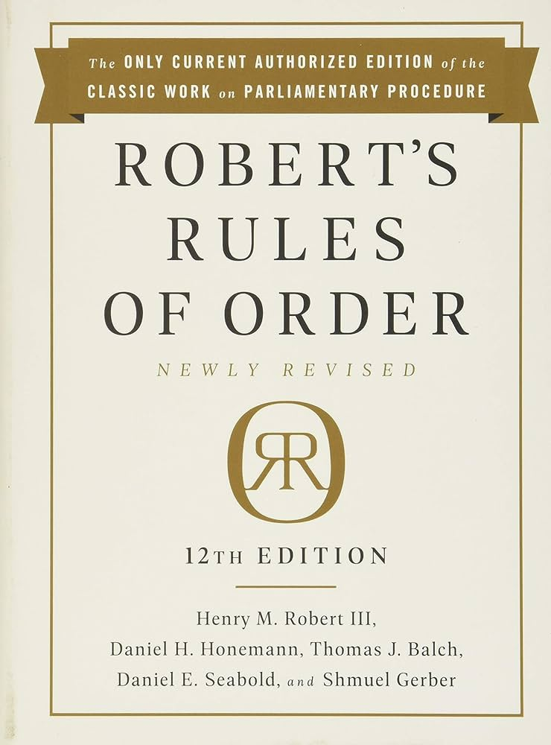
BASIC PROCEDURES FOR THE BOARD
How to Make Motion?
Does a Motion Need a Second?
How to Propose an Amendment?
Role of the Board President?

Slide 8
BASIC PROCEDURES FOR THE BOARD
How to Make Motion?
Be recognized by the Chair
State your motion
Gain a second to your motion
Explain the motion, after again being recognized by the Chair

Slide 9
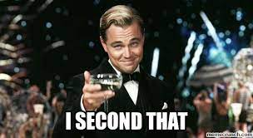
BASIC PROCEDURES FOR THE BOARD
Does a Motion Need a Second?
Yes. Every main motion or resolution must receive a Second before the Board agrees to hear the motion or resolution

Slide 10
BASIC PROCEDURES FOR THE BOARD
How to Propose an Amendment?
Be recognized by the Chair
Say “I move to amend the main motion by . . .”
Wait for a Second to your motion
Explain your amendment
The Board debates, if any is necessary, the amendment

Slide 11
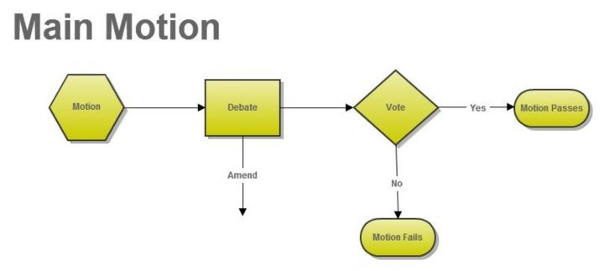
BASIC PROCEDURES FOR THE BOARD

Slide 12
BASIC PROCEDURES FOR THE BOARD
Role of the Board President (Chair)?
To introduce business in proper order per the agenda
To recognize speakers
To determine if a motion is in order
To keep discussion focused on the pending motion
To maintain order
To respect the rights of the majority to make decisions and the minority to be heard
To put motions to a vote and announce results

Slide 13
FREQUENTLY MISUNDERSTOOD ITEMS
There is NO such thing as a friendly amendment
Only two amendments can be considered at one time
The maker of the motion DOES NOT get to speak last
There is no such things as “old business”, only the items on the approved agenda should be considered
Abstentions are NOT counted as YES or NO, they are not counted at all

Slide 14
GROUP SCENARIOS
The Board has a properly motioned and seconded amendment before it for discussion.
One member of the Board proposes an amendment to the amendment.
Another Board member wishes to propose a “friendly amendment”. The Motion Maker of the original motion wants the Board to vote on their motion now.
How would you as the Board chair proceed?

Slide 15
QUESTIONS FROM YOUR EXPERIENCE
What questions, suggestions or insights do you have to share with the group?

Slide 16
WE APPRECIATE YOU!
CASB Resources
Leadership Workbook
Board Member Handbook
Podcasts
Webinars

Slide 17
WE APPRECIATE YOU!
CASB Resources
Legal Information
Policy Questions
Board Training
info@casb.org or 303-832-1000

Slide 18
WE APPRECIATE YOU!
Matt Cook
mcook@casb.org
mobile - 720-838-8279
X(formerly Twitter) @casbmattcook

